Slide 1
Network Attached Storage
NAS
My Application- CLFCloud
Storage, Backup, Access, Share

Slide 2
NAS for Photographers
All Photos in one place
Access all photos from anywhere
All exported Photos in one place which could be shared
Complete Back up Possibilities

Slide 3
Backup and Protections
Two HDs in Raid configuration
  – Protection for Hardware failures
  Synology Hybrid RAID ( SHR) with Data protection
Daily Backup at 3 AM to a USB Drive
Monthly Manual backup to a separate USB drive
  - To keep in a different place
Snapshot replication every two hours
–Protection against Ransomware

Slide 4
My Motivations
Same workflow at home or when travelling
Immediate automatic backup of Imported images at home or when travelling.
Access to image archive at home or when travelling
  Even if you have low capacity HW you have access to TB of data
Sharing exported Images
Sharing selected exported images in a public web space

Slide 5
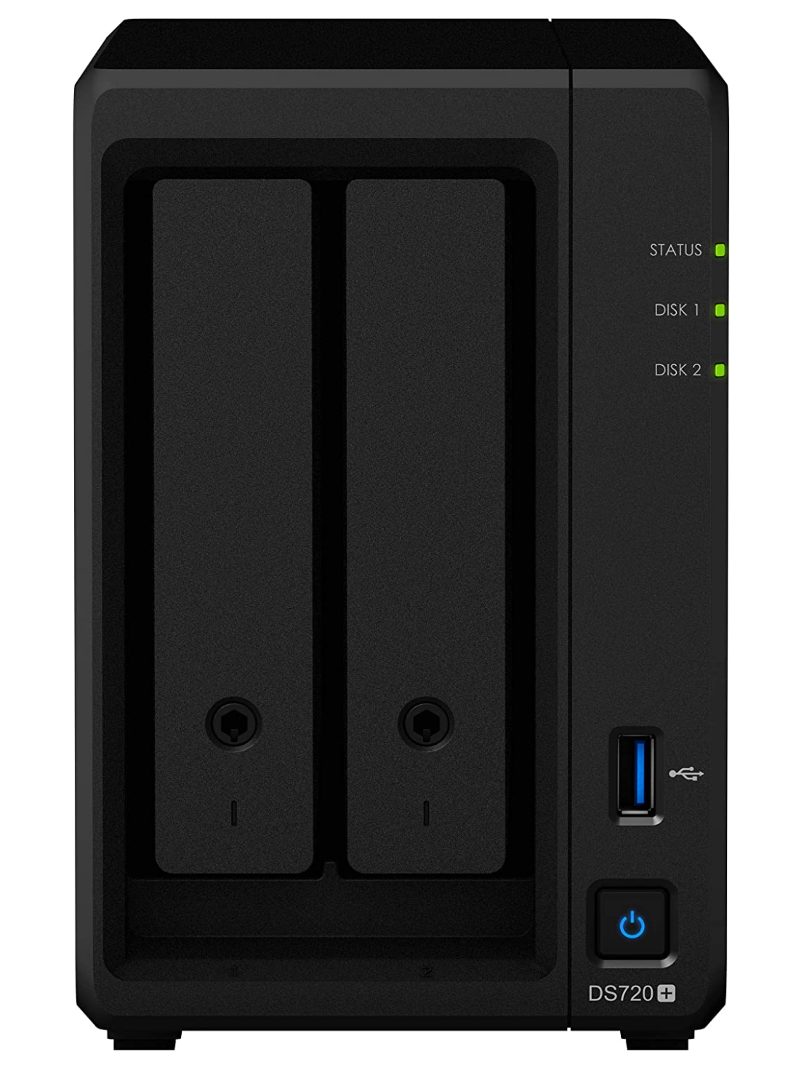
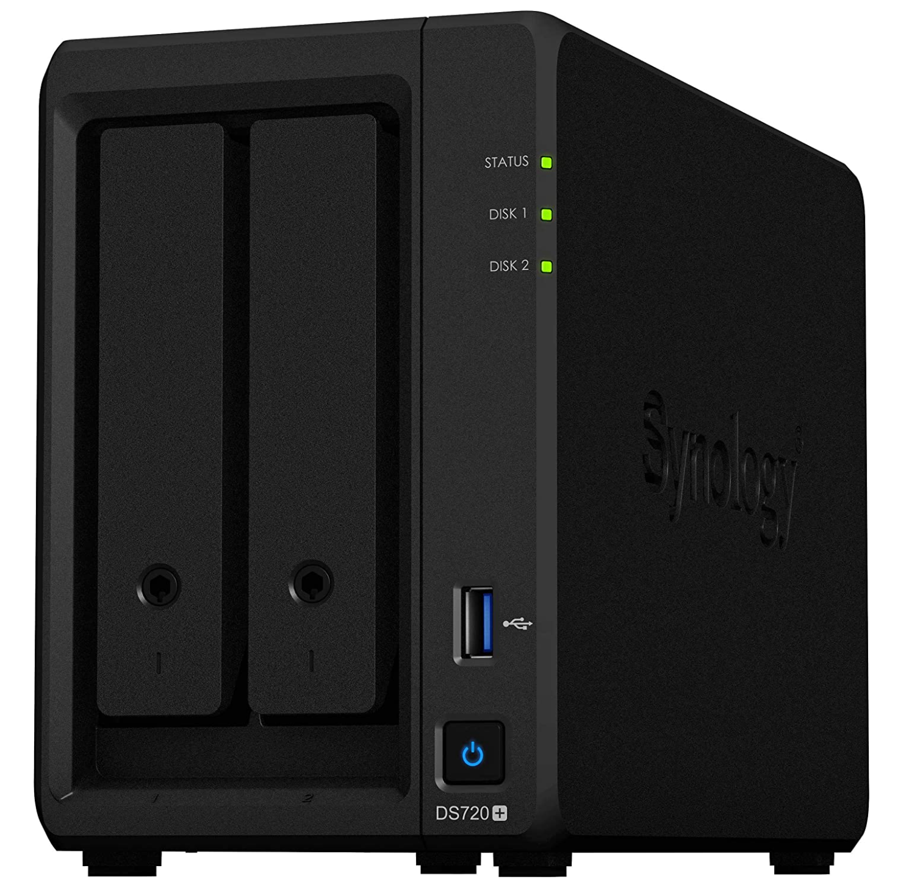
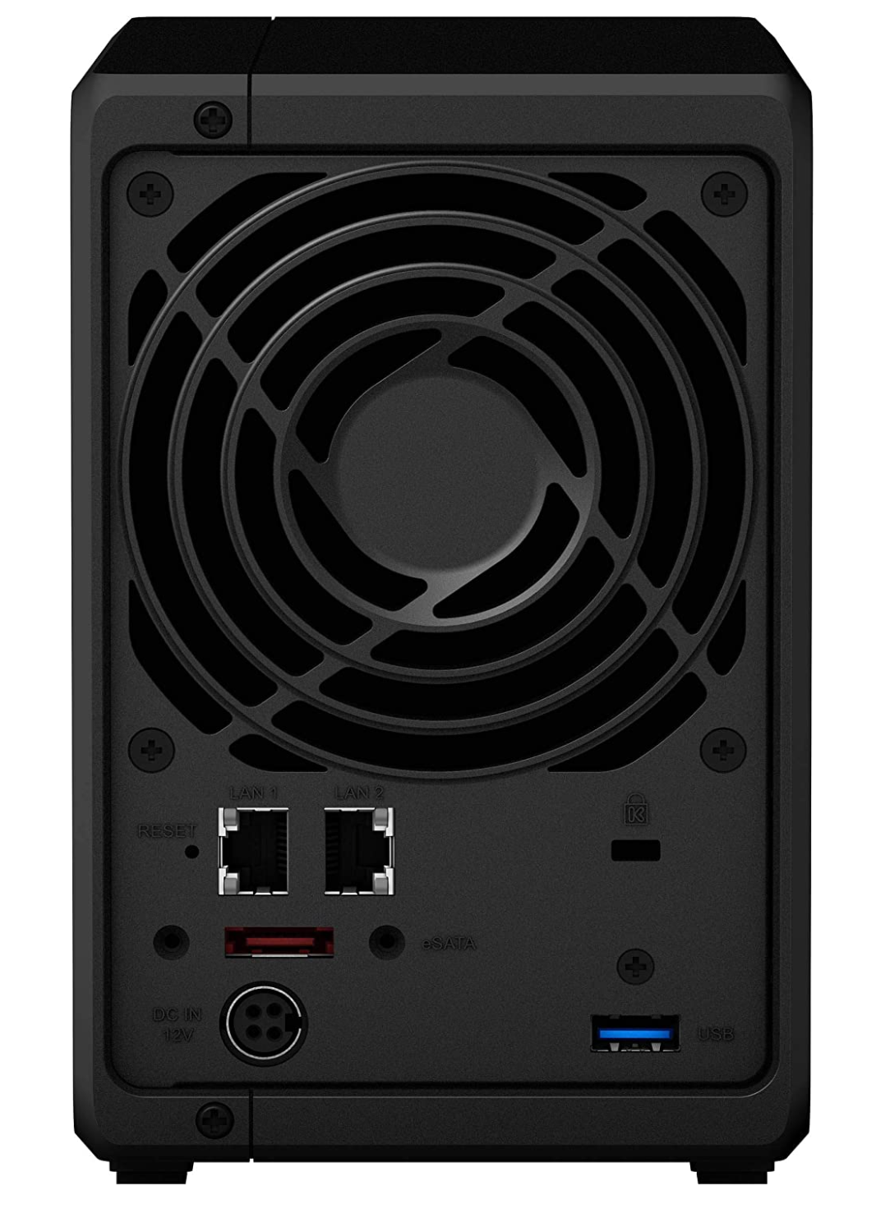
Synology 720+

Slide 6
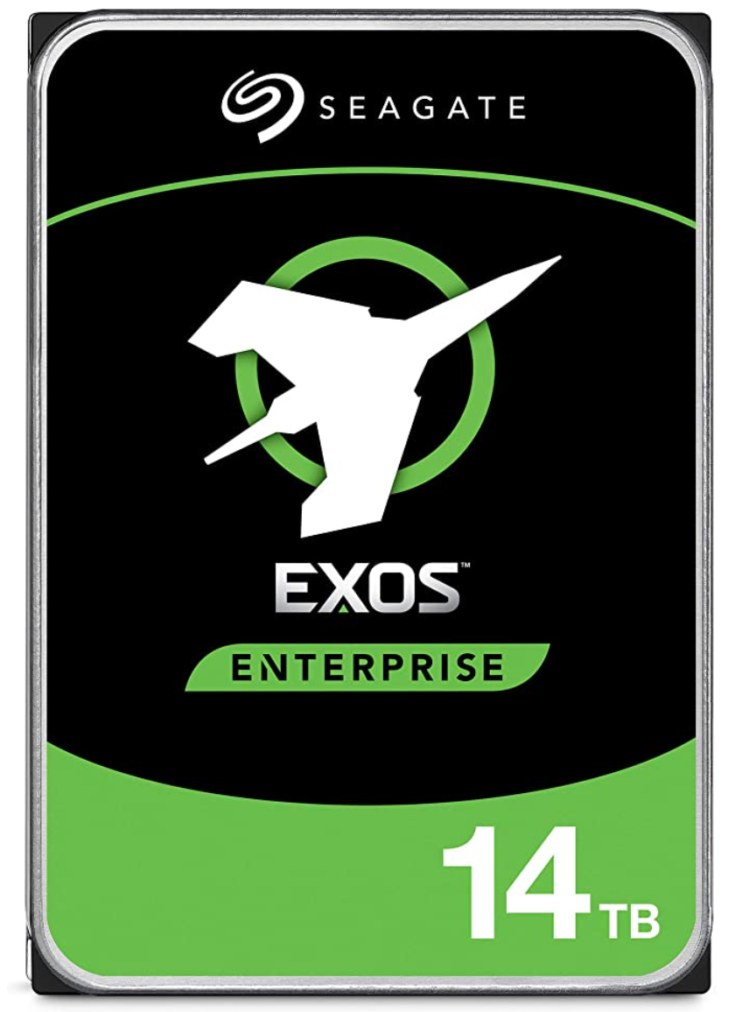
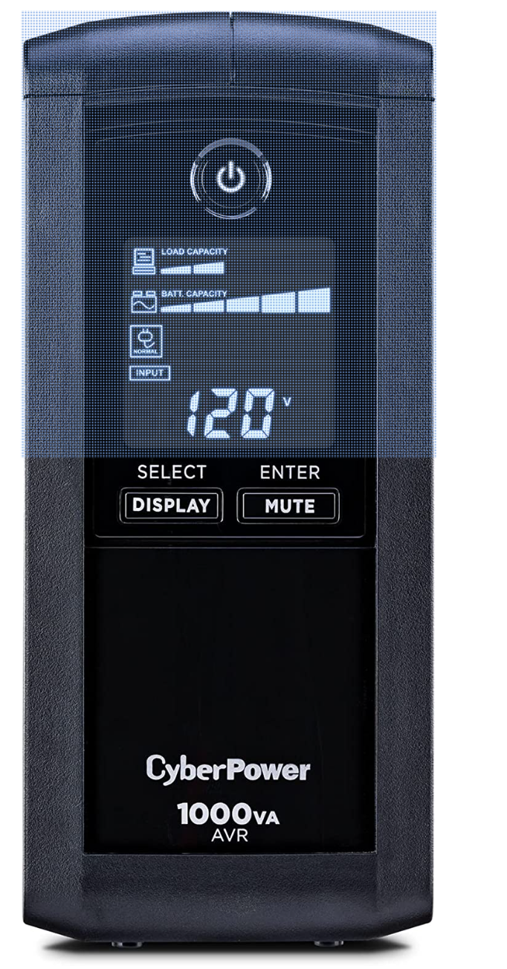
Other HW
Seagate Exos X16 14TB 7200 RPM SATA 6Gb/s 256MB Cache 3.5-Inch Internal Data Center HDD Enterprise Hard Drive (ST14000NM001G)
CyberPower CP1000AVRLCD Intelligent LCD UPS System, 1000VA/600W, 9 Outlets, AVR, Mini-Tower, Black

Slide 7





My HW Setup
Home network
4 port WIFI Router
ATT GB plan
Synology 720+
LapTop
Dell XPS15
C Drive 1TB NVMeSSD
External USB HD
DeskTop
Windows 11
Home built
C Drive 1TB NVMeSSD
D Drive 1TB NVMeSSD

Slide 8
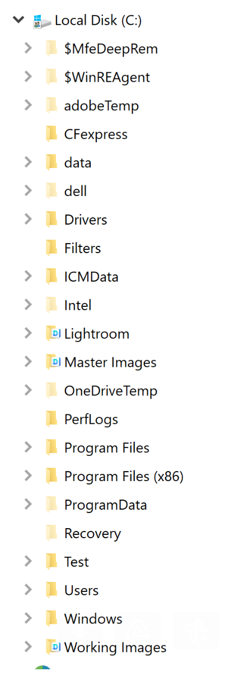
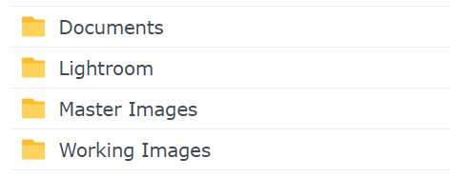
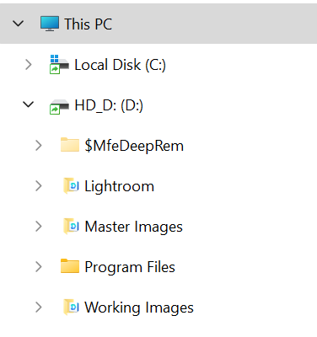
My HW Setup
Home network
4 port WIFI Router
ATT GB plan
Synology 720+
LapTop
Dell XPS15
C Drive 1TB NVMeSSD
External USB HD
DeskTop
Windows 11
Home built
C Drive 1TB NVMeSSD
D Drive 1TB NVMeSSD

Slide 9
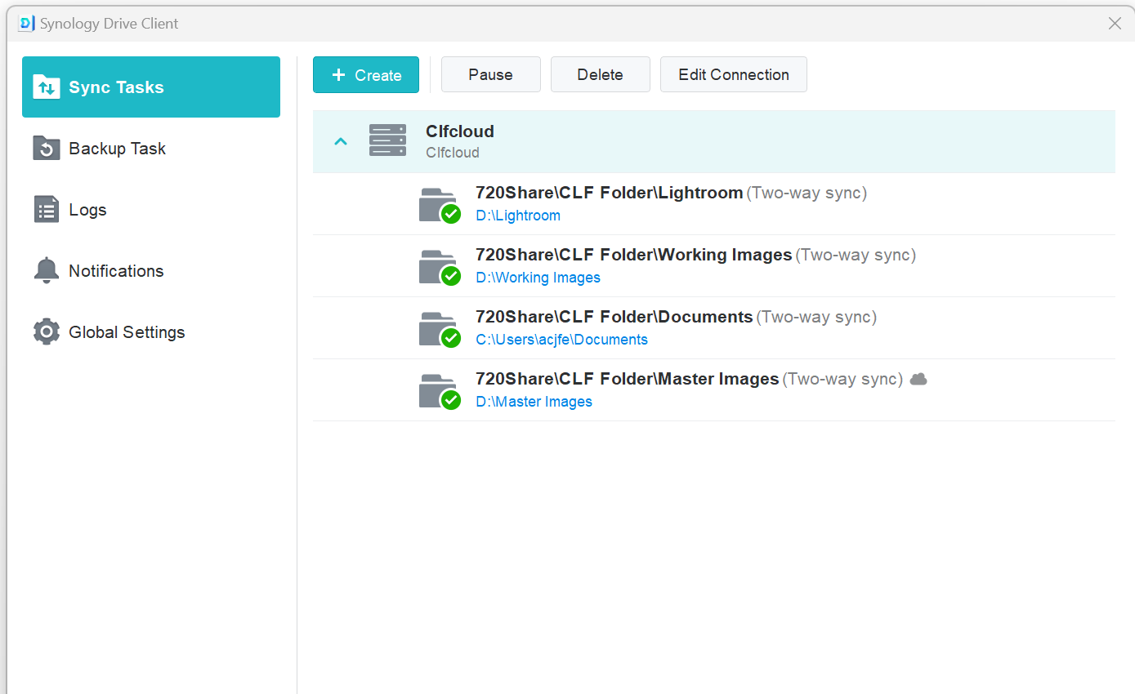
Desktop

Slide 10
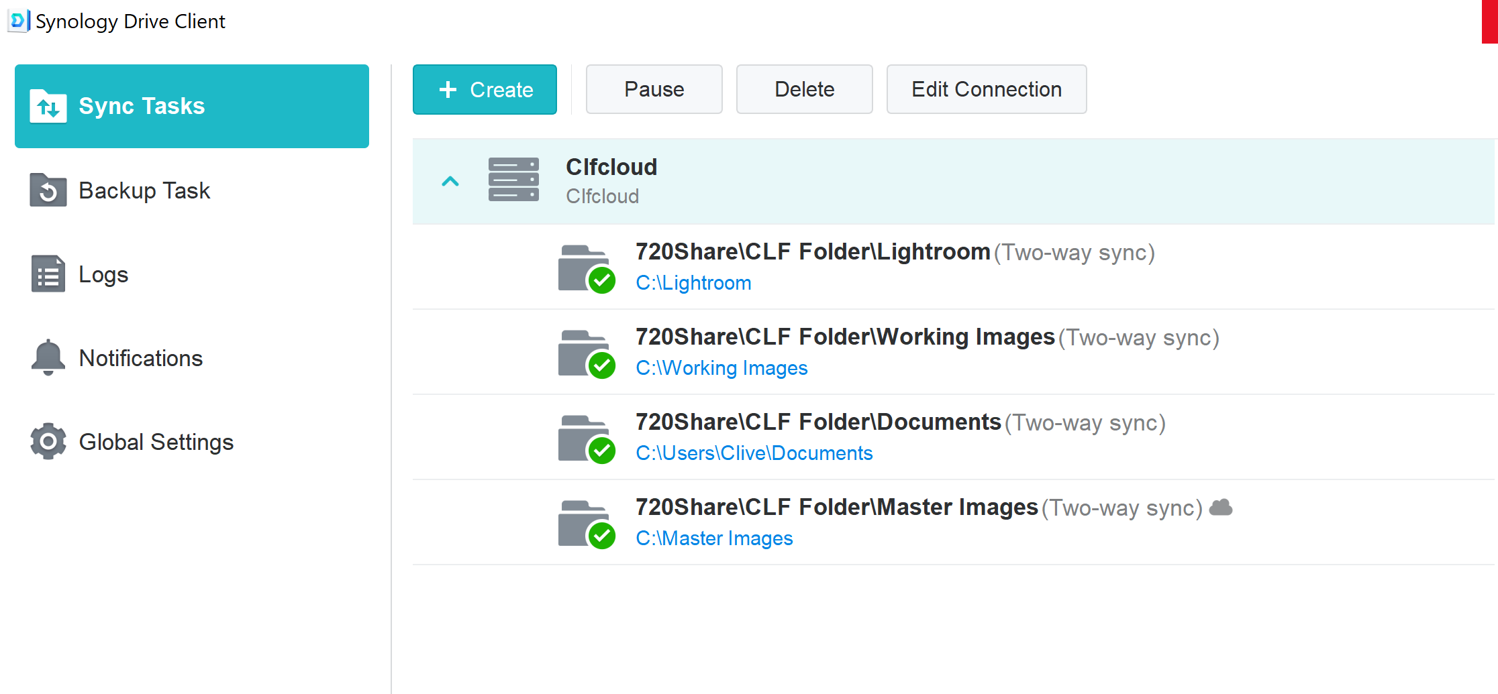
Laptop

Slide 11
Synology Photo
Can share any folder or single image
My Public site: https://clfddns.synology.me:5443

