Slide 1
Ghost Ranch Planning Guide – Part 2
Dennis Fritsche
July 20, 2023
All Photographs (except where noted) are Copyright Dennis

Slide 2
Exploring around Ghost Ranch

Slide 3
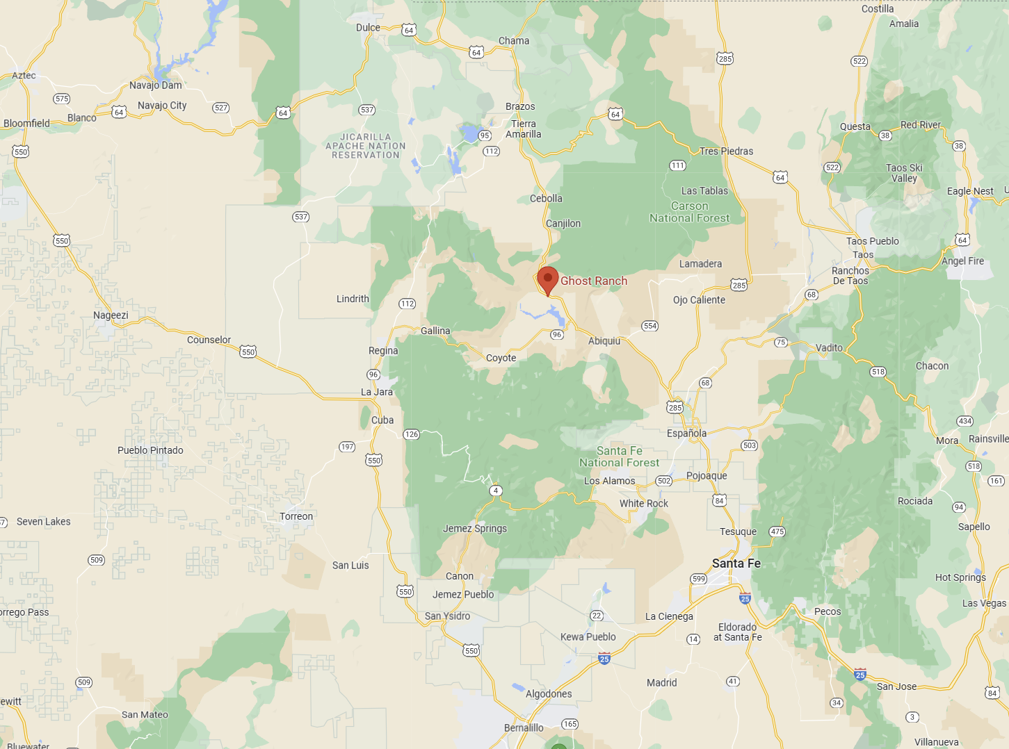
Ghost Ranch is a Destination and a Starting Place to Explore
W – White Place (Plaza Blanco)
H – Hernandez (Think Ansel Adams)
B – Black Place

Slide 4
Tuesday, September 26
9:30 AM O'Keeffe Landscape Tour LINK
10:56 AM Echo Amphitheater
2:20 PM O'Keeffe Abiquiu Home and Studio Tour LINK
4:00 PM Chimney Rock Trail
Wednesday, September 27
8:45 AM Plaza Blanca
11:40 AM Rito - Photos and Lunch?
2:20 PM Tres Piedras - Aspen Hunt via 111
4:47 PM Ghost Ranch - Aspen Hunt via 64 Or Box Canyon at Ghost Ranch

Slide 5
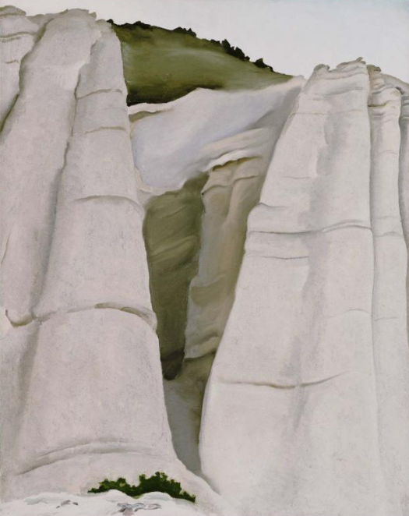
Plaza Blanca – O’Keeffe’s The White Place

Slide 6
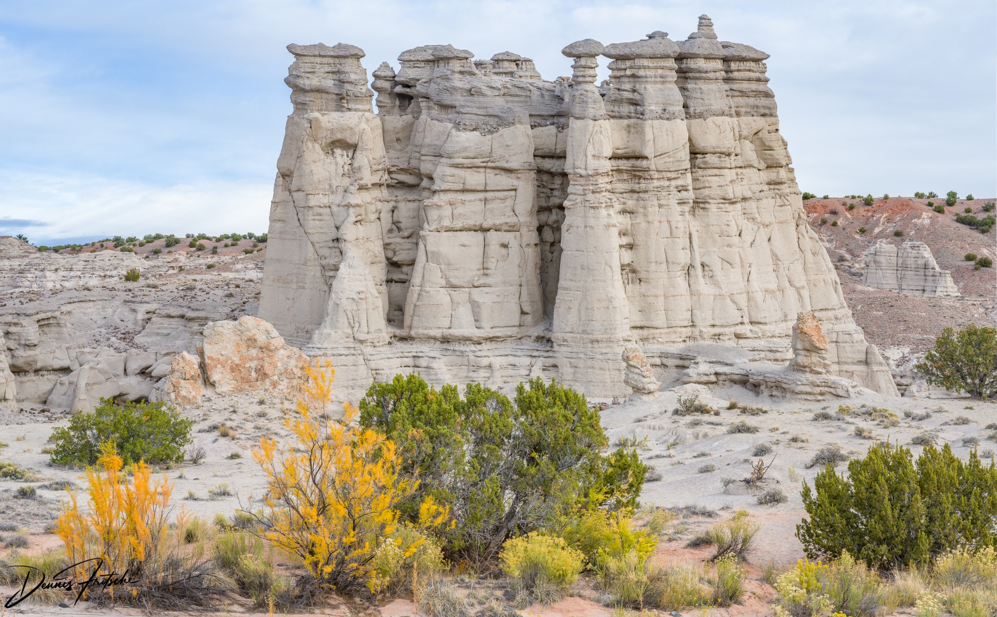
Plaza Blanca – Fritsche’s Photographs

Slide 7
About Plaza Blanca
Plaza Blanca is a region of volcanic ash tufas.
It is owned by Dar al Islam.
Until the last few years, it was open to the public.
Due to misuse of the property and disrespect for the fragile environment, Dar al Islam now allows access only with express permission.
You may contact them for permission at plazablanca@daralislam.org
When I did this the rules provided say I would not have copy right to my images.

Slide 8
About Plaza Blanca
If you are interested in visiting on your own without this clause, I can provide you the “Use of Images Agreement” and the gate code.
In return for permission to enter the area, each photographer will be required to sign a “Use of Images Agreement” wherein you agree that the images are for non-commercial use and that if you want to use an image for a commercial purpose, you will contact Dar al Islam for express permission.
Please read and understand the document.
I will give the gate code to each driver, and I will provide Dar al Islam with your name and contact information.

Slide 9
The Rules
No climbing on the fragile rock formations
You must sign the “Use of Images Agreement”
No professional photos or art (ie not for commercial use without express approval from Dar al Islam)
Do not share the gate code with outsiders and only share with club members with my approval.
No drone photography
Keep the area clean.
Keep groups small (6 people or less) and maintain social distancing as appropriate.
Follow the existing trails
18 yrs. old or older.
No vehicles or bicycles past the parking lot
No camping or fires
Note there a decline from the parking lot.

Slide 10
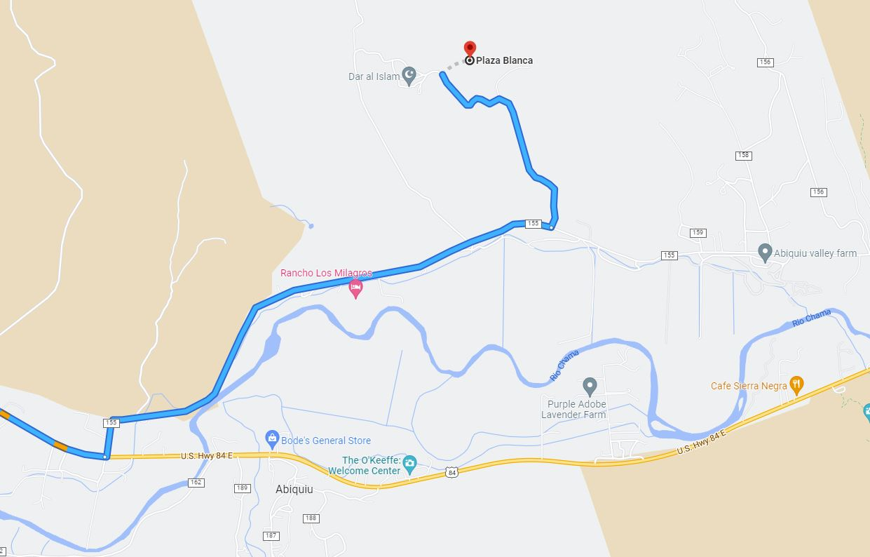
From the Southwest

Slide 11
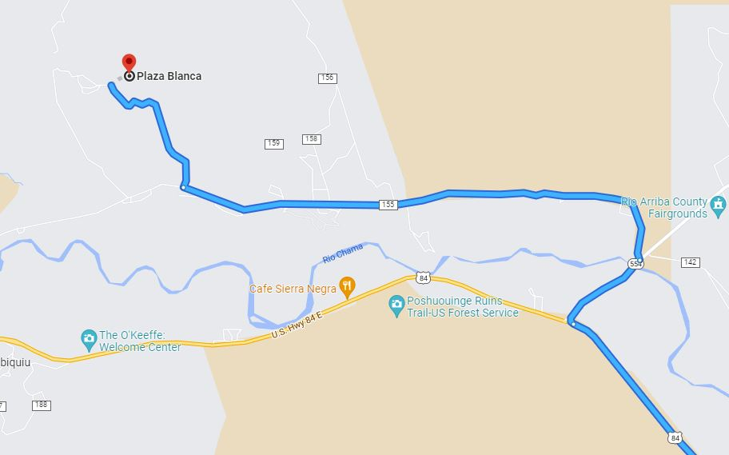
From the Northeast

Slide 12
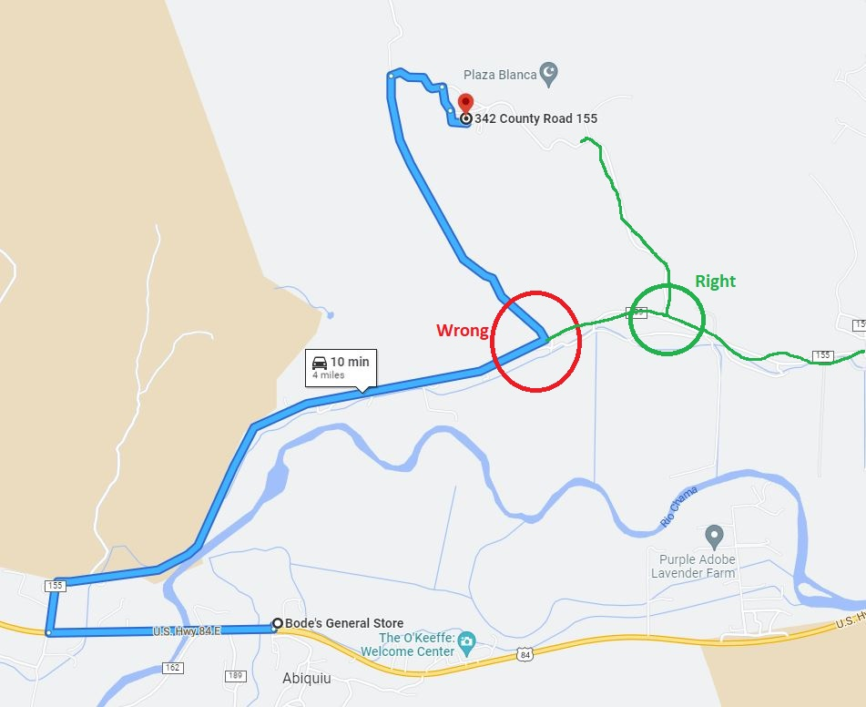
Wrong

Slide 13
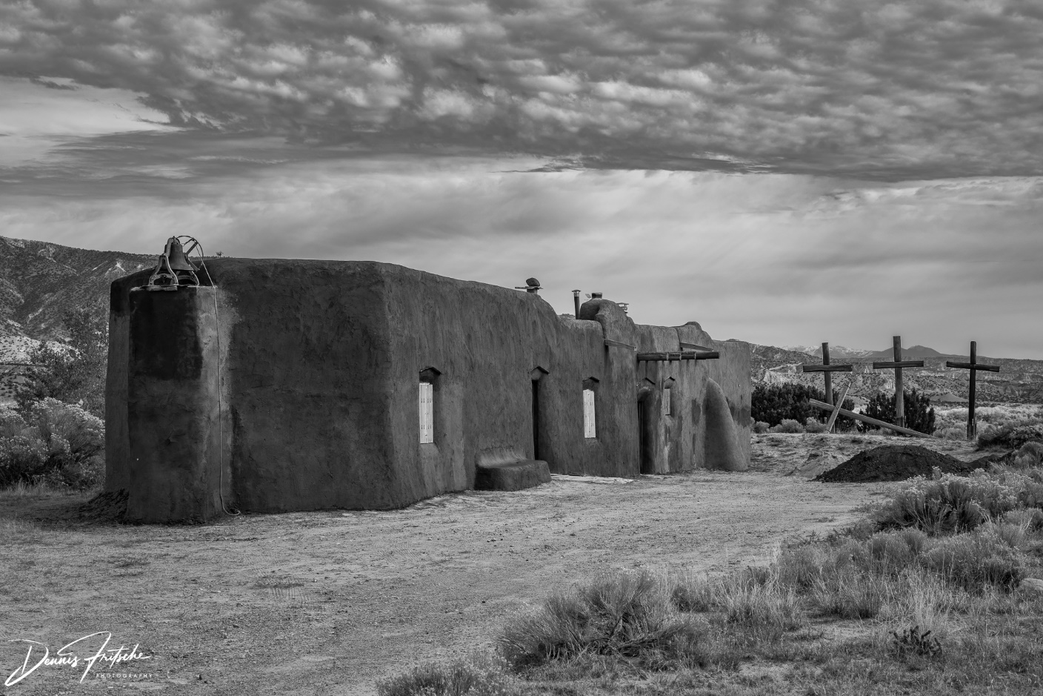
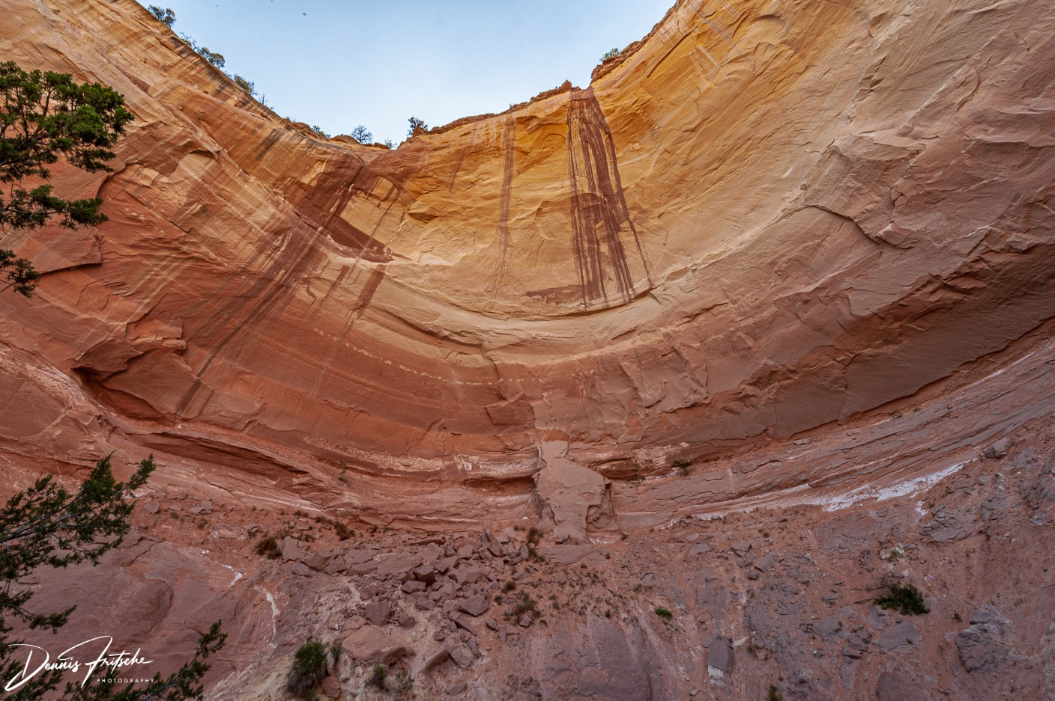
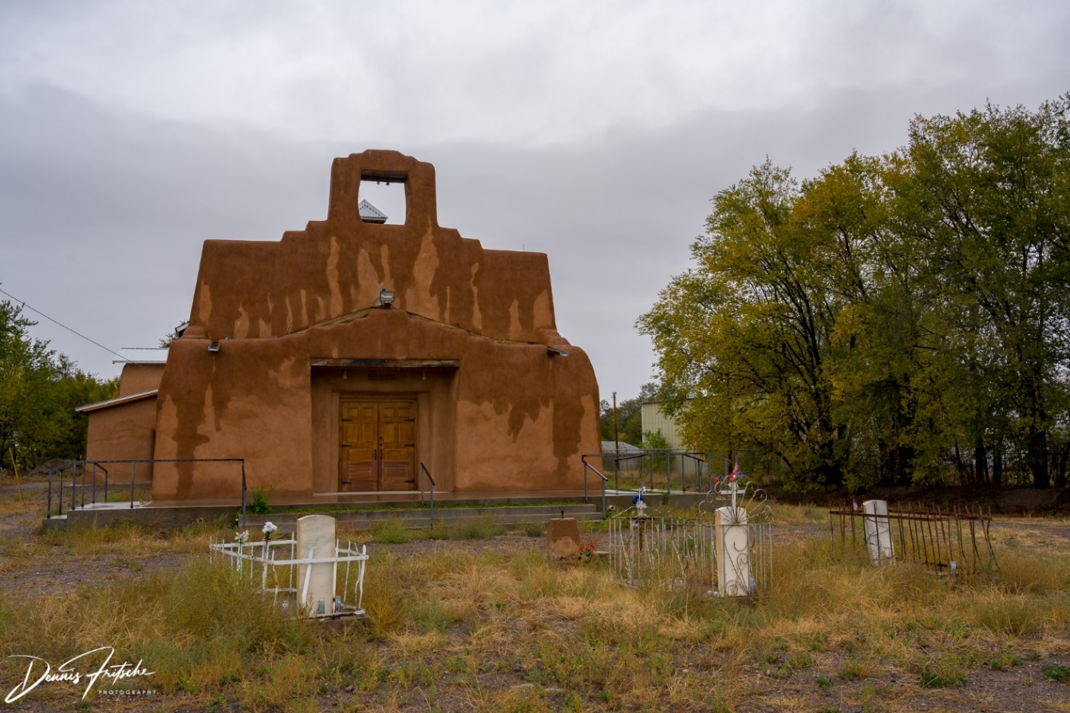
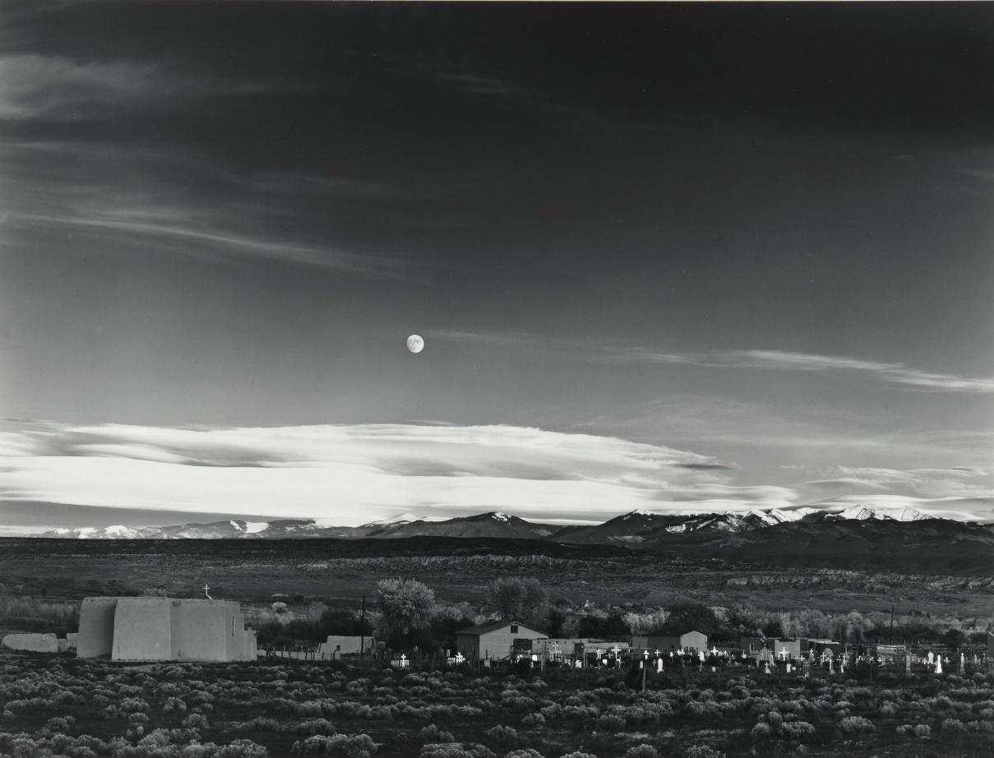
Abiquiu
Echo Amphitheater
Hernandez – Ansel Adams Moonrise over Hernandez

Slide 14
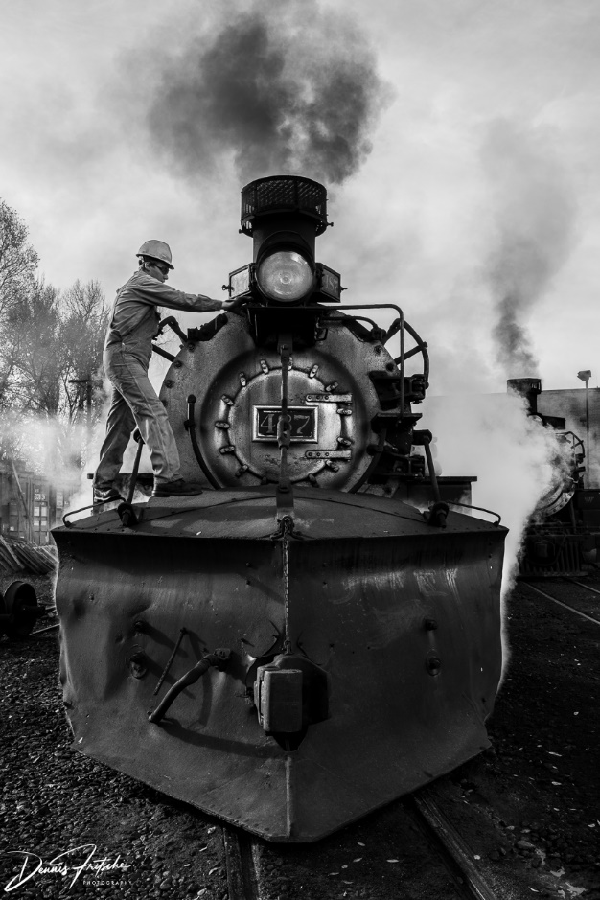
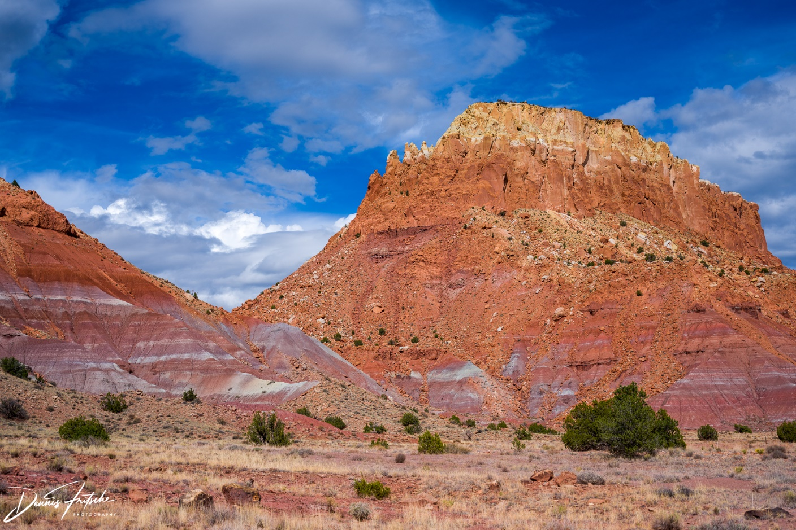
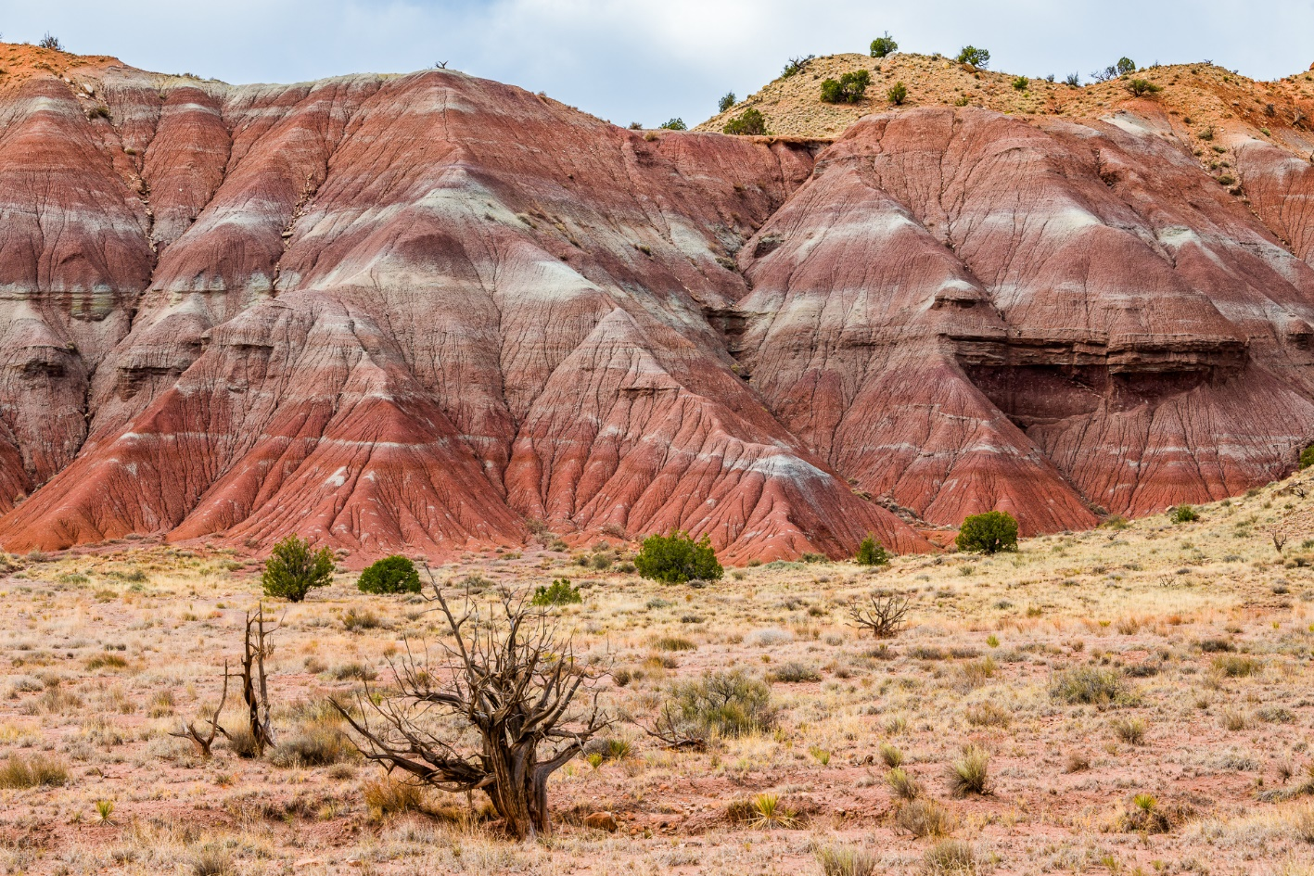
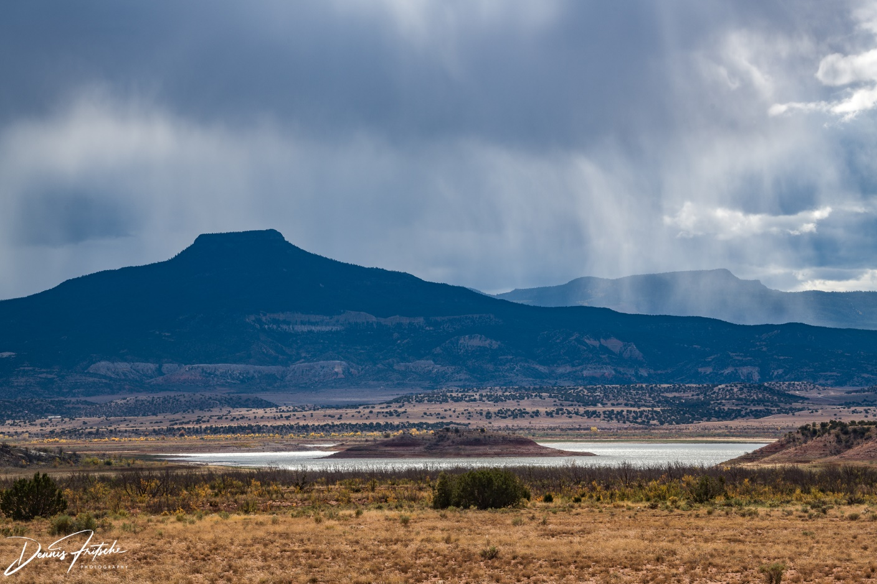
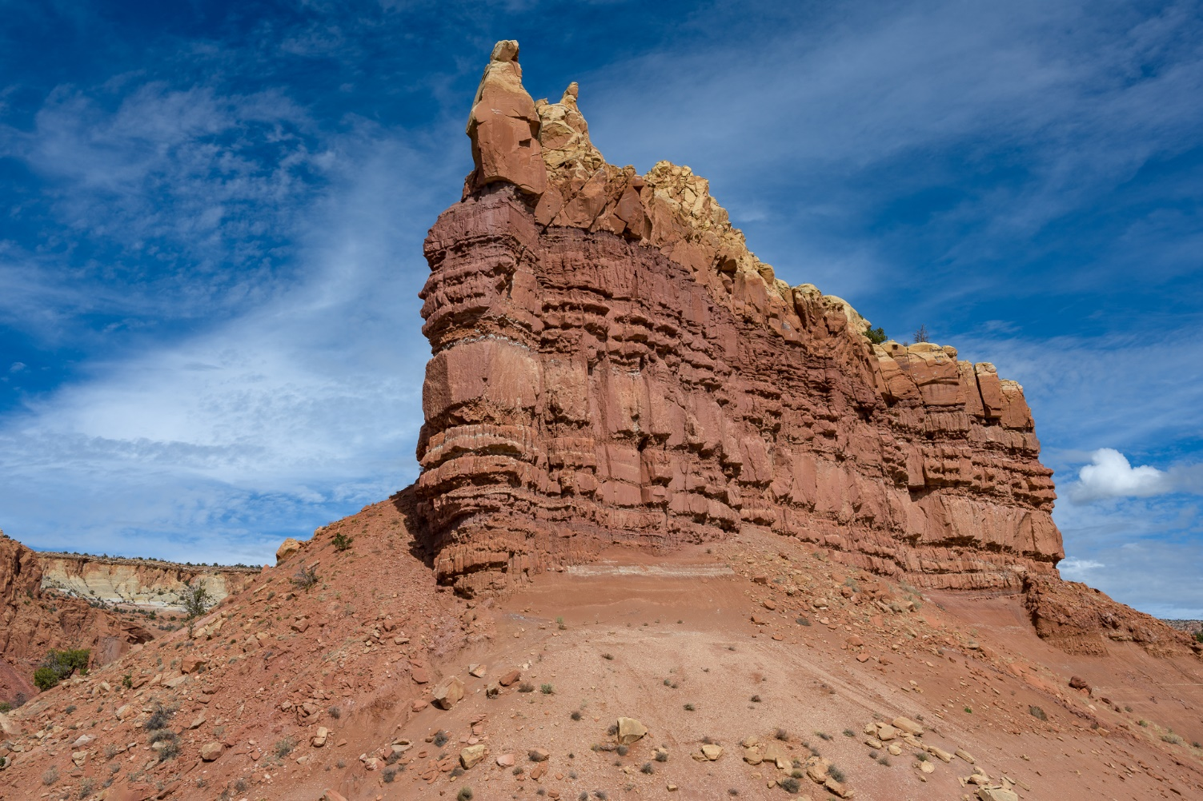
Train at Chama
Roadside Viewpoint on 84 South of Ghost Ranch
Pedernal

Slide 15
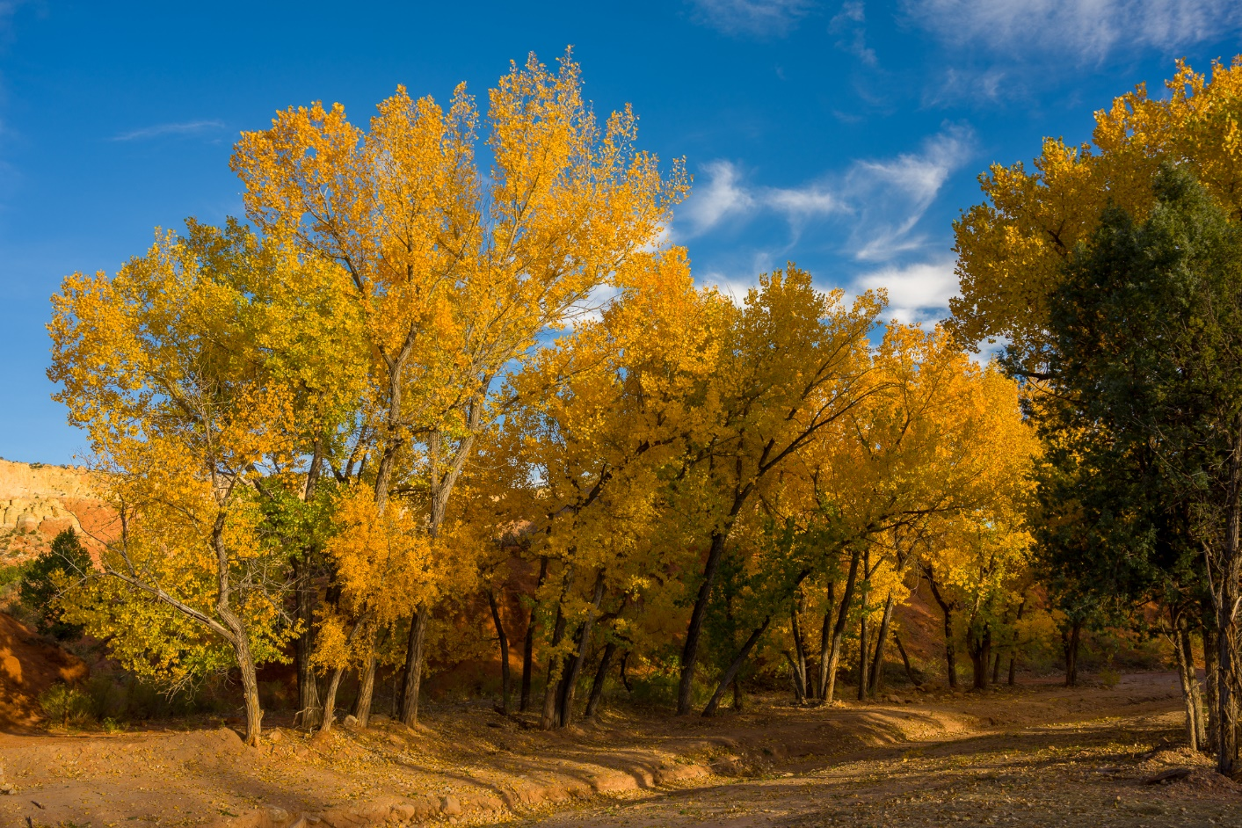
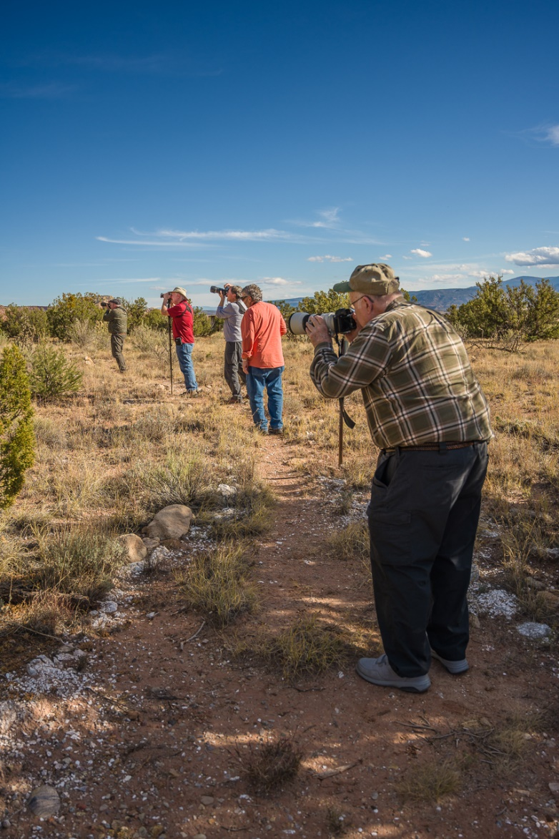
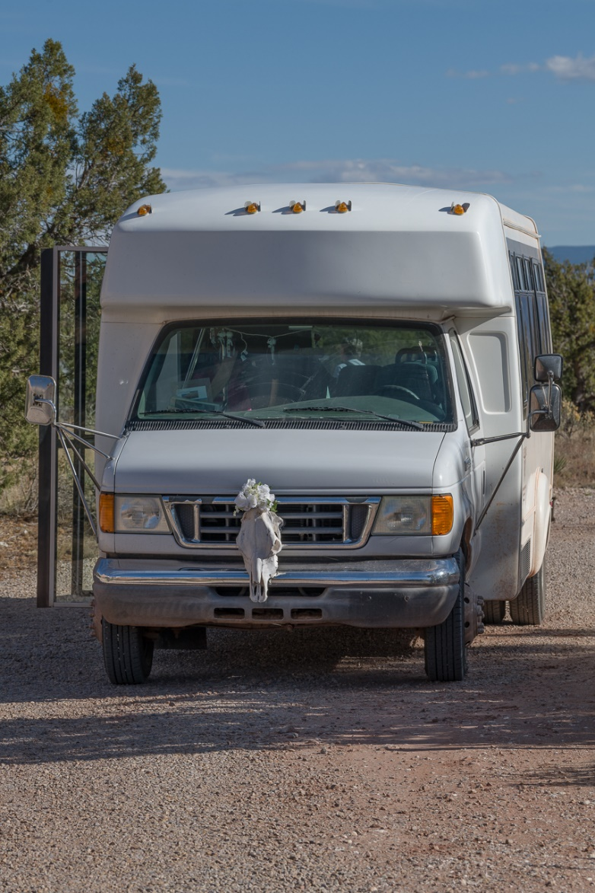
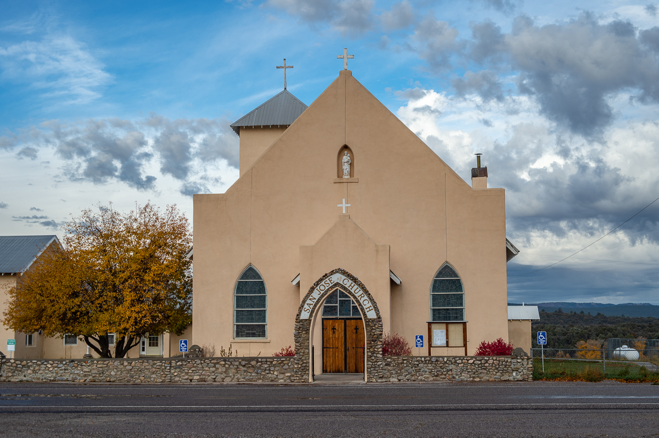
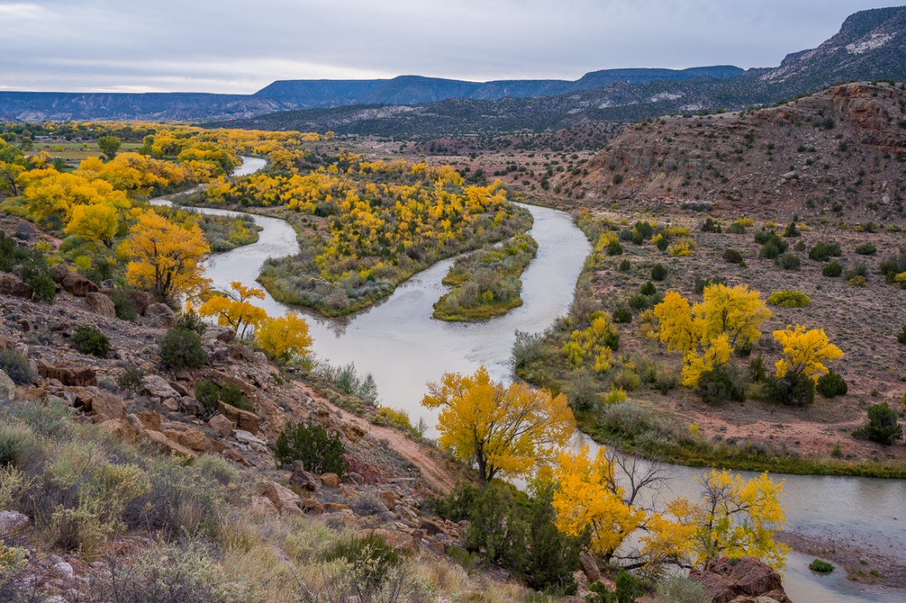
O’Keeffe Landscape Tour
Church at Los Ojos
Chama River Overlook

Slide 16
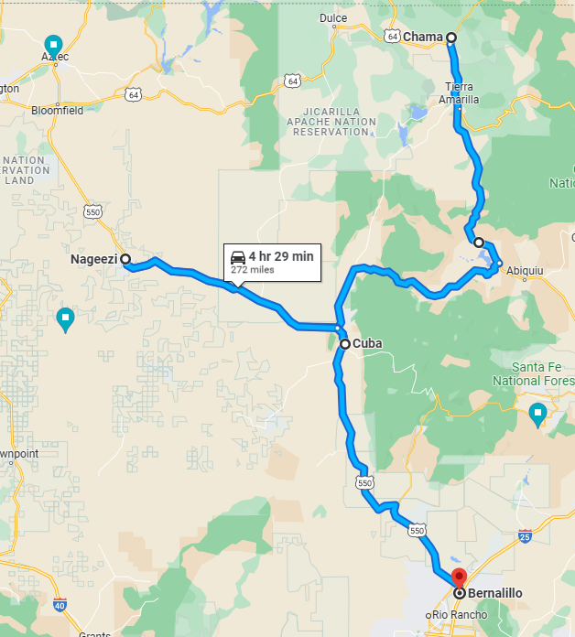
Ghost Ranch – Our Route Return
Day 1 Return– Bernalillo
- Chama Train Yard
- Black Place - Mesa Chijuilla
Day 2/3 Return
- Ojita Wilderness
- Start Journey home
Chaco Canyon Cultural Site
Is fascinating.
(20 miles of washboard road.)

Slide 17
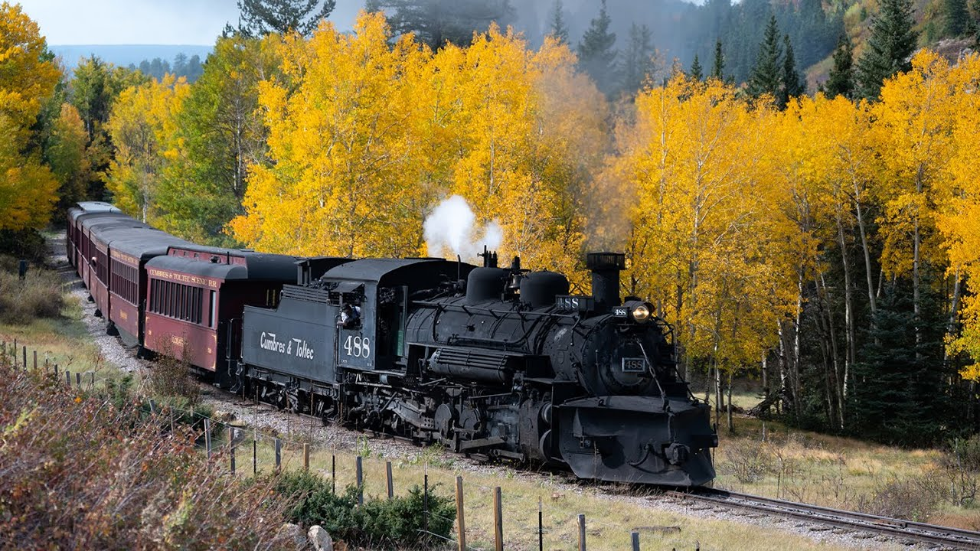
Cumbres & Toltec Scenic Railroad
September 28, 2023
bit.ly/ghostranch

Slide 18
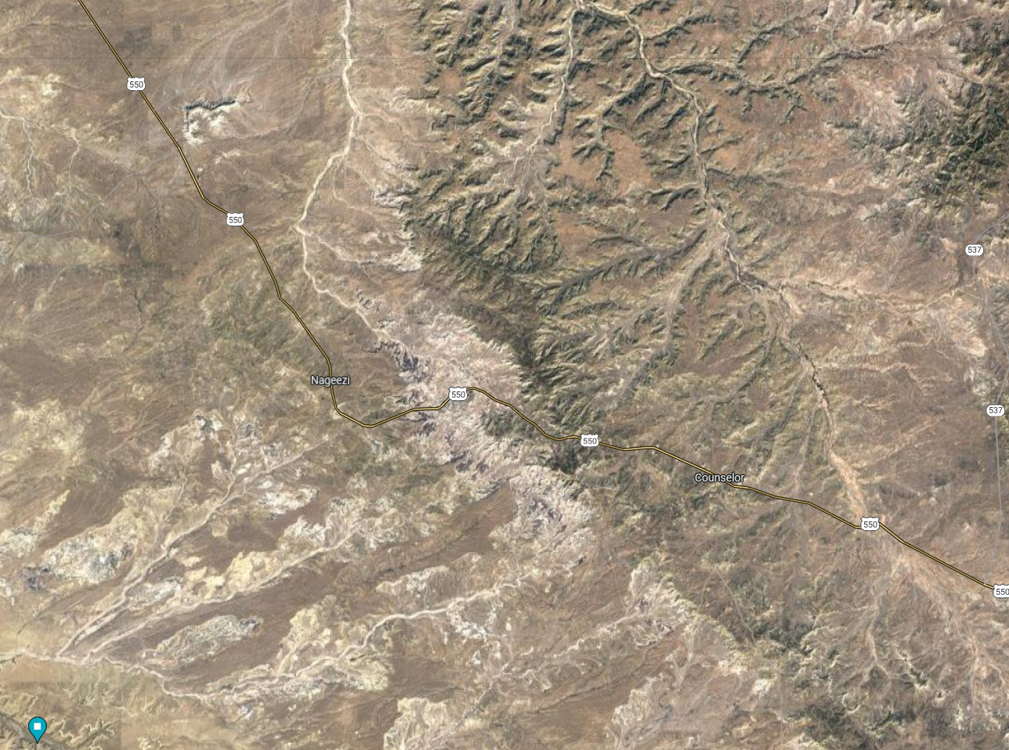
Black Place Location

Slide 19
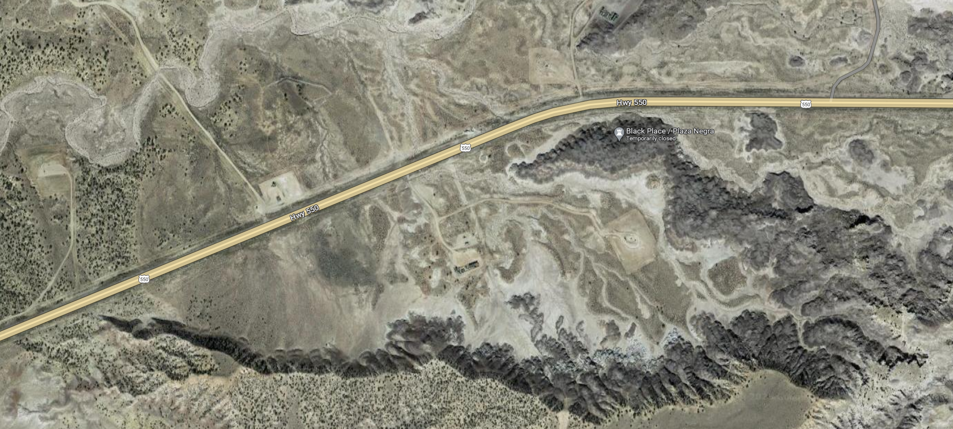
Black Place Location

Slide 20
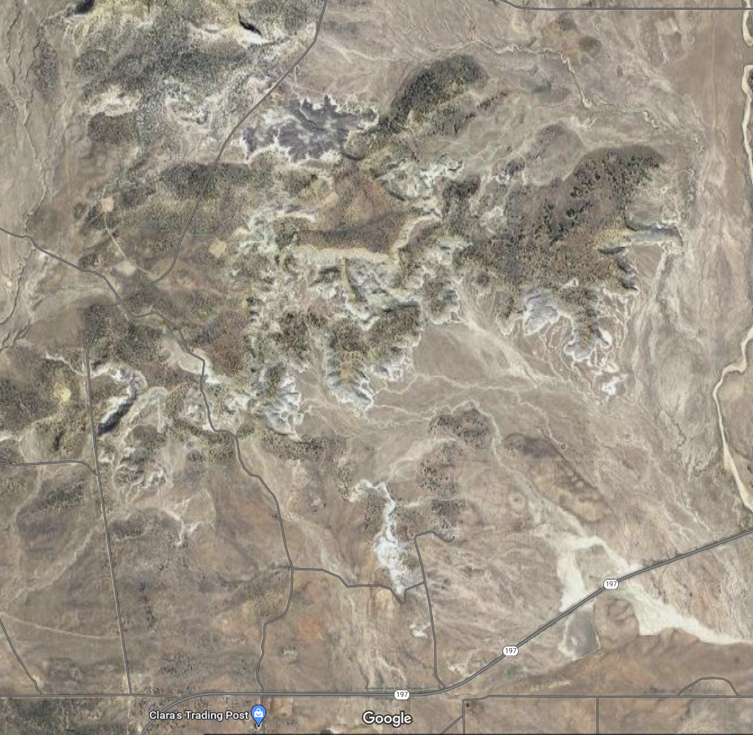
Mesa Chijuilla Location
From Cuba, NM

Slide 21
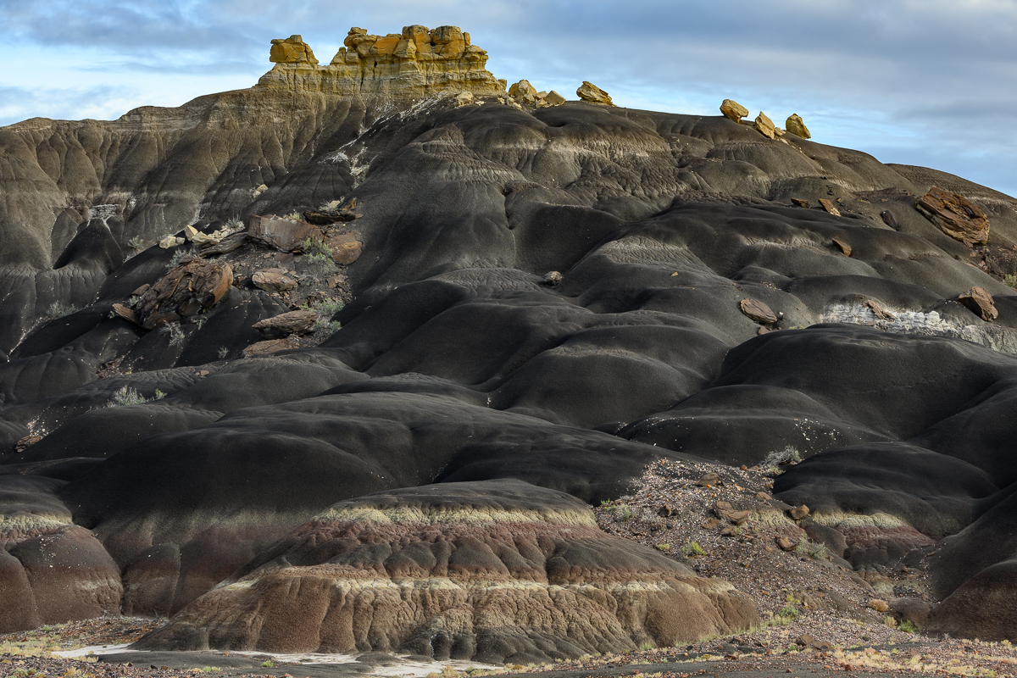
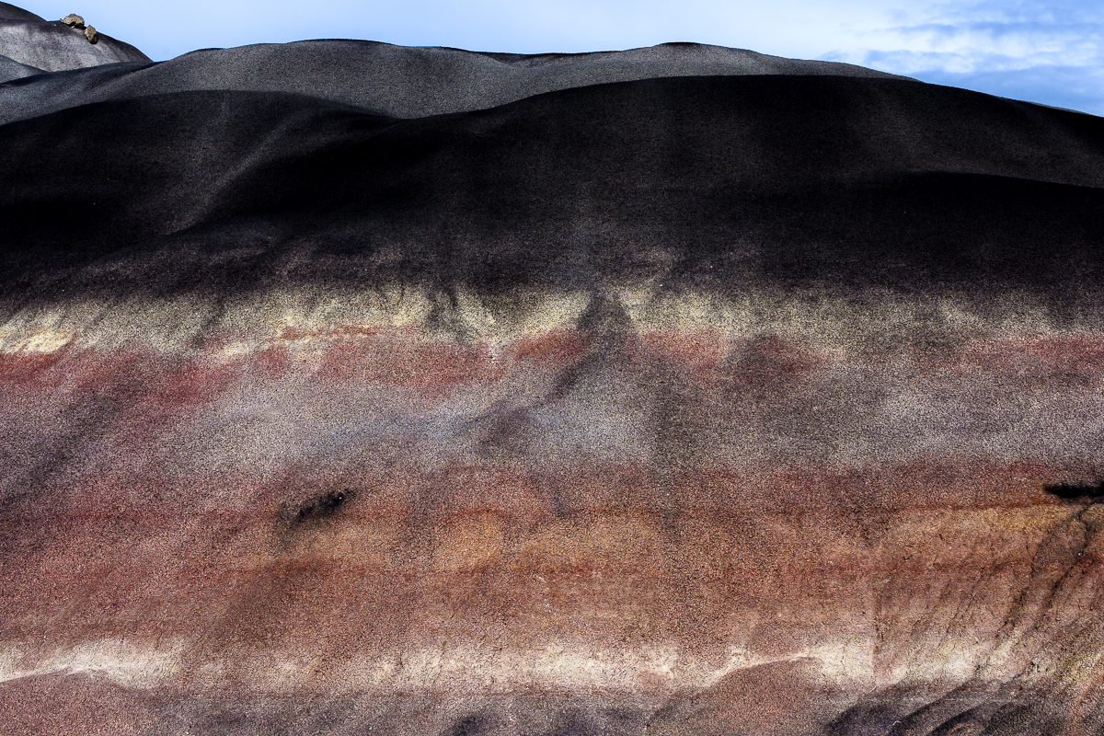
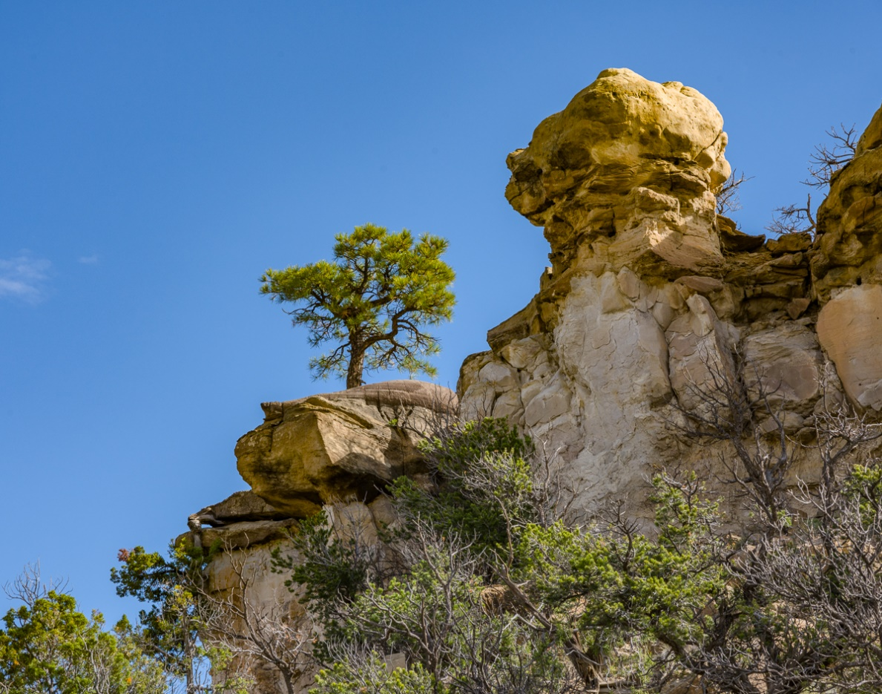
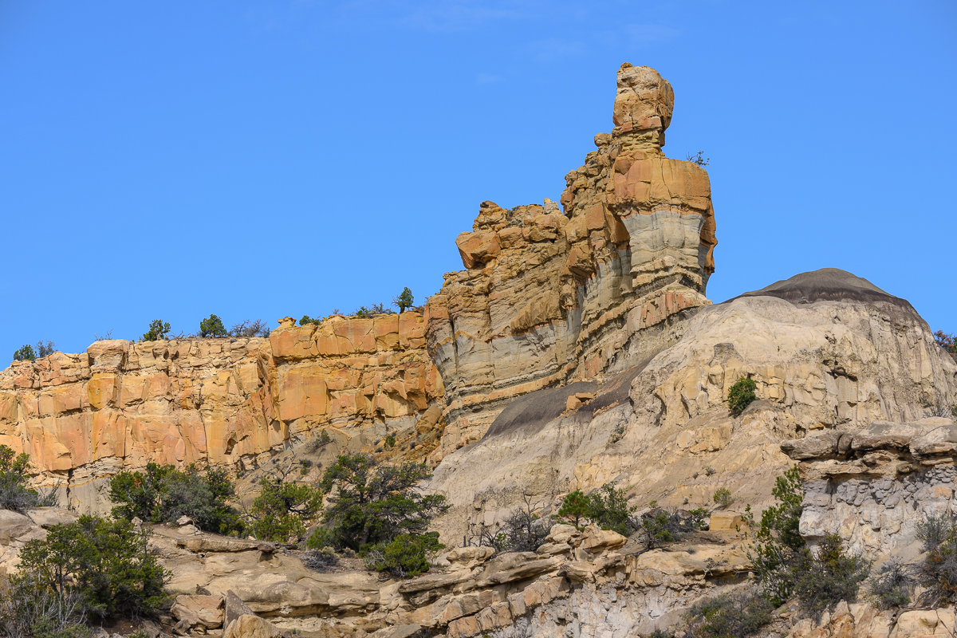
Black Place
Black Place
Mesa Chijuilla
Mesa Chijuilla

Slide 22
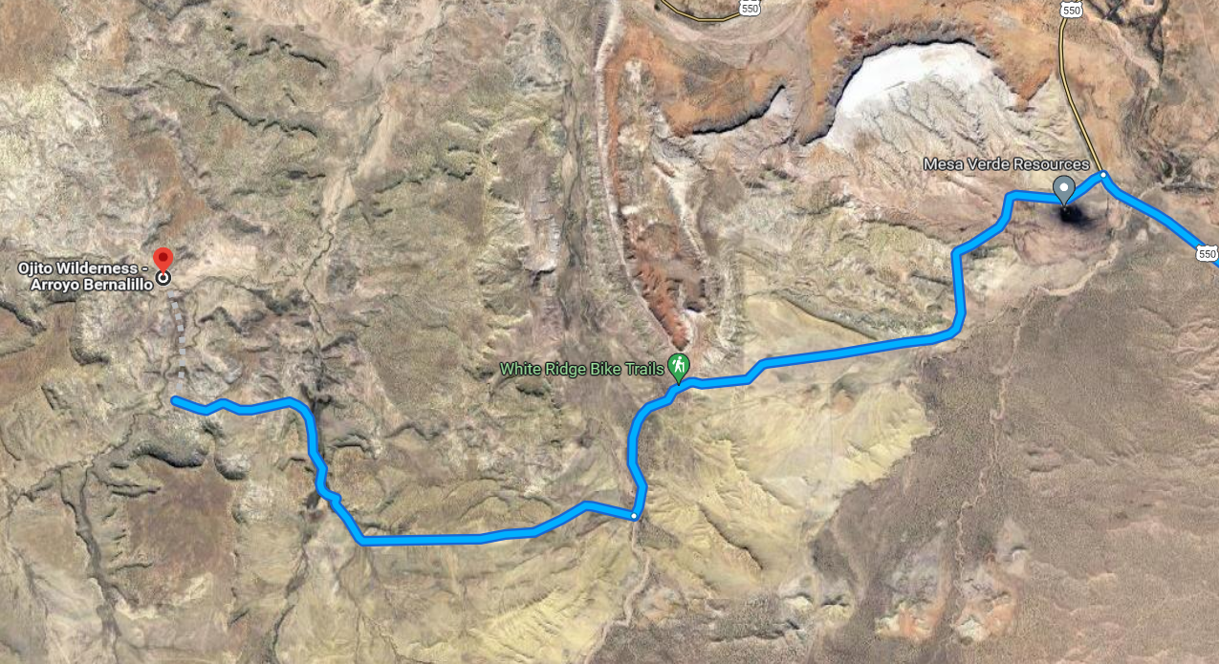
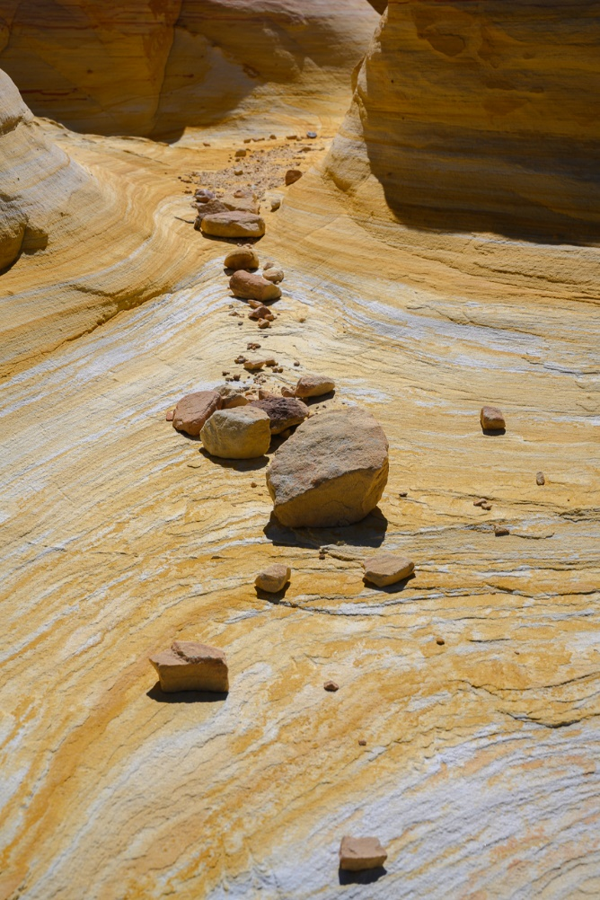
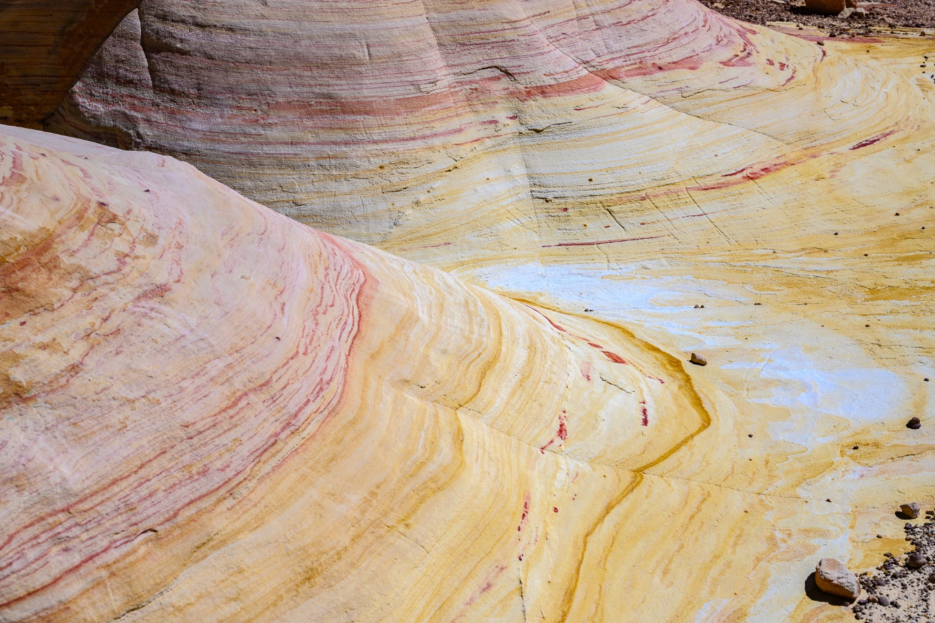
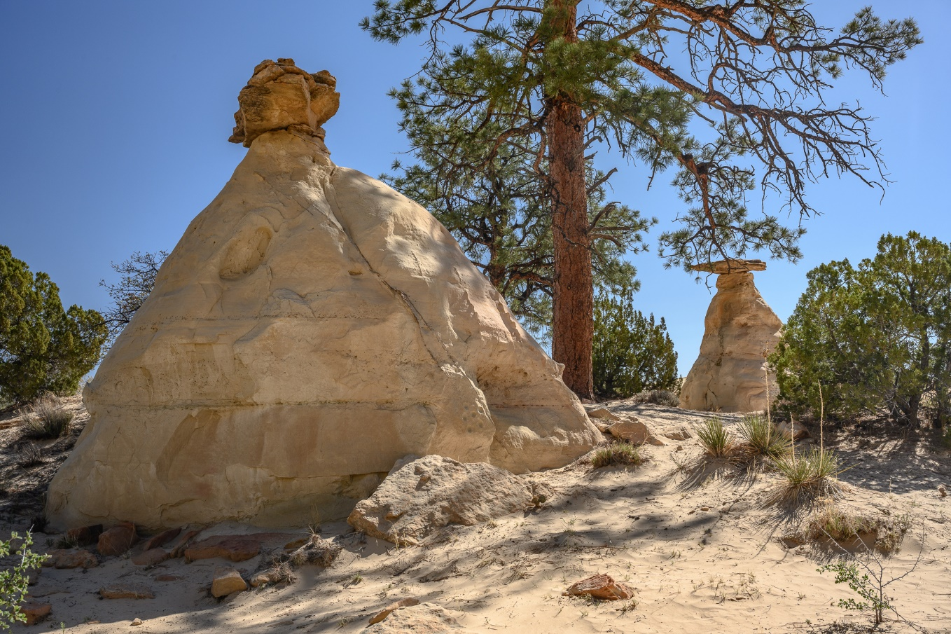
Ojito Wilderness - Arroyo Bernalillo
From Bernalillo

Slide 23
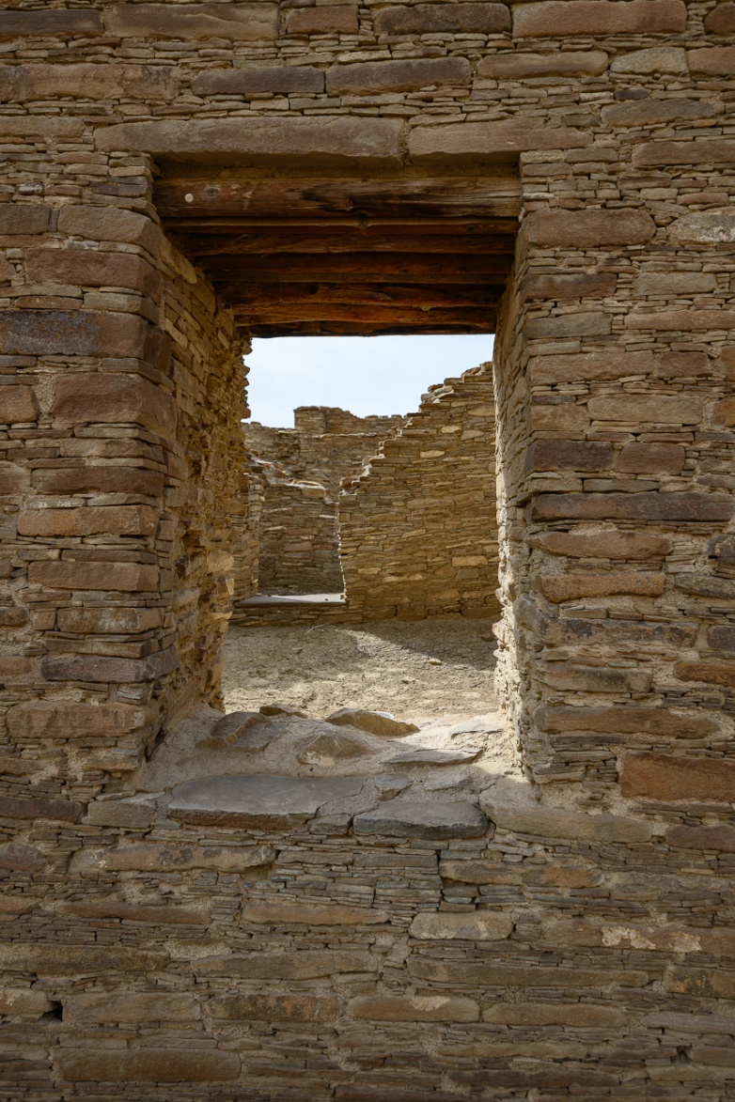
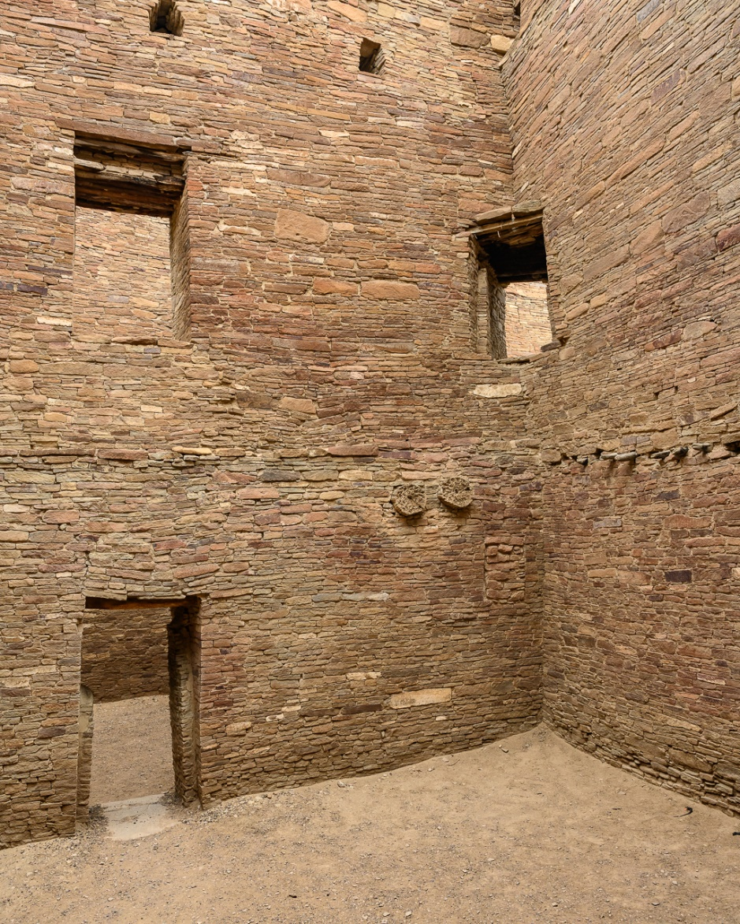
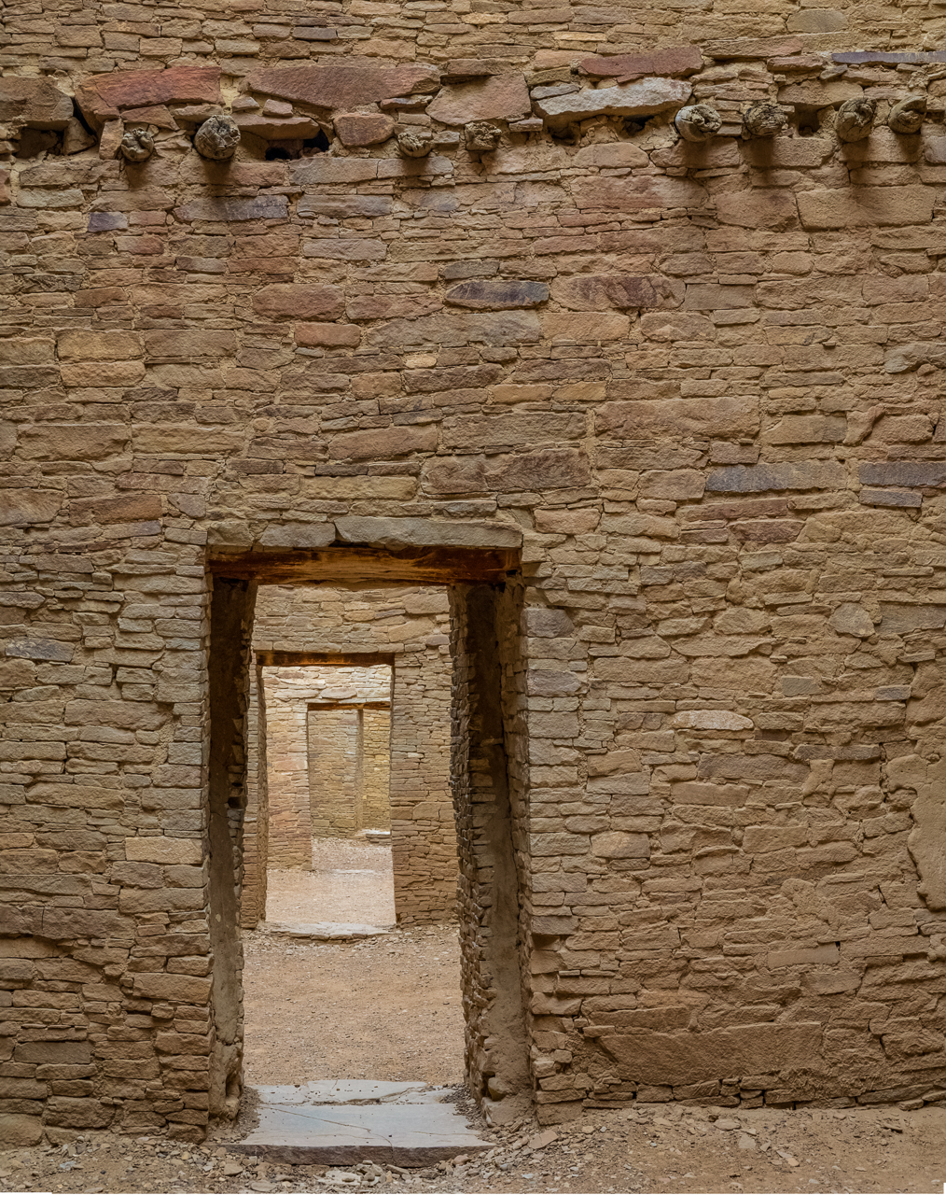
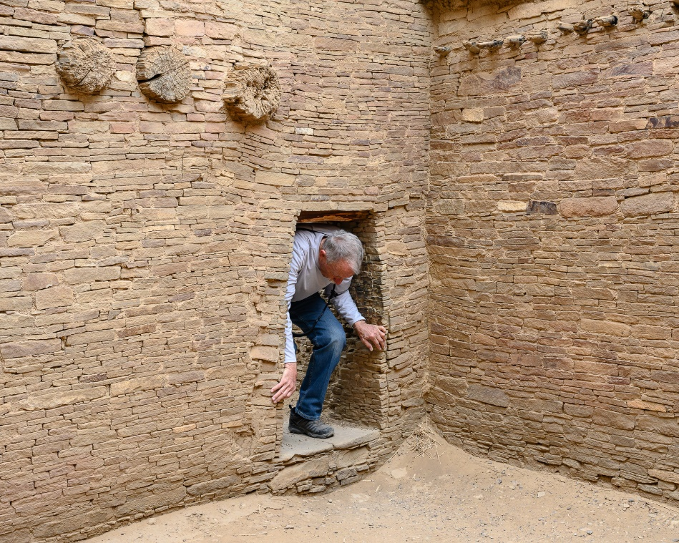
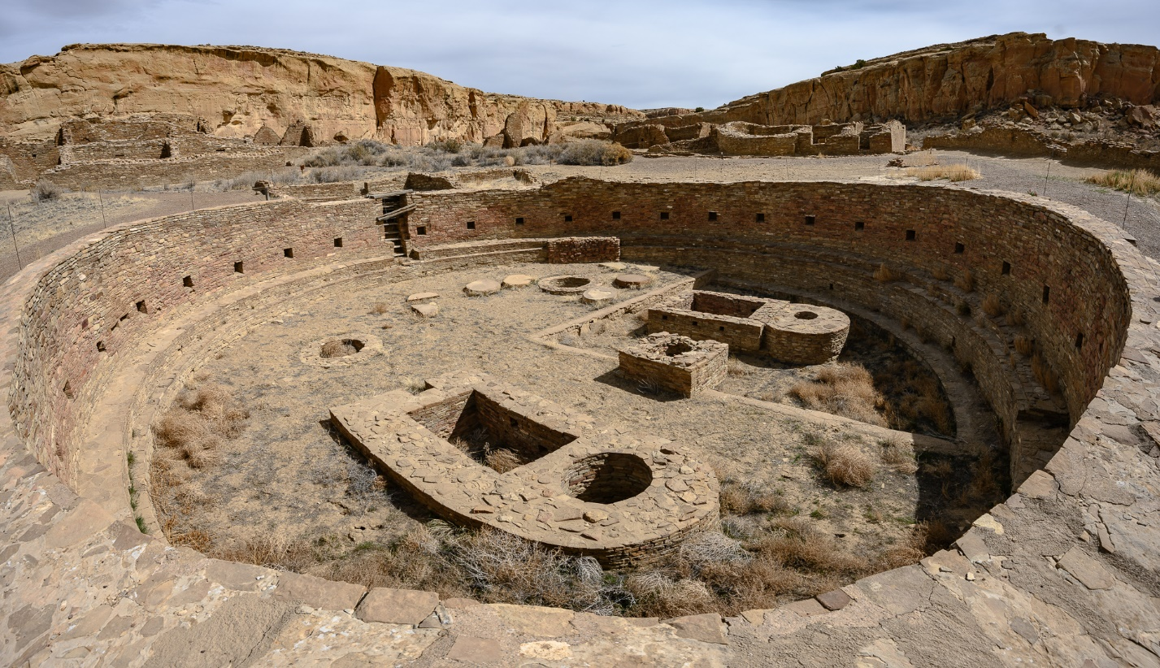
Chaco Canyon Cultural Site

