Slide 1
Ghost Ranch
Planning Guide – Part 1
Dennis Fritsche
July 20, 2023
All Photographs (except where noted) are Copyright Dennis

Slide 2
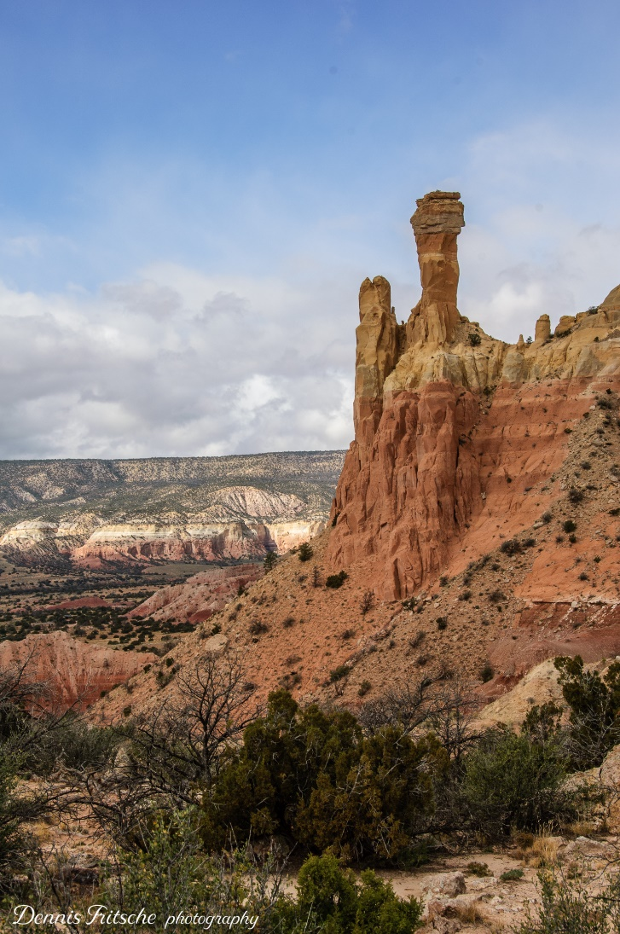
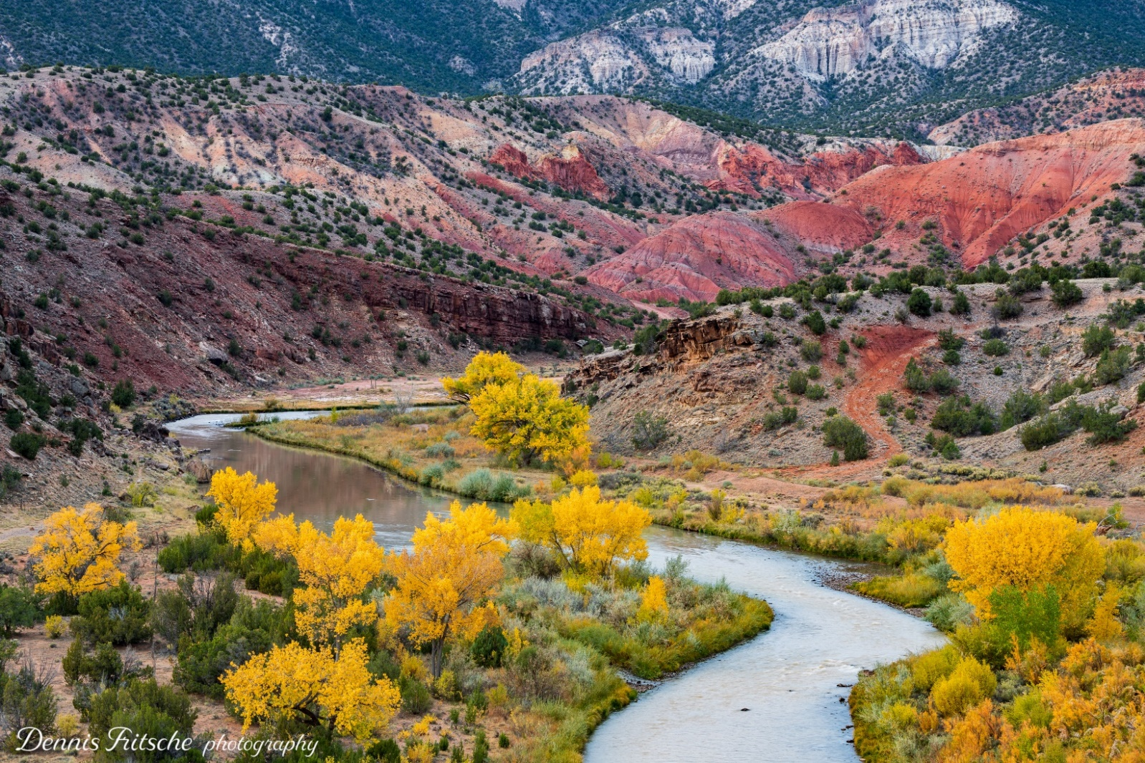
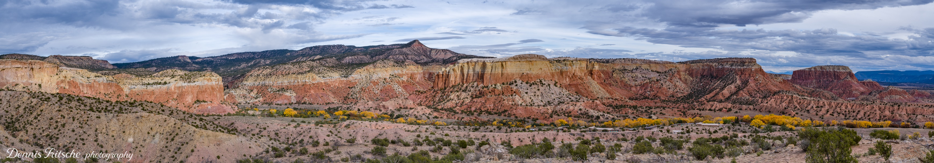
Georgia O'Keeffe Country
Ghost
Ranch
September 25-27, 2023
Chimney Rock
Chama River with Cottonwoods
Panorama of Ghost Ranch from Chimney Rock

Slide 3
References
Photographing the Southwest by Laurent Martrès
  Volume 1 – Southern Utah
  Volume 2 – Arizona
  Volume 3 – Colorado and New Mexico (a little of Texas)
Artist on the Loose. Colorado and New Mexico, 2022 by various
Artists on the Loose by Alan Whiteside | Blurb Books
The culmination of an extraordinary journey: an extended Dallas Camera Club "Fall Colors in Colorado" field trip. Six artists, two cars, ten days, and an exuberance of creative spirit. Contains 20 images from each photographer, watercolor sketches, and haiku poetry reflecting the 15 venues we explored, plus brief descriptions and directions to each of the locations.

Slide 4
Important Times
Mealtimes at Ghost Ranch
  7:30-8:30 a.m. – Breakfast
  Noon-1:00 p.m. – Lunch
  5:30-6:30 p.m. – Dinner
Date Sunrise Sunset
09/25/2023 06:56:48 AM 06:57:45 PM
09/26/2023 06:57:36 AM 06:56:16 PM
09/27/2023 06:58:25 AM 06:54:47 PM
Moon
Date Rise %
25-Sep 5:07PM 83
26-Sep 5:44 PM 92
27-Sep 6:16PM 97
28-Sep 6:46 PM Full
Milky Way
Vertical after sunset

Slide 5
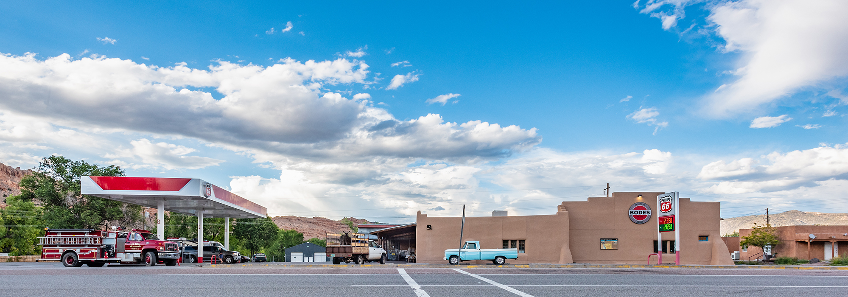
General Tips
Ghost Ranch is remote
Watch your gas gauge
Have water and snacks
Bode’s General Store outside of Abiquiui has everything including gas and a restaurant
Stock Photo

Slide 6
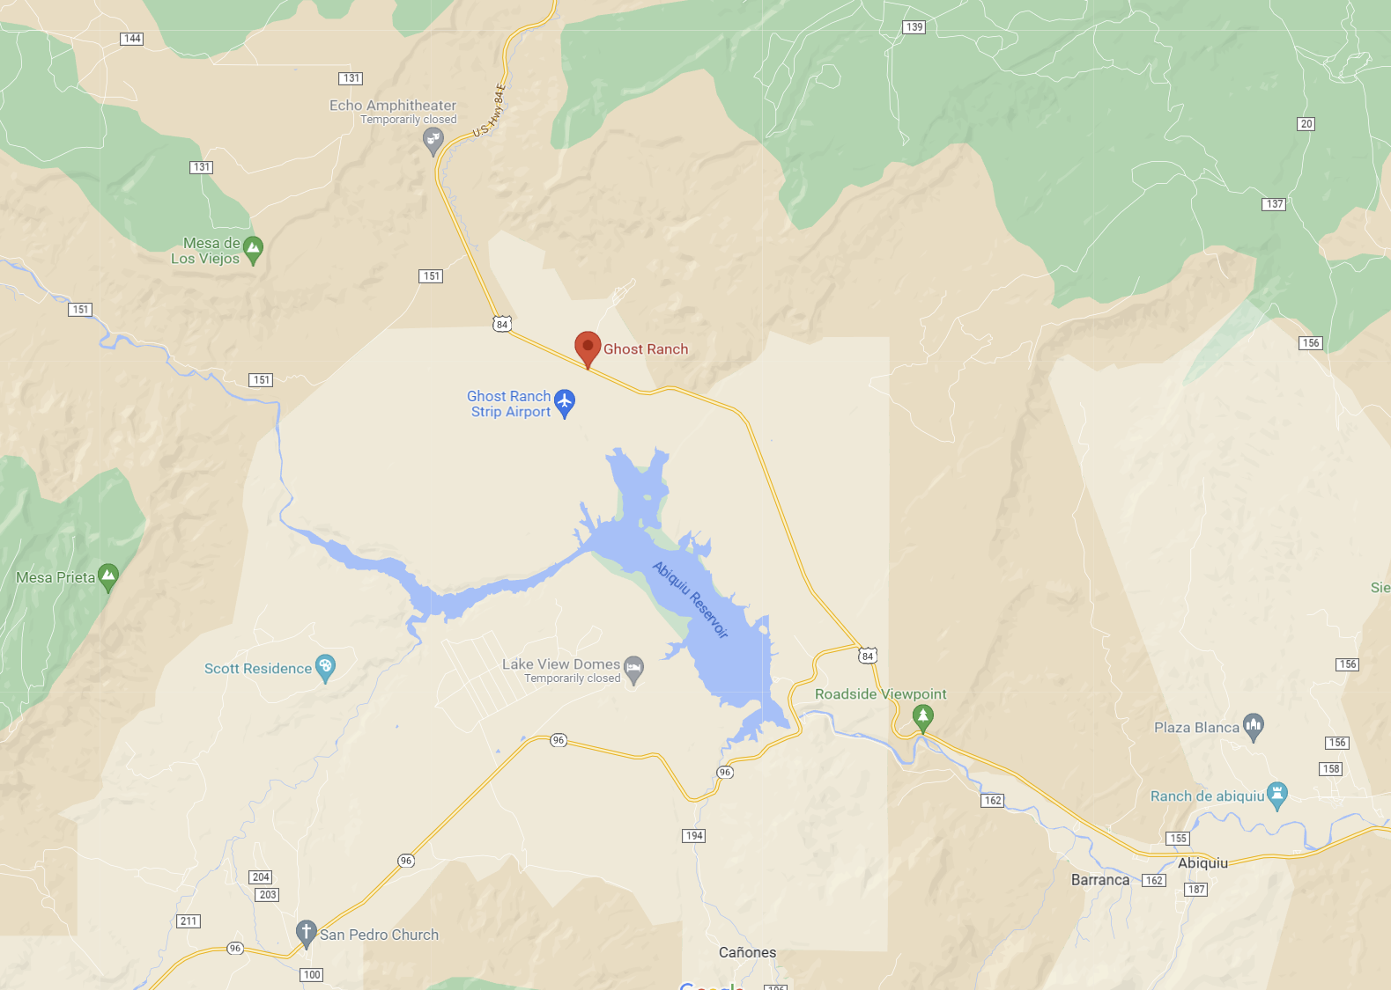





Ghost Ranch is a Destination and a Starting Place to Explore

Slide 7
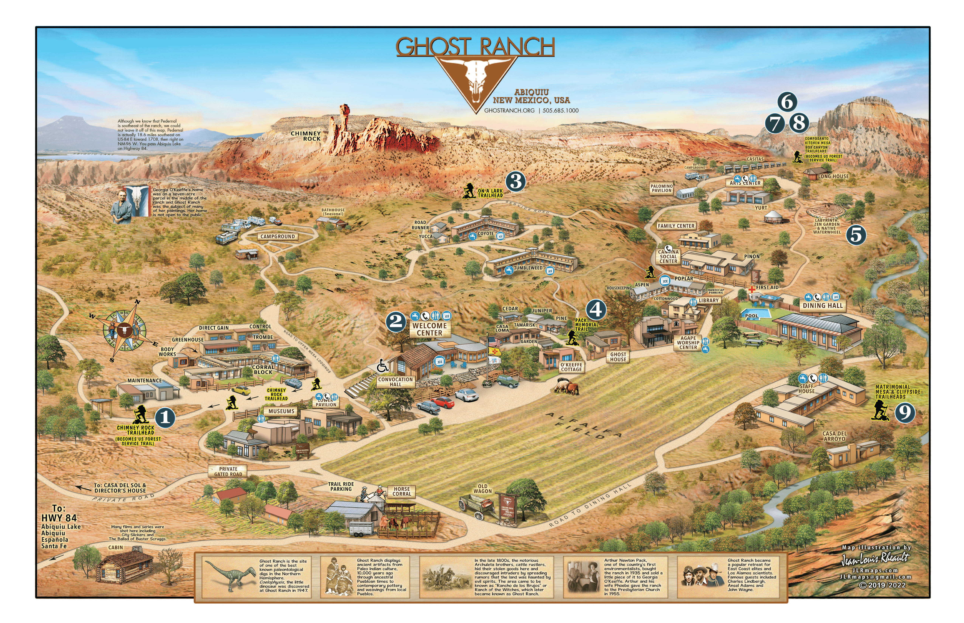
Map - Ghost Ranch
Ghost Ranch Photography Policy: Free to take photographs for non-commercial purposes

Slide 8
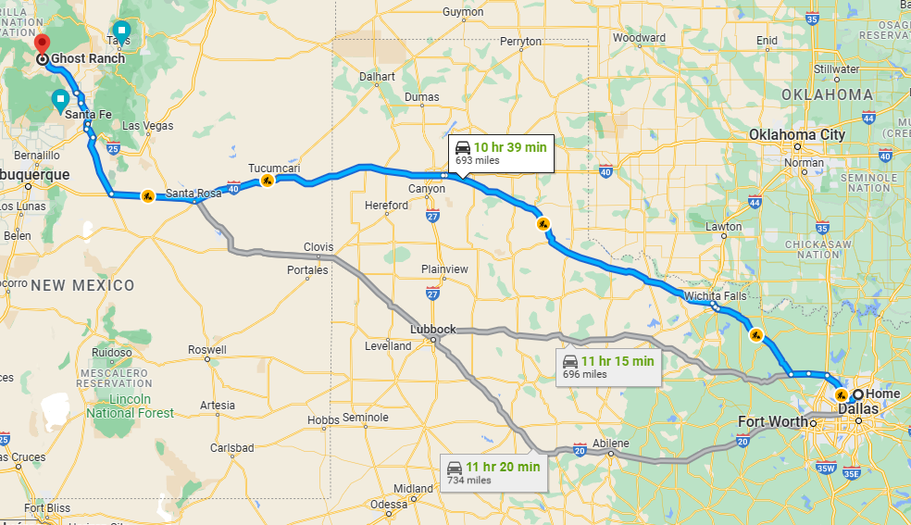
Ghost Ranch – Plan Your Route
Direct

Slide 9

Ghost Ranch – Our Route
Day 1

Slide 10
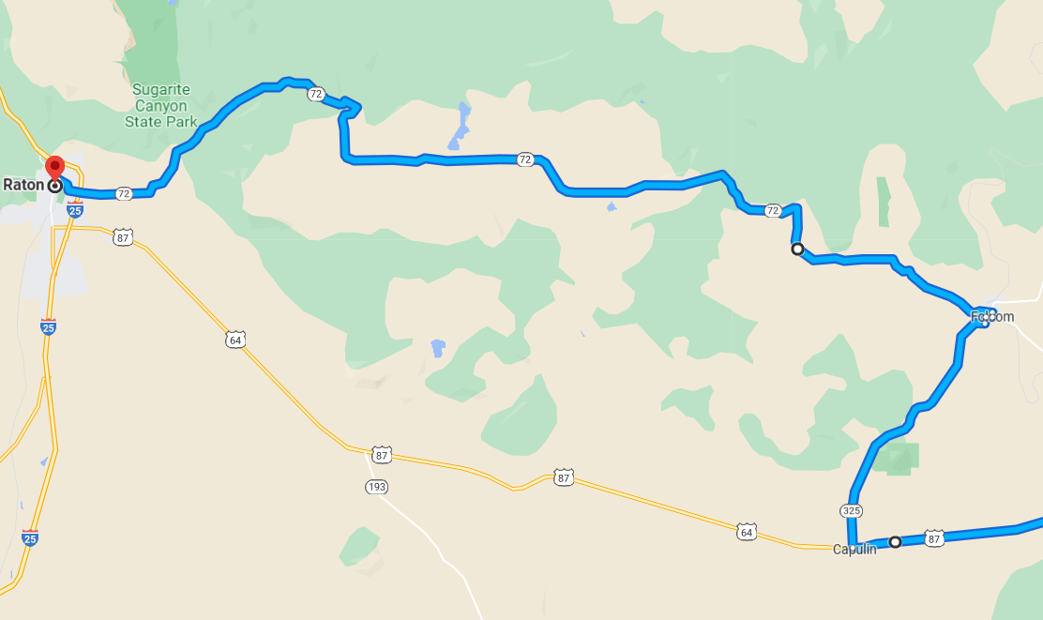
Ghost Ranch – Our Route
Day 1
Capulin Volcano National Monument
Then up to Folsom
Follow Highway 72 across Johnson Mesa to Raton

Slide 11
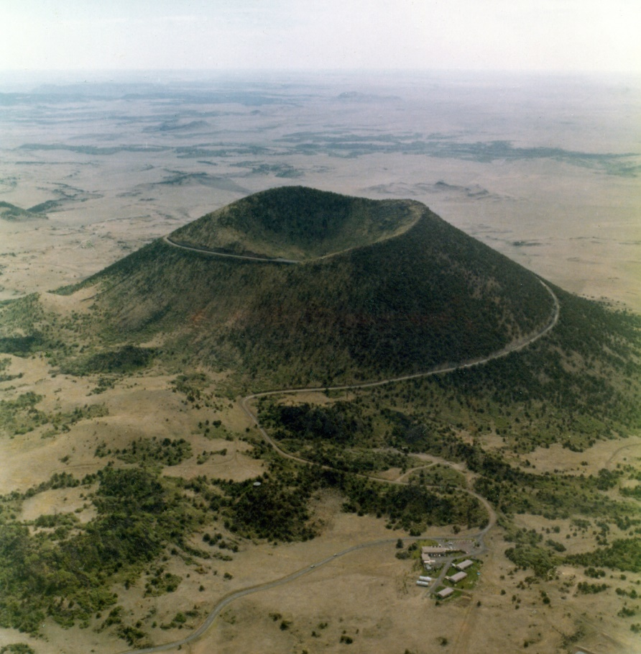
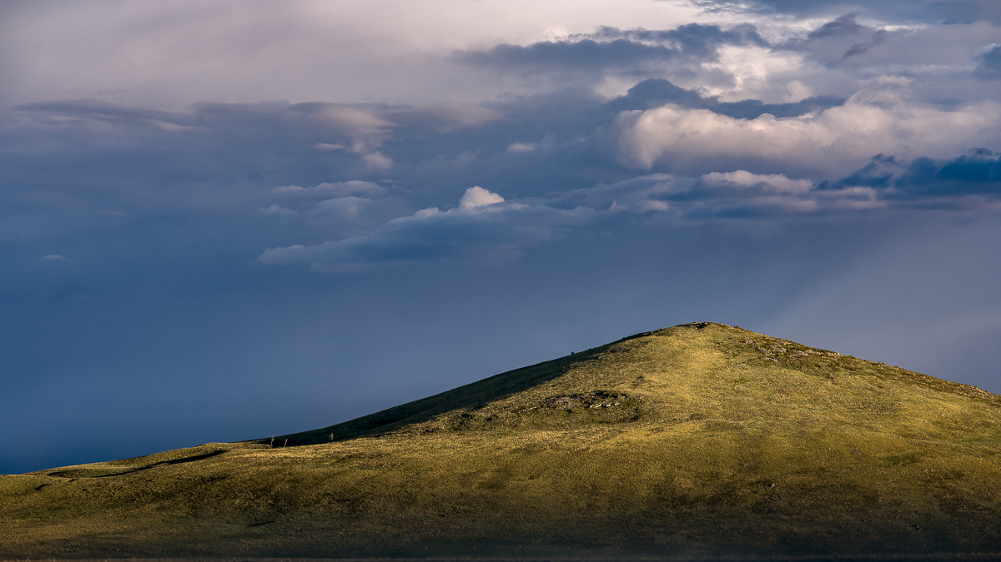
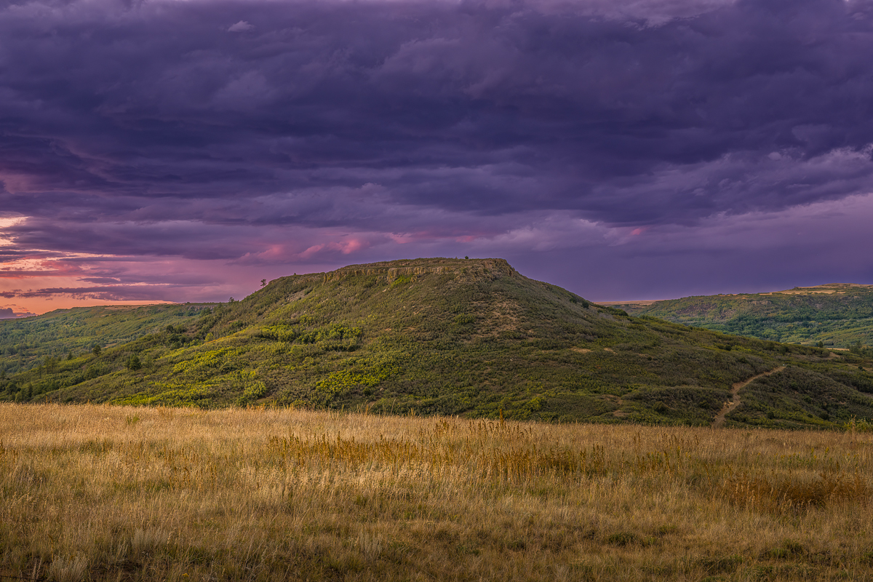
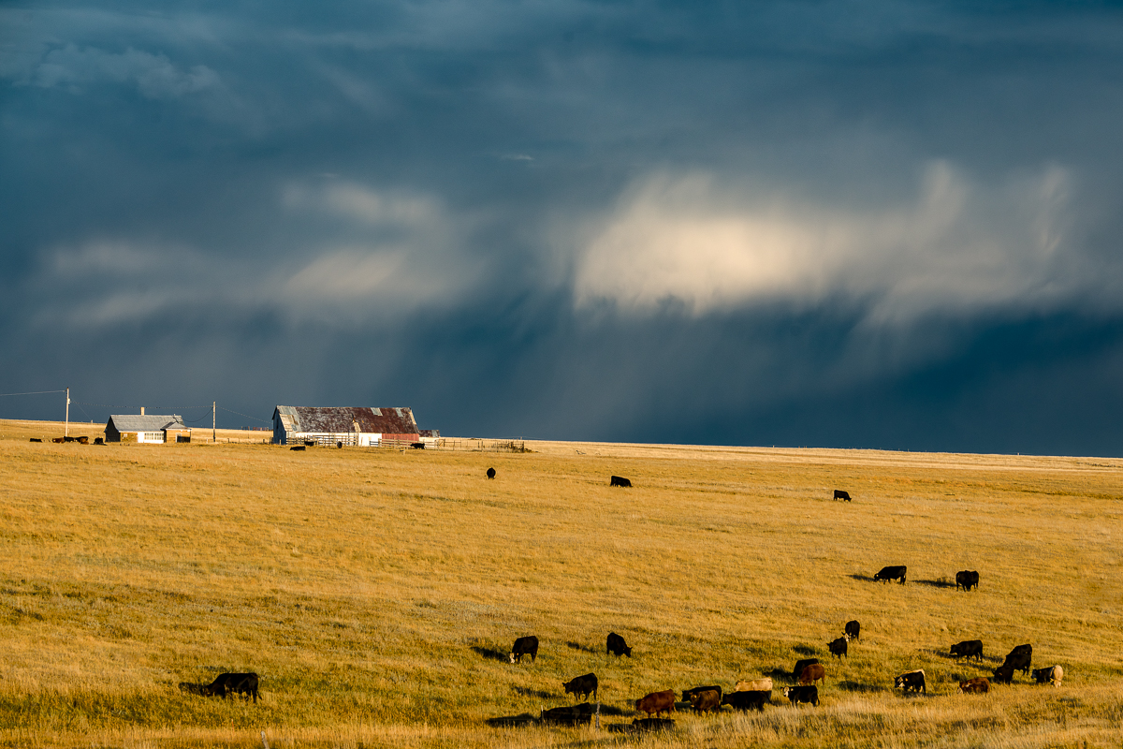
Stock Photo

Slide 12
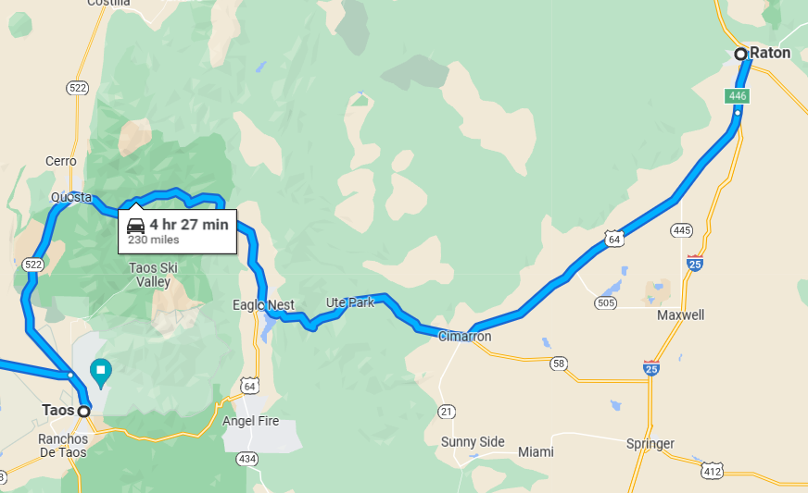
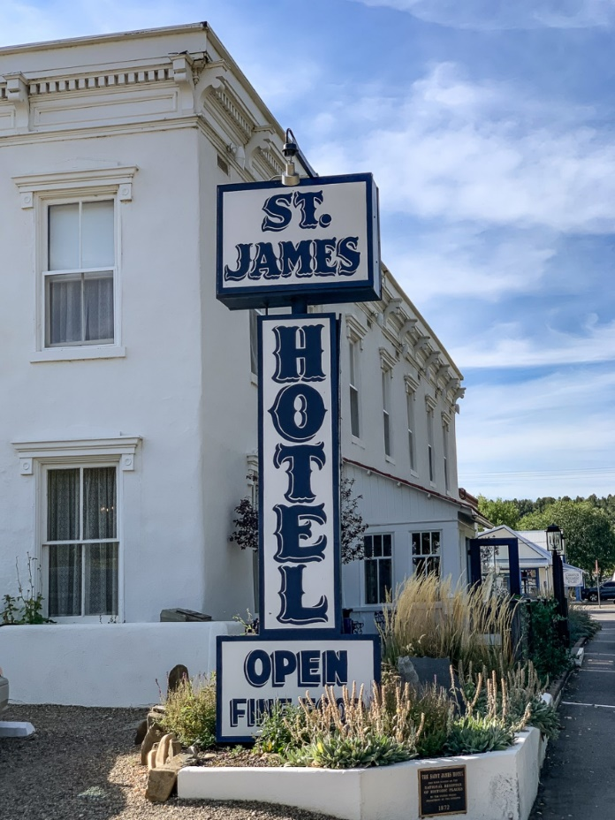
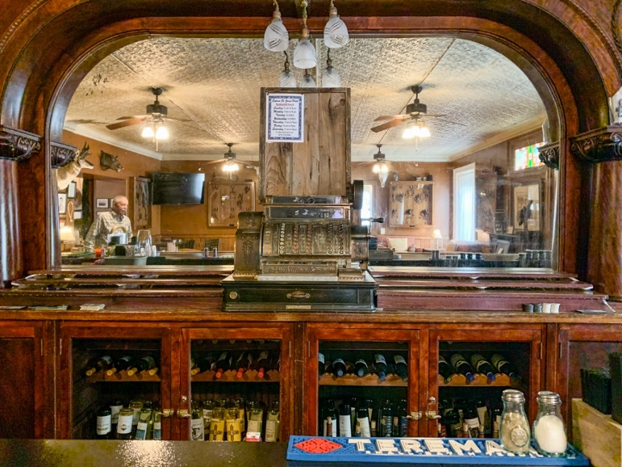
Ghost Ranch – Our Route
Day 2
Day 2 – Taos
- Cimmaron St James Hotel
- Cimmaron Canyon
- Red River of the North
- Taos and Rancho Church
- Wild Rivers National Monument

Slide 13
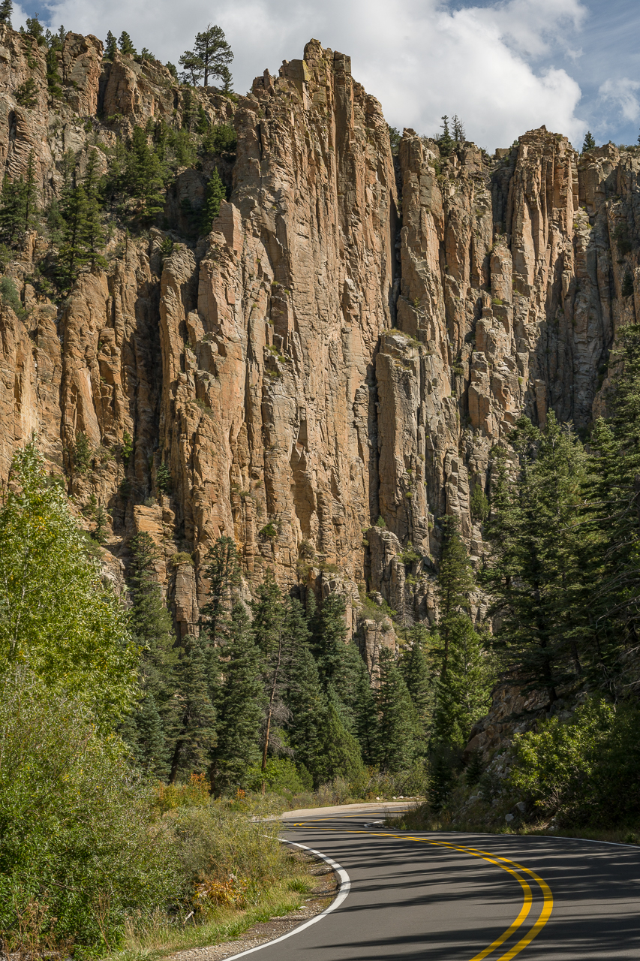
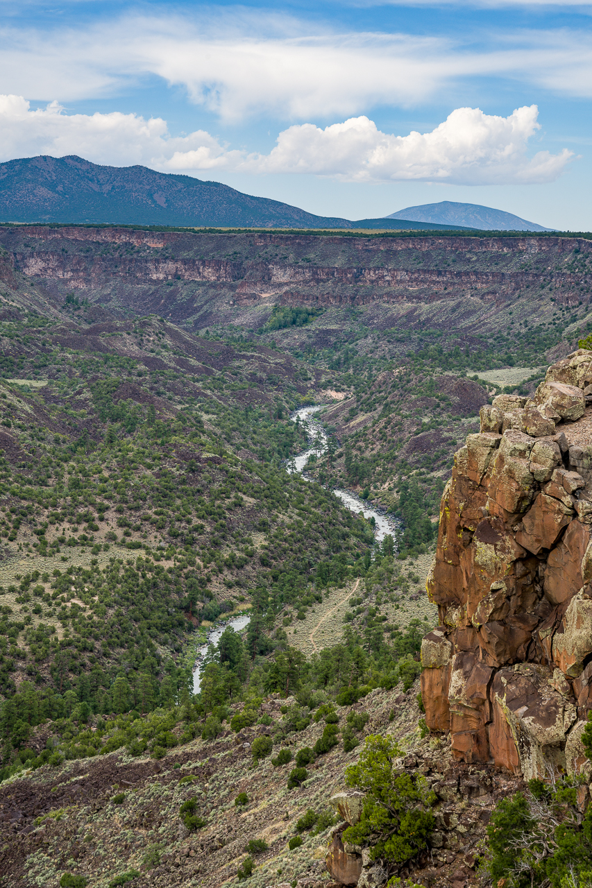
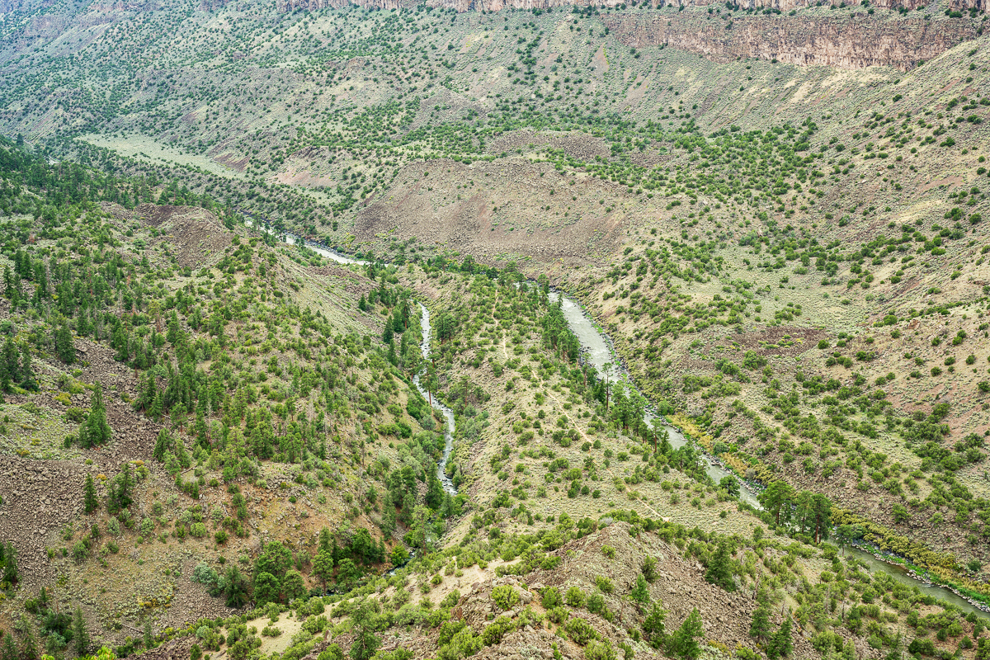
Near Questa is the Wild River National Monument where the Red River of the North Flows into the Rio Grande
Cimmaron Canyon

Slide 14
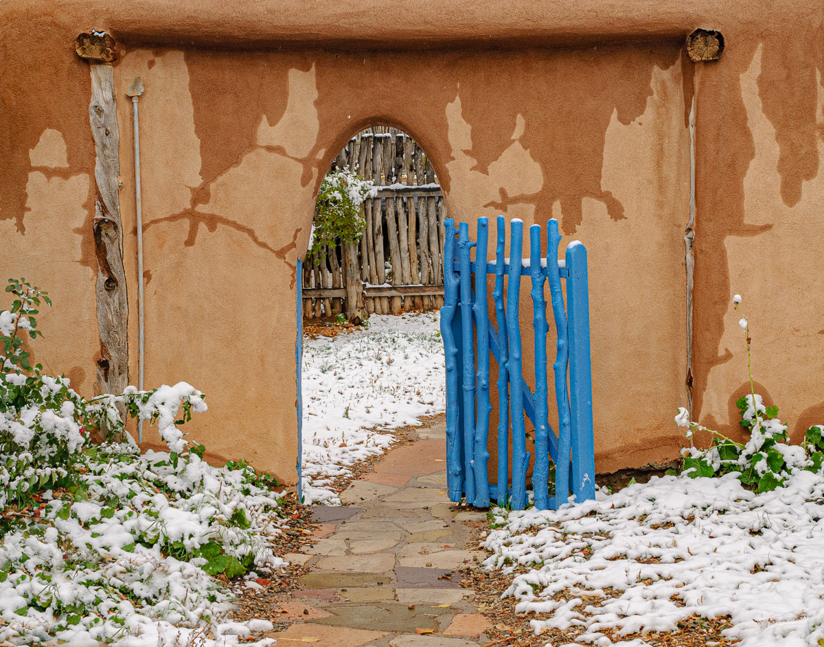
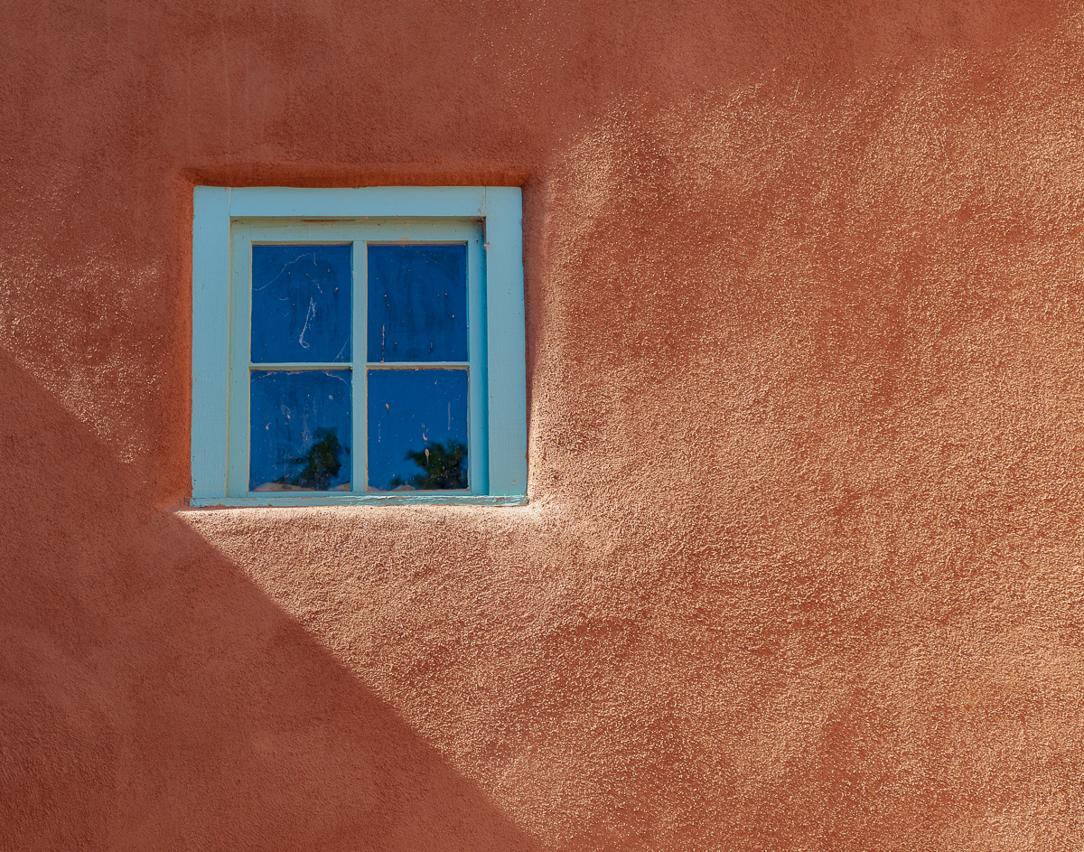
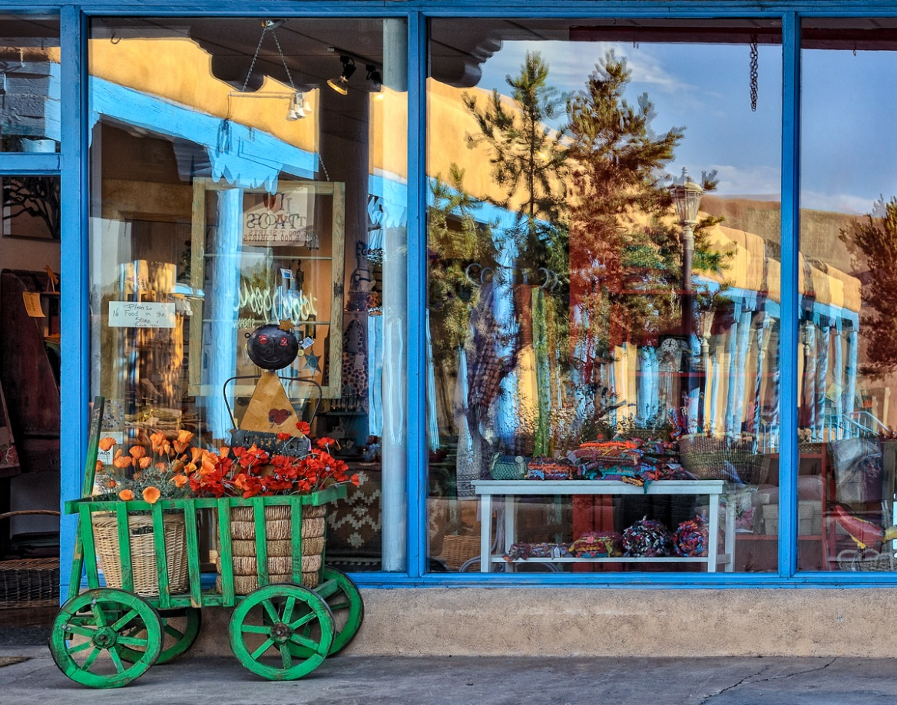
Taos

Slide 15
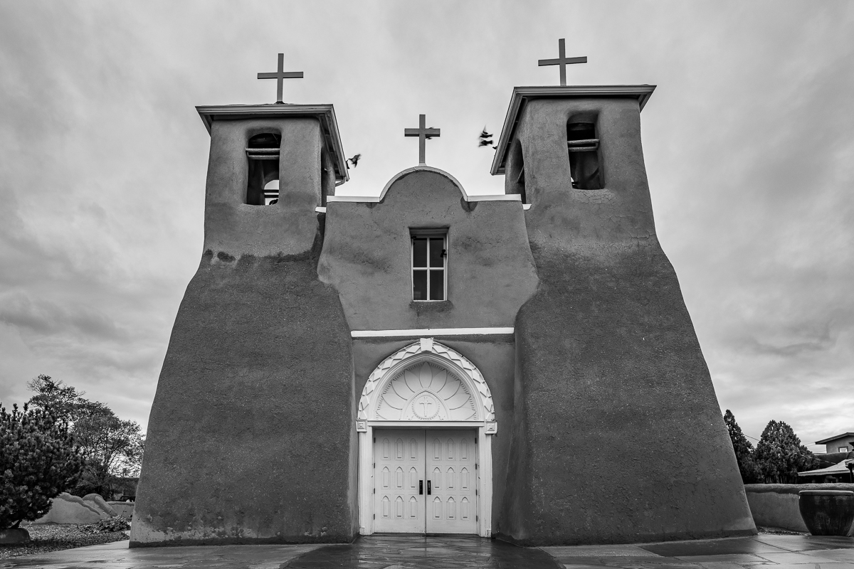
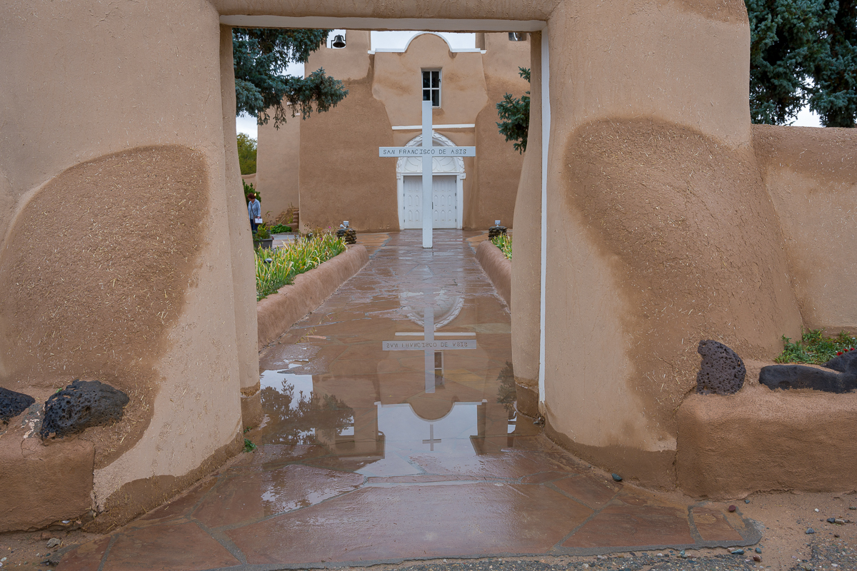
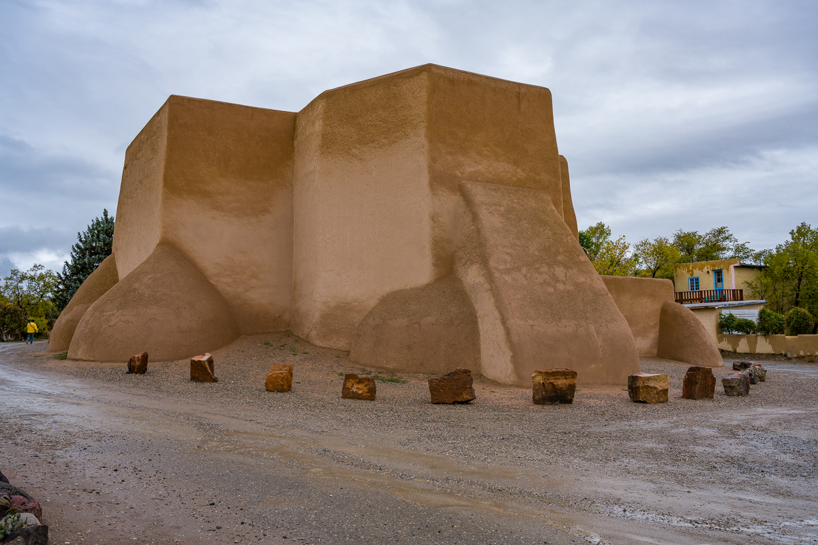
Ranchos de Taos Church
(San Francisco de Assis Catholic Mission)

Slide 16
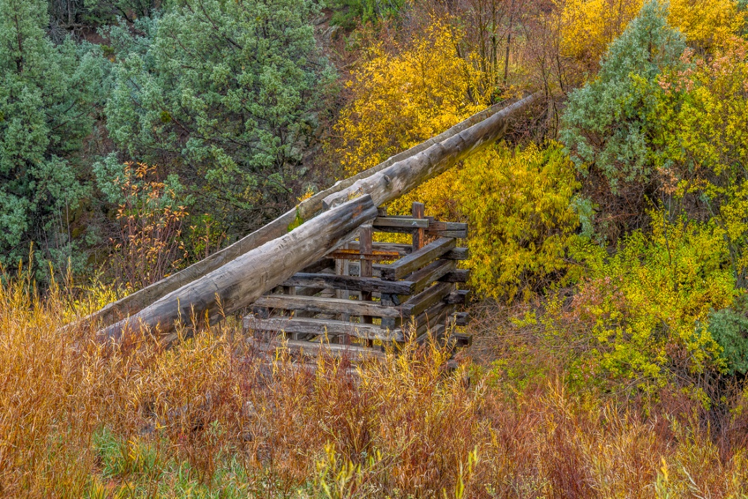
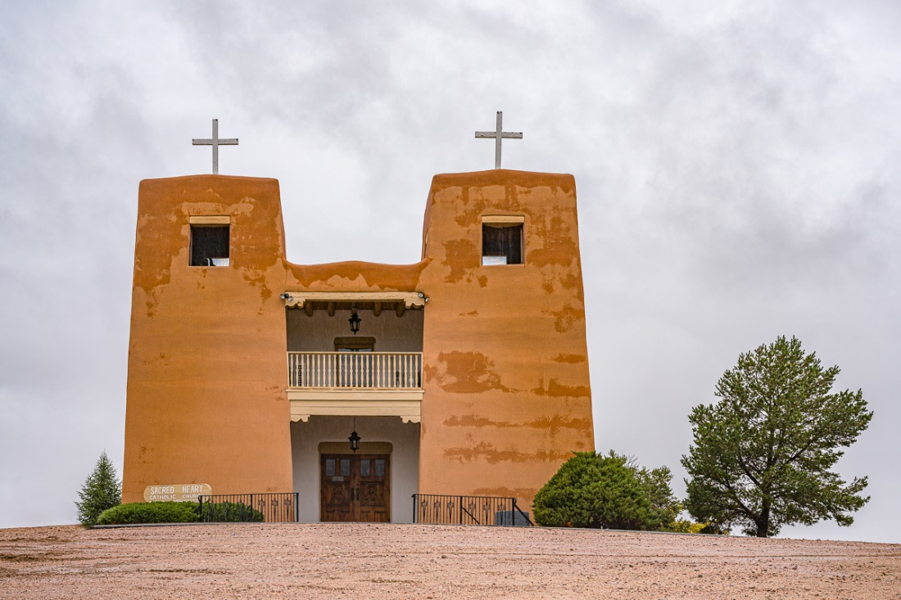
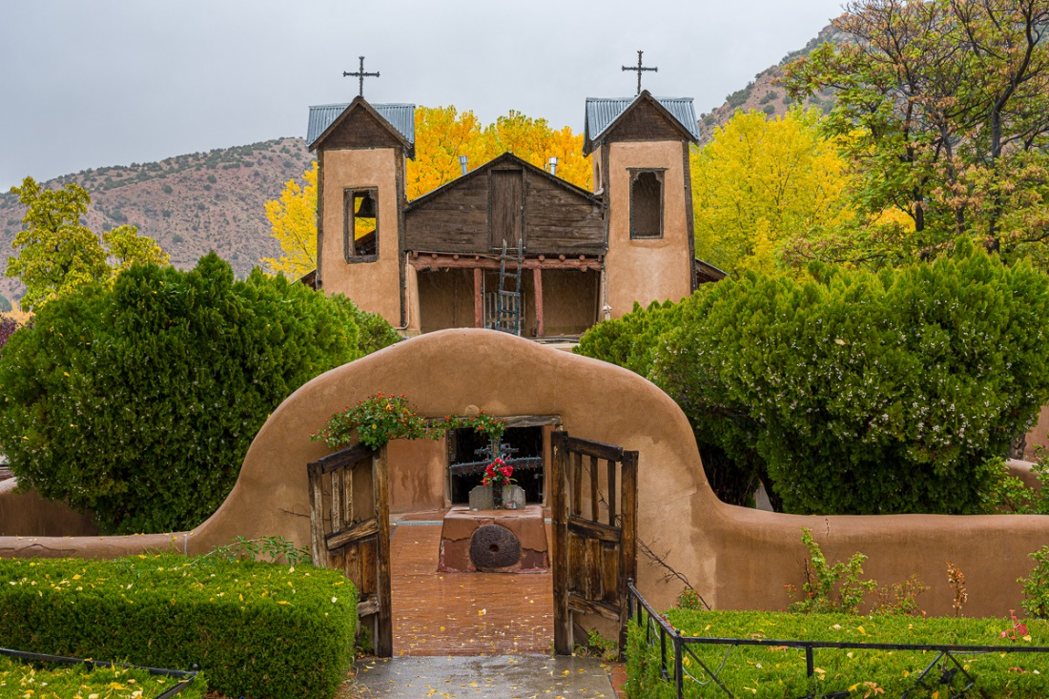
High Road to Taos if Coming from Albuquerque
The 56-mile High Road to Taos is a scenic, winding road through the Sangre de Cristo Mountains between Santa Fe and Taos. It winds through high desert, mountains, forests, small farms, and tiny Spanish land grant villages and Pueblo Indian villages.
Tips for Driving the High Road to Taos from Santa Fe, New Mexico (myitchytravelfeet.com)
Highroad to Taos - Google My Maps

Slide 17
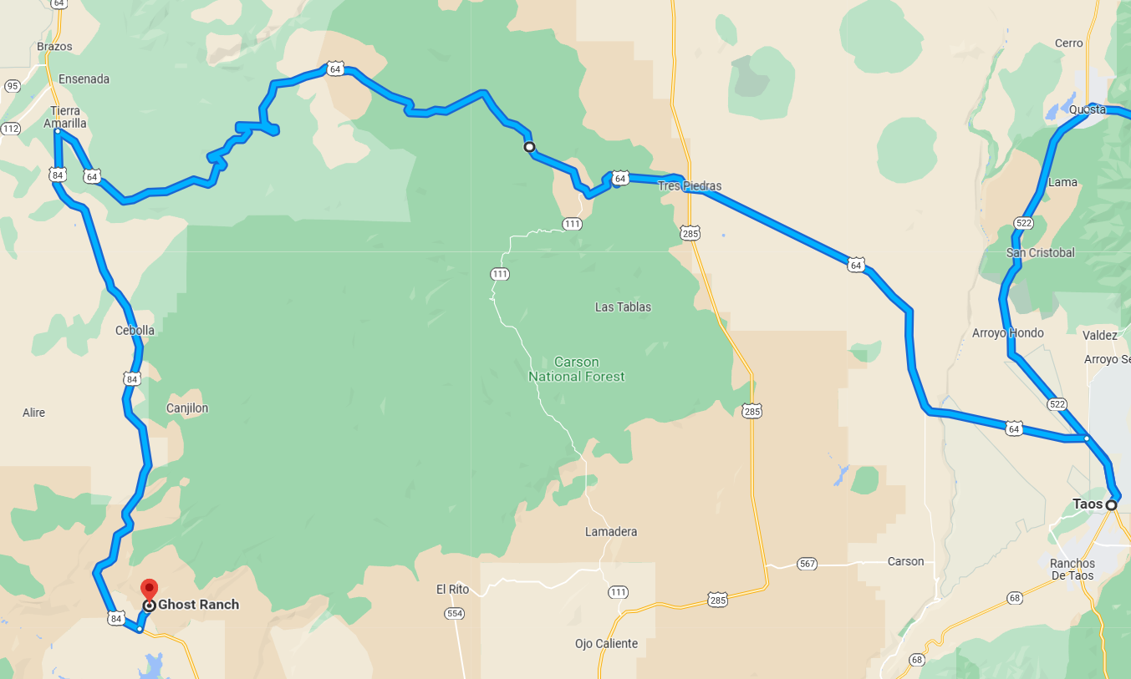
Ghost Ranch – Our Route
Day 3
Day 3 – Ghost Ranch
- Taos
- Rancho de Taos Church
(Saint Francis od Assis)
- Taos Pueblo
- Rio Grande Gorge Bridge
- Earthship Community
- Highway 64 for Apsen
- Echo Ampitheater

Slide 18
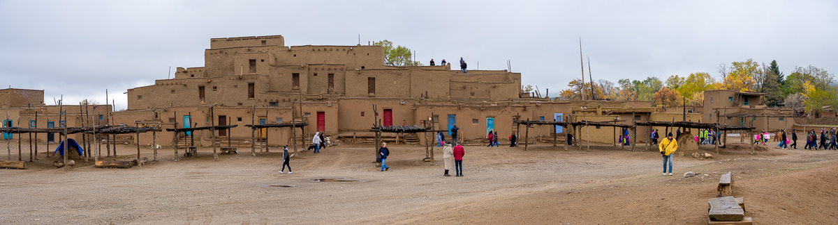
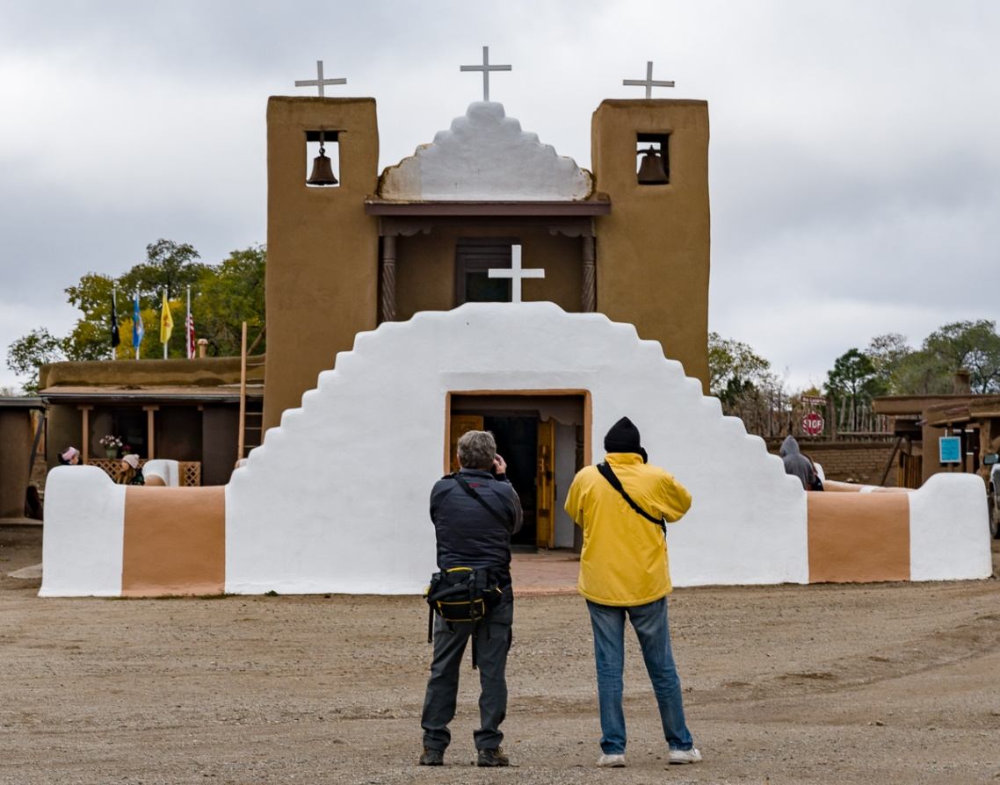
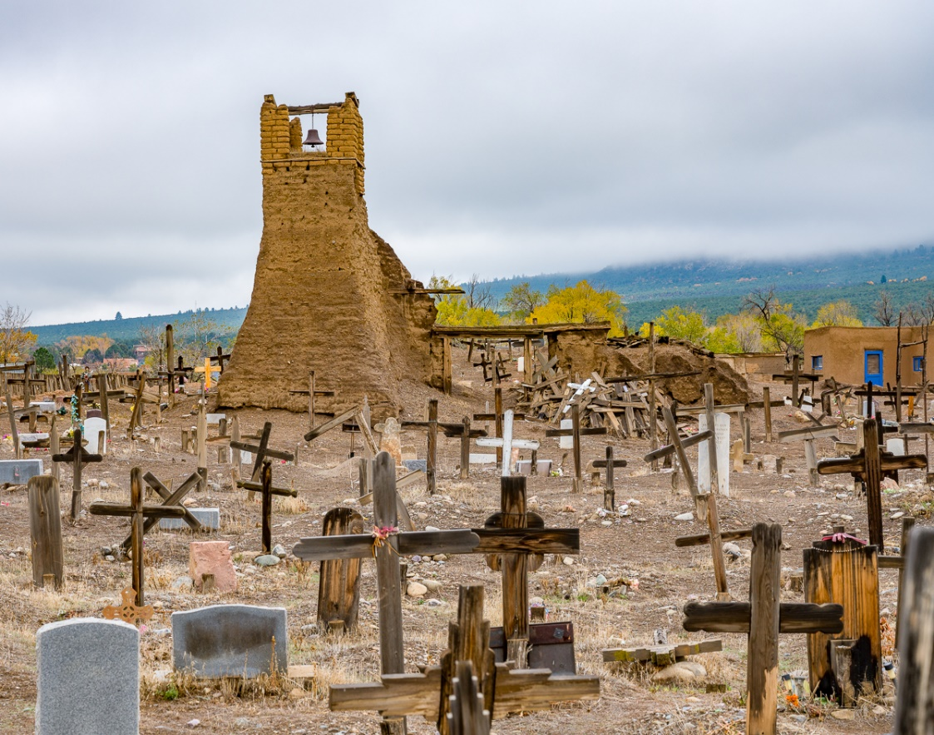
Taos Pueblo – oldest occupied housing in US
Opens at 10:00

Slide 19
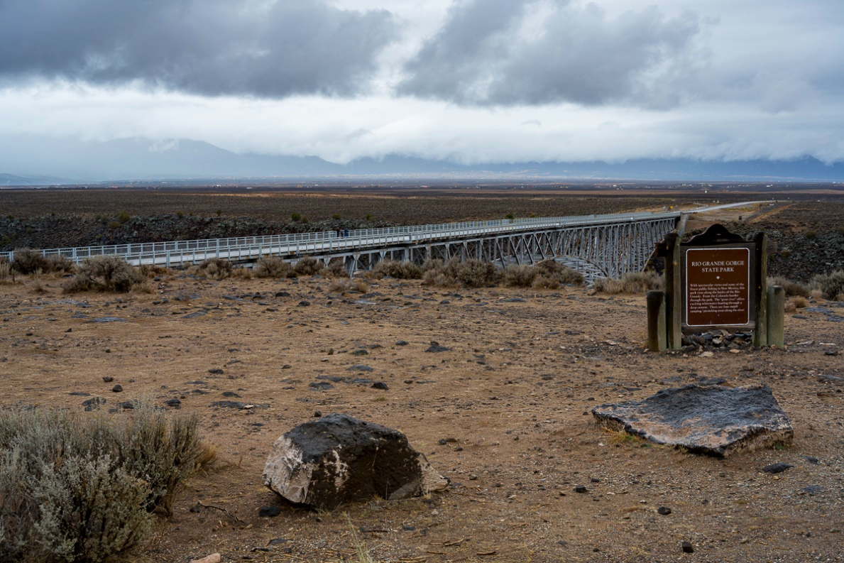
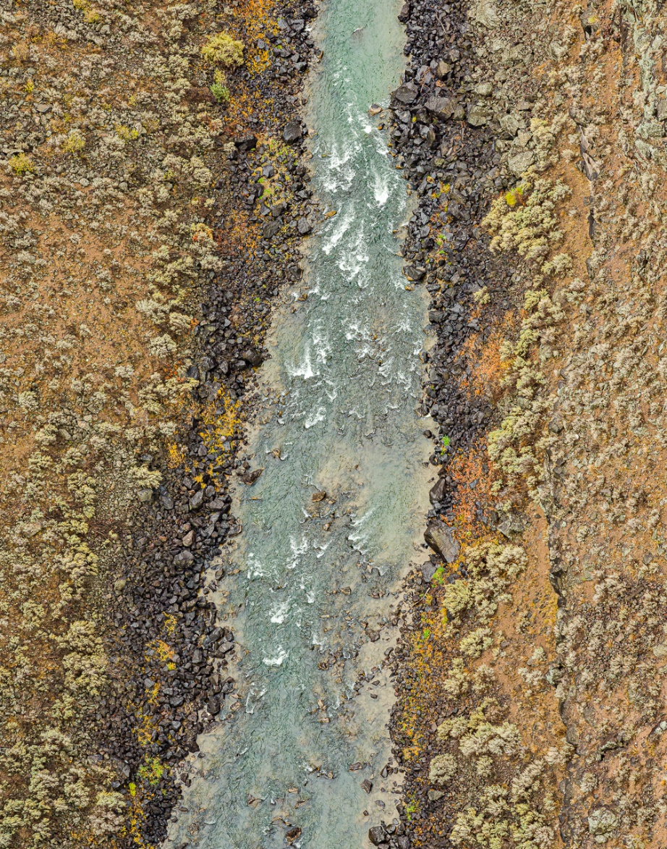
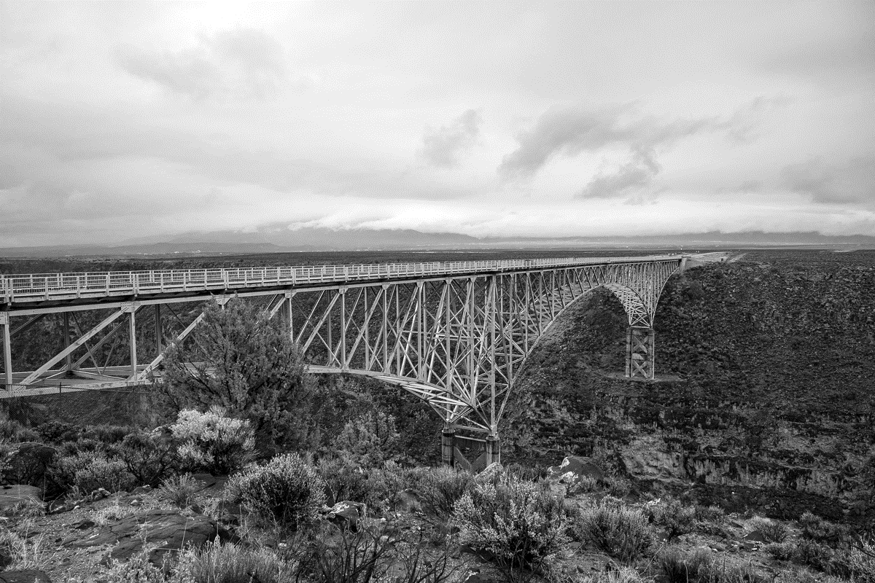
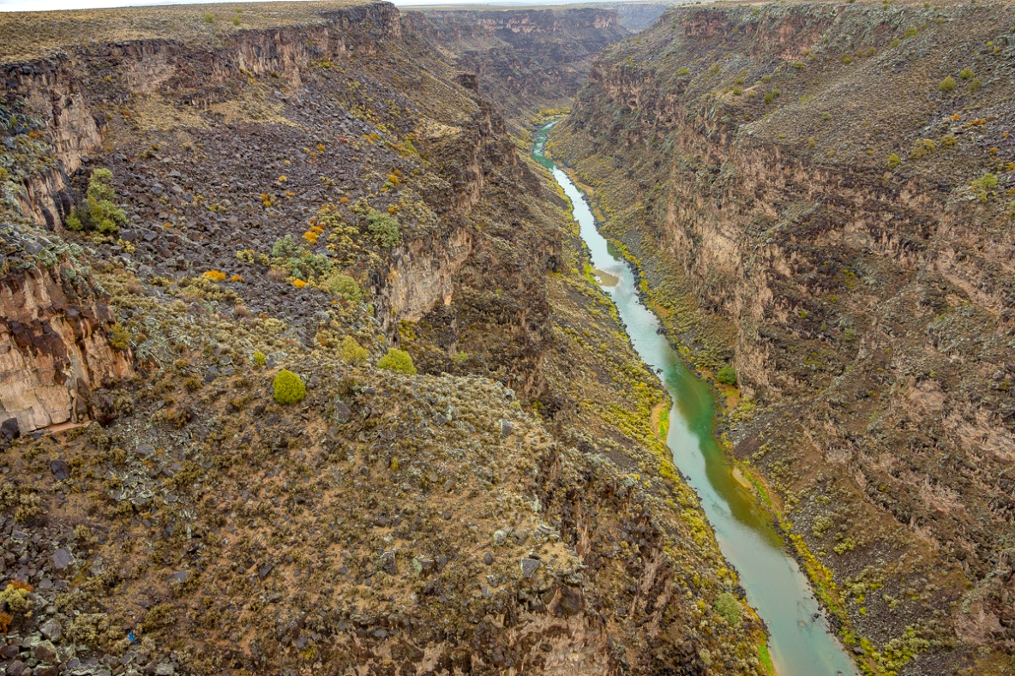
Rio Grand Gorge Bridge

Slide 20
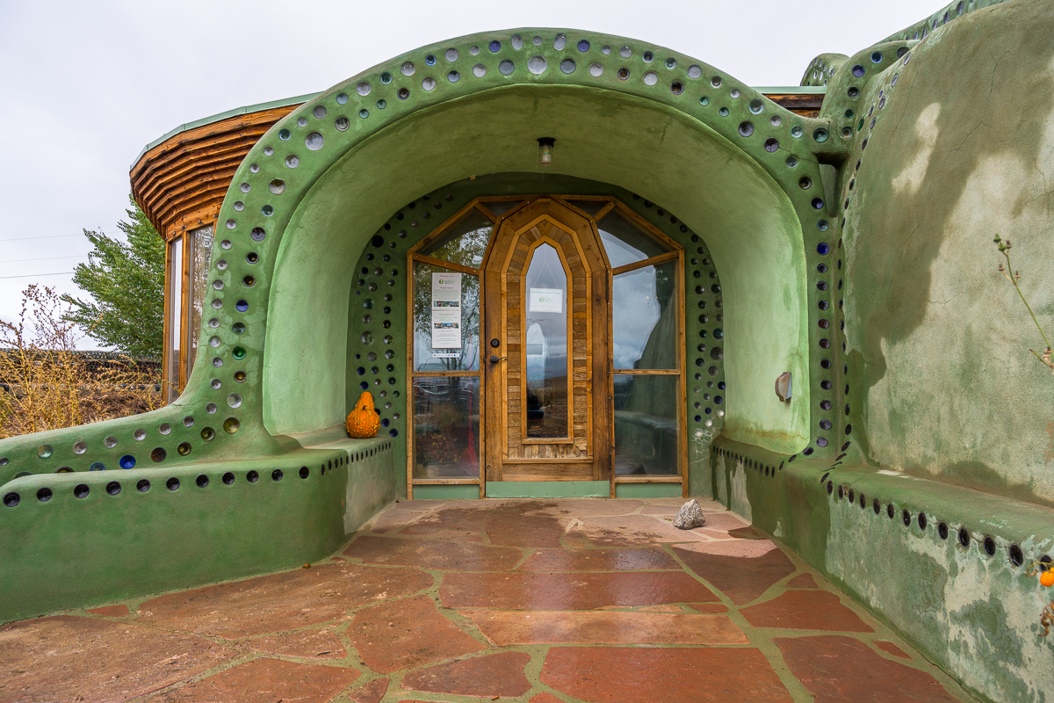
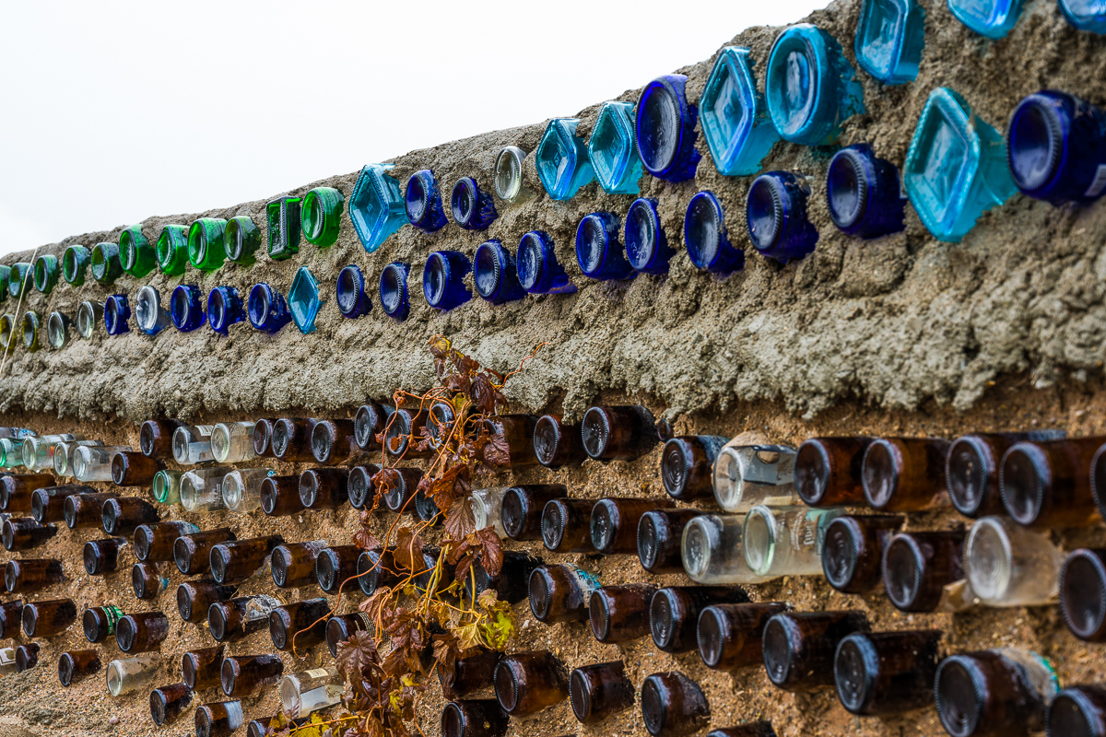
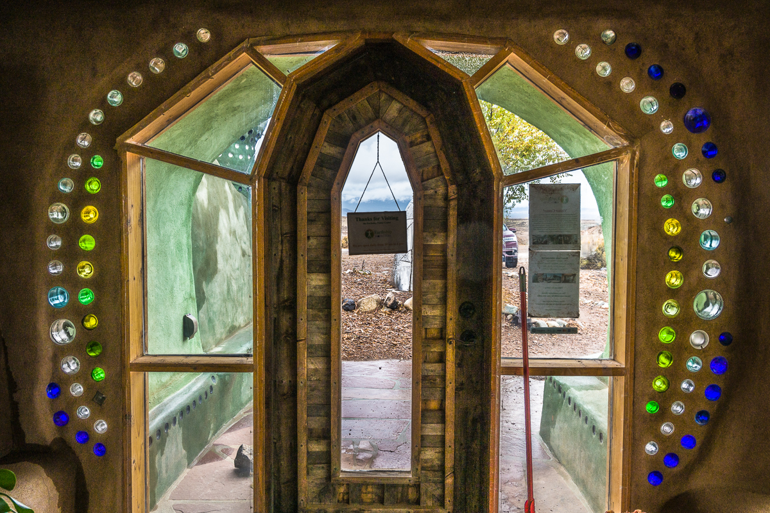
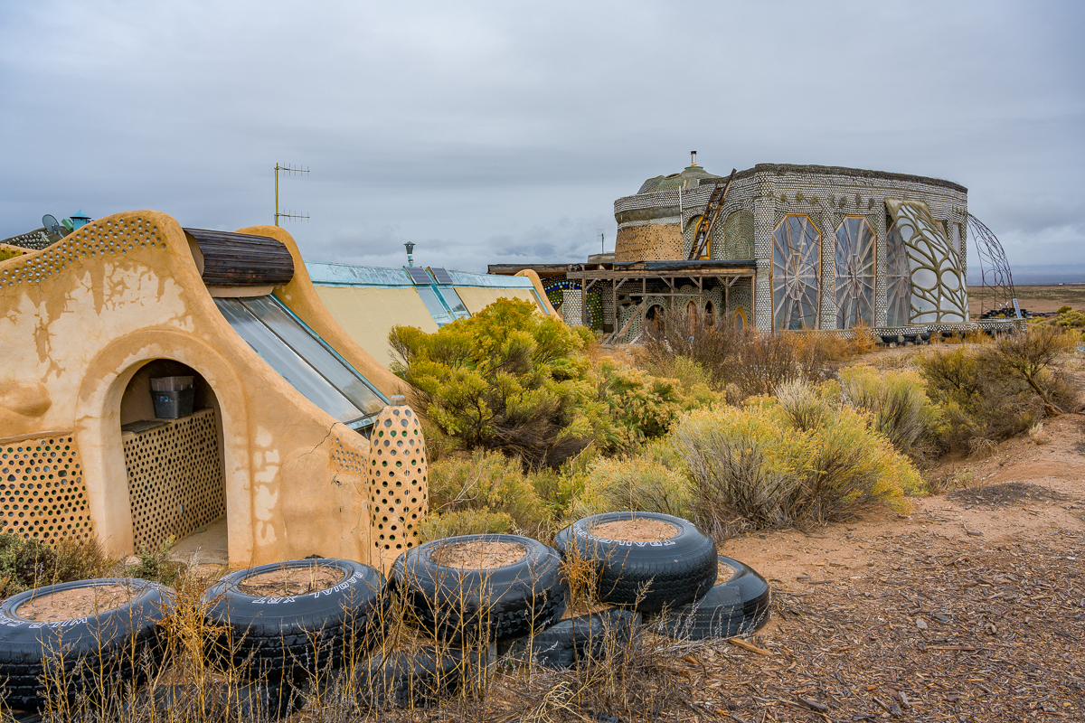
Earthship Development (These are people’s home)

Slide 21
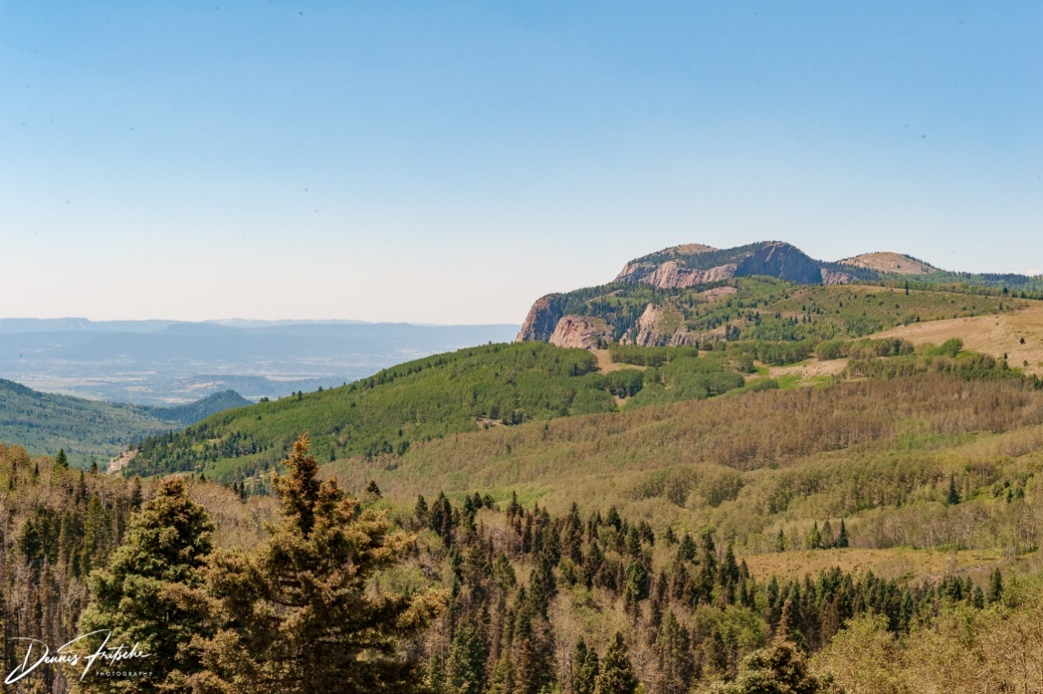
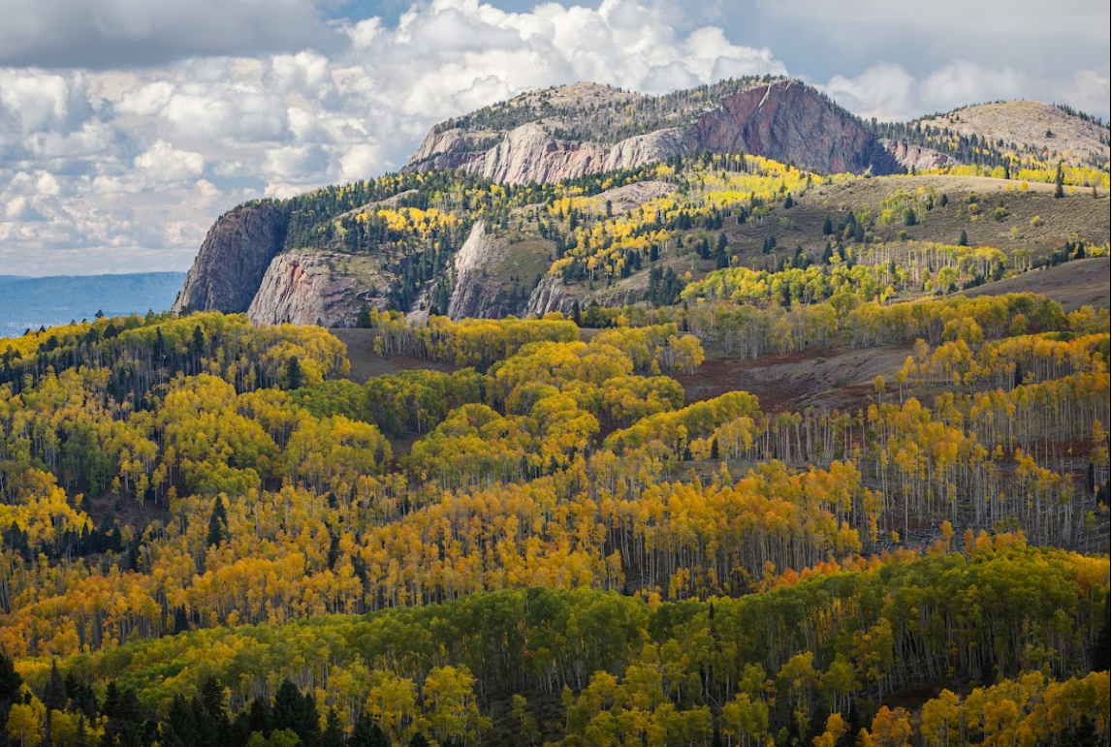
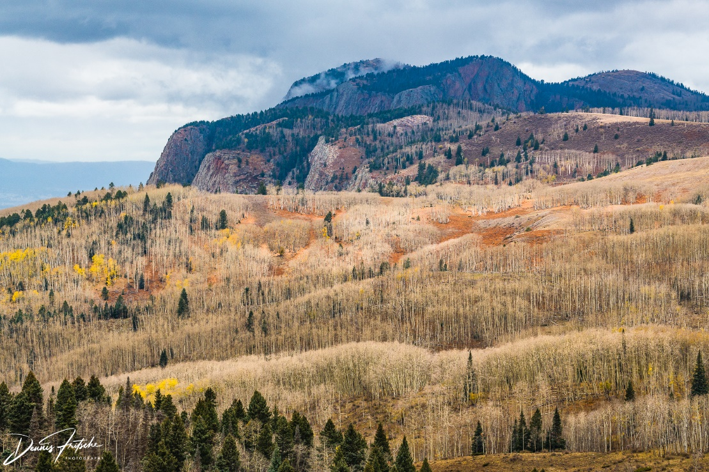
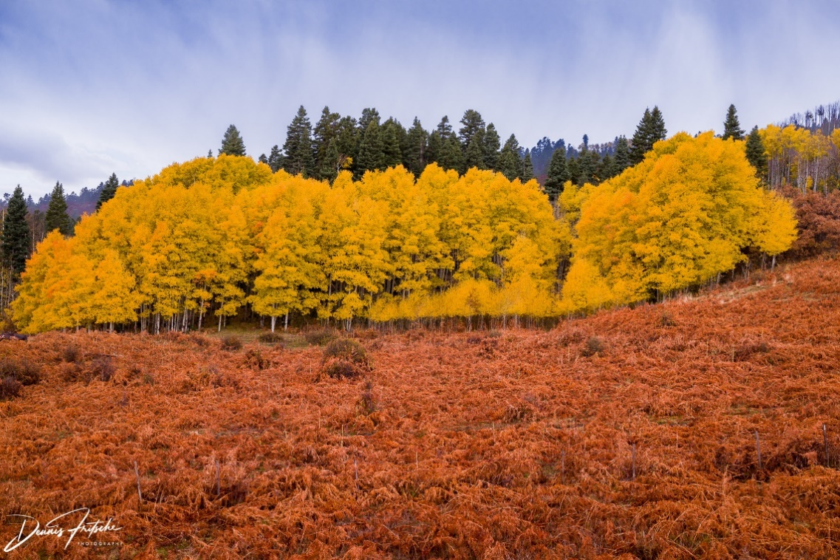
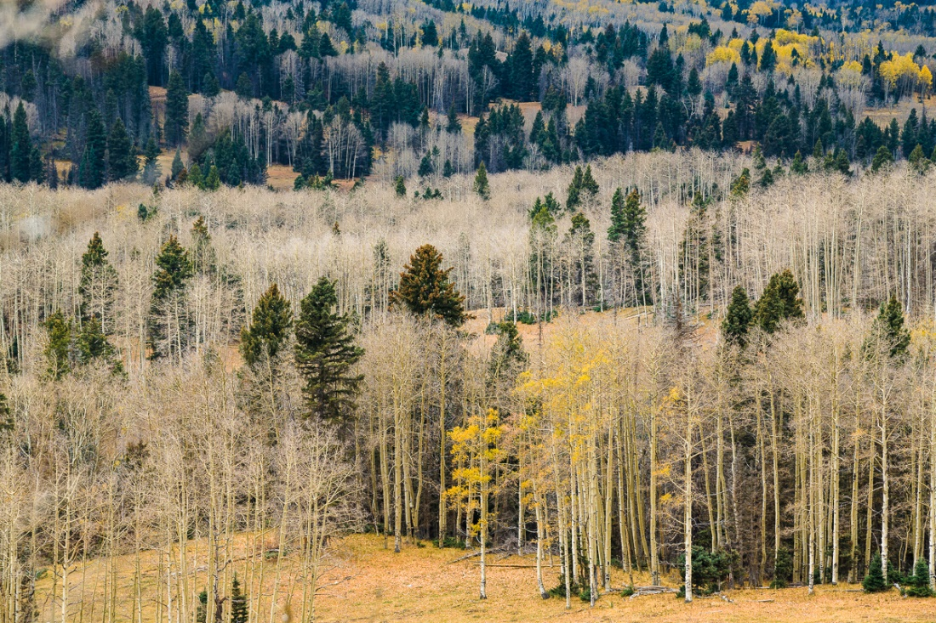
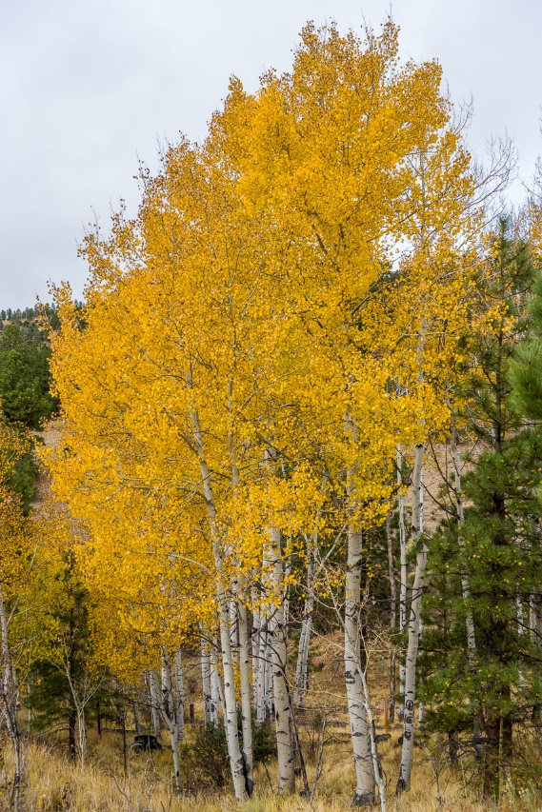
Highway 64 for Aspen
Brazos Summit on Highway 64
August 2006
Stock Photo – Peak Color
October 23, 2018
Along Highway 64 Tierra Amarilla to Tres Piedras

