Slide 1

Workflow
Process
Cliff McKenzie

Slide 2

Canon
Workflow Process – Cliff McKenzie

Slide 3
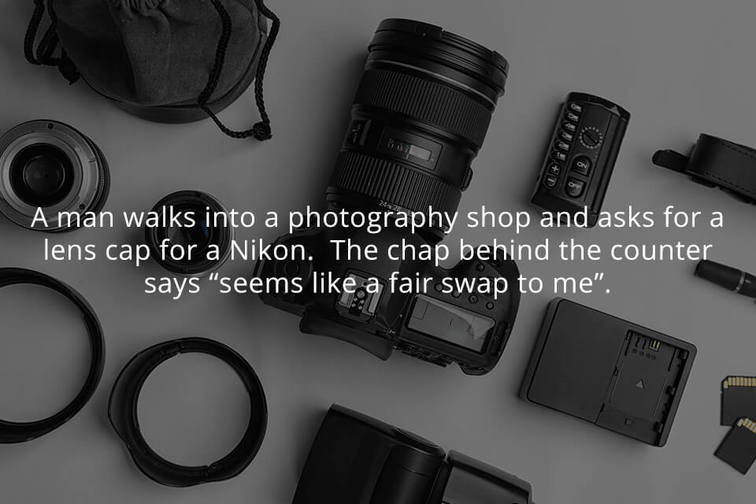
Workflow Process – Cliff McKenzie

Slide 4
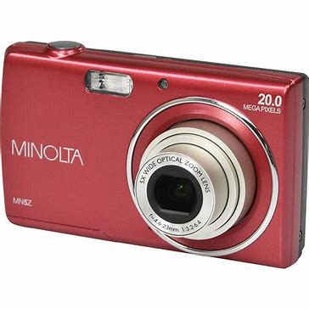
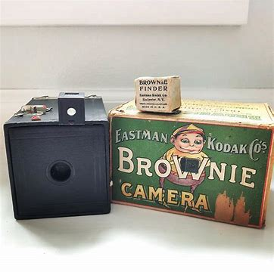
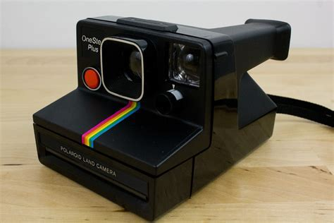
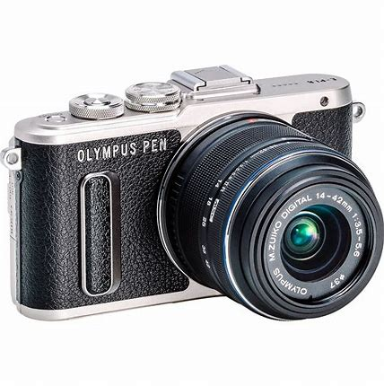
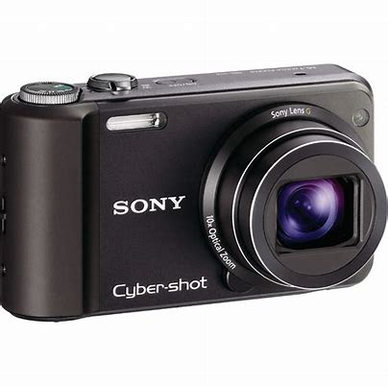
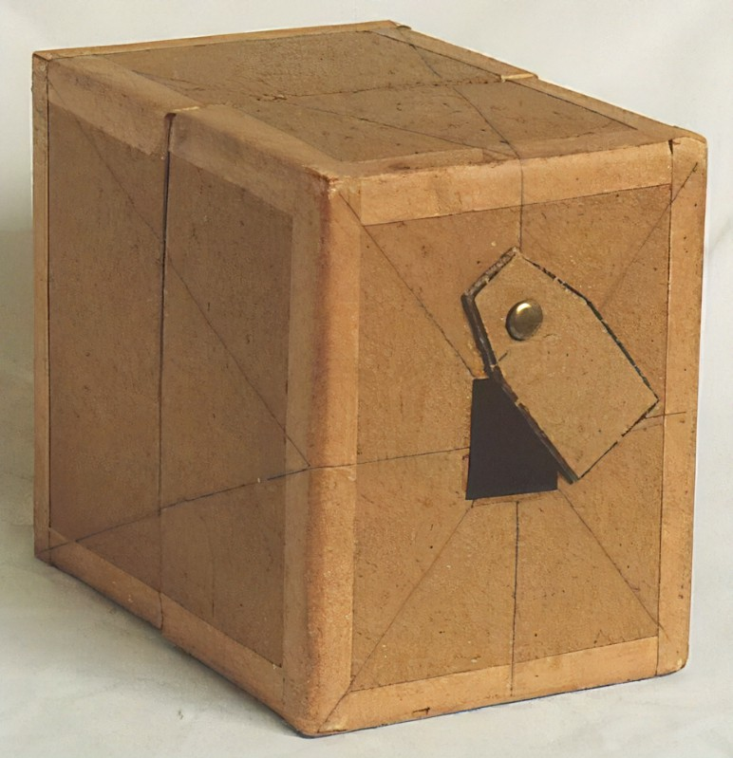
Really?
Is Everyone Now Equally Insulted?
Workflow Process – Cliff McKenzie

Slide 5
Workflow Process
Check List
Culling
Importing
Collections
Develop
Export
Backup
Workflow Process – Cliff McKenzie

Slide 6

Travel to Hawaii to Prepaid Photography Outing – One Battery
Thankfully I have a Raincoat…where is my Camera Raincoat?
Husband Lock Keys in Car During Photo Shoot
Love Photography – Left Chip in Card Reader
Check List
Honey, where is
my Tripod?
Camera Battery Charged – Flash Batteries Not So Much
Have Smart Phone –
Why Do I Need a Map?
Photography Outing Ruined – Wrong Camera Settings
Workflow Process – Cliff McKenzie

Slide 7
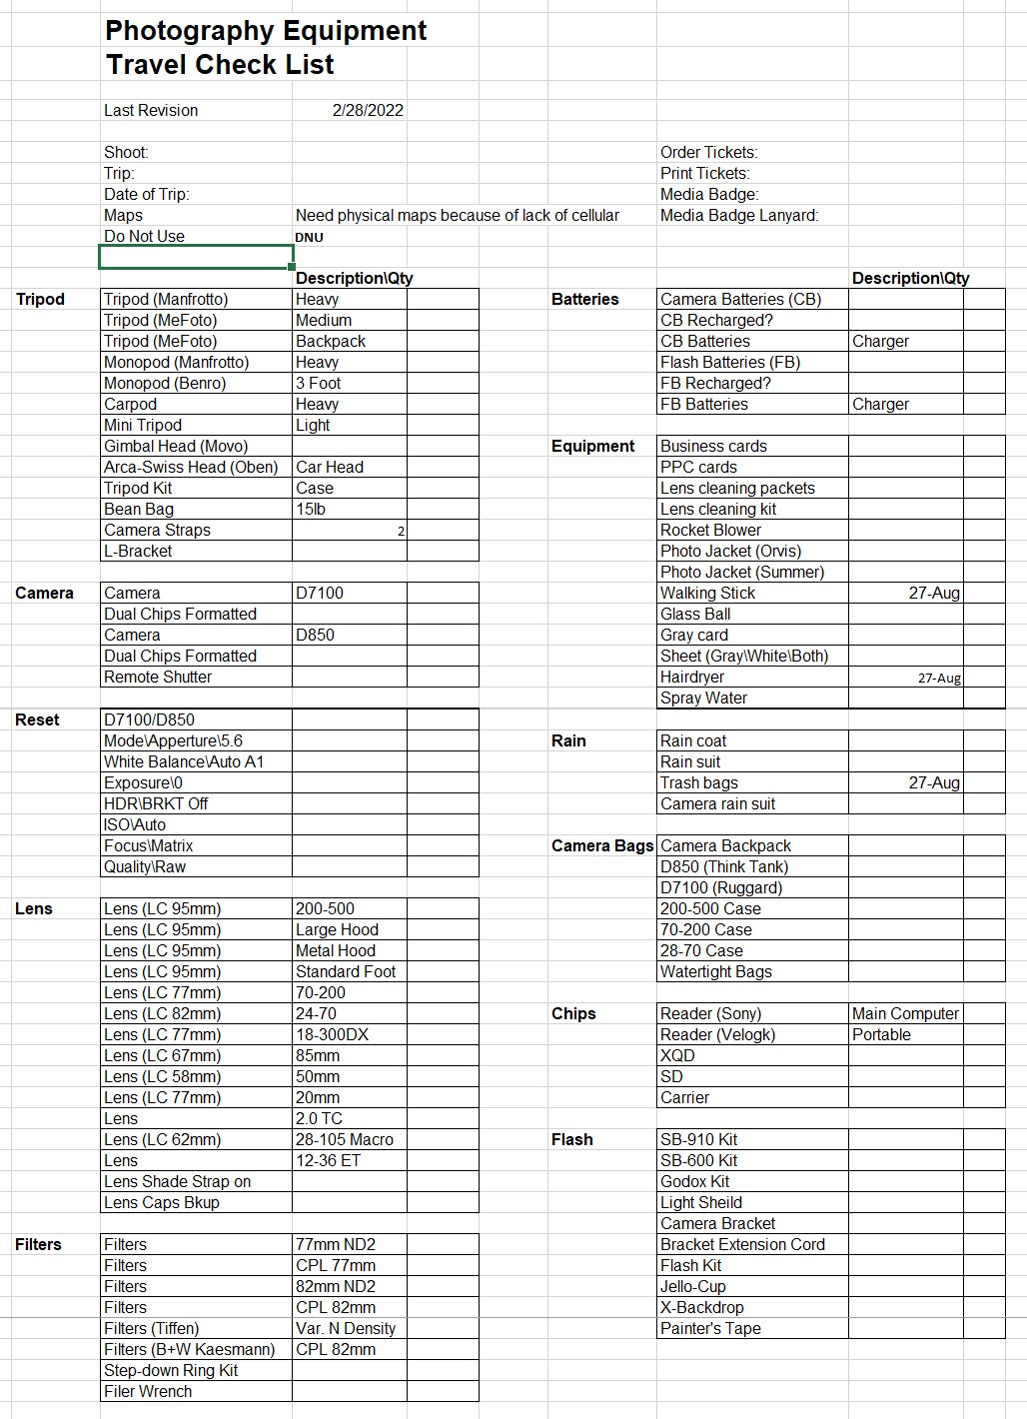
Batteries
Tripod
Check List
Vest
Format
Rain
Settings
Lens
Chips
Flash
Workflow Process – Cliff McKenzie

Slide 8
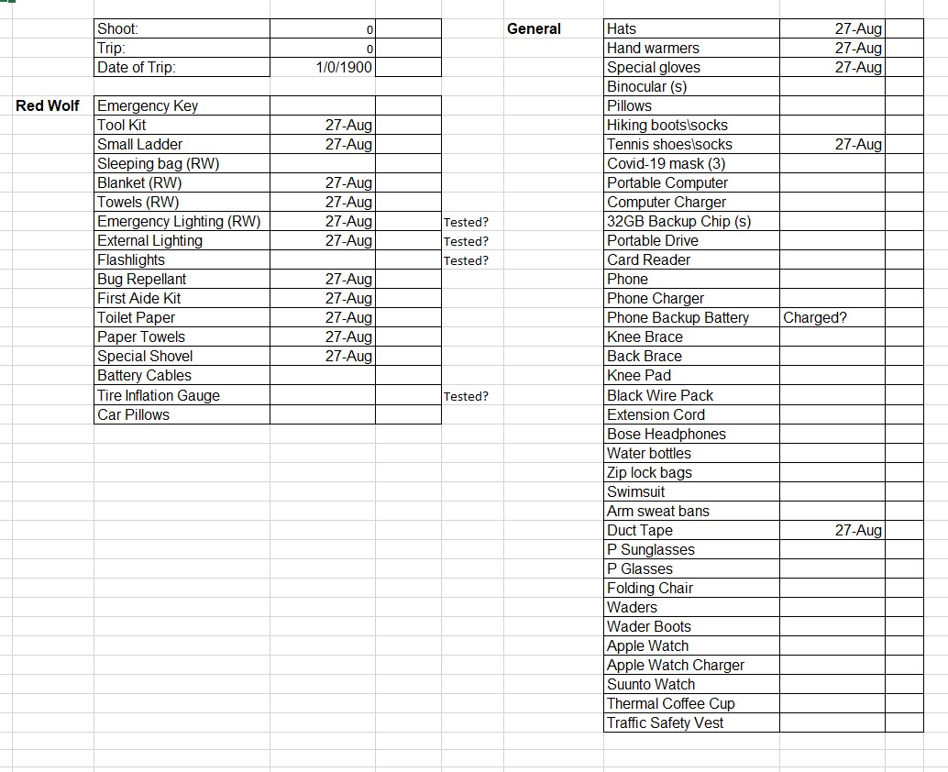
Backup
Key
Chargers
Check List
First
Aide
Duct Tape
Workflow Process – Cliff McKenzie

Slide 9
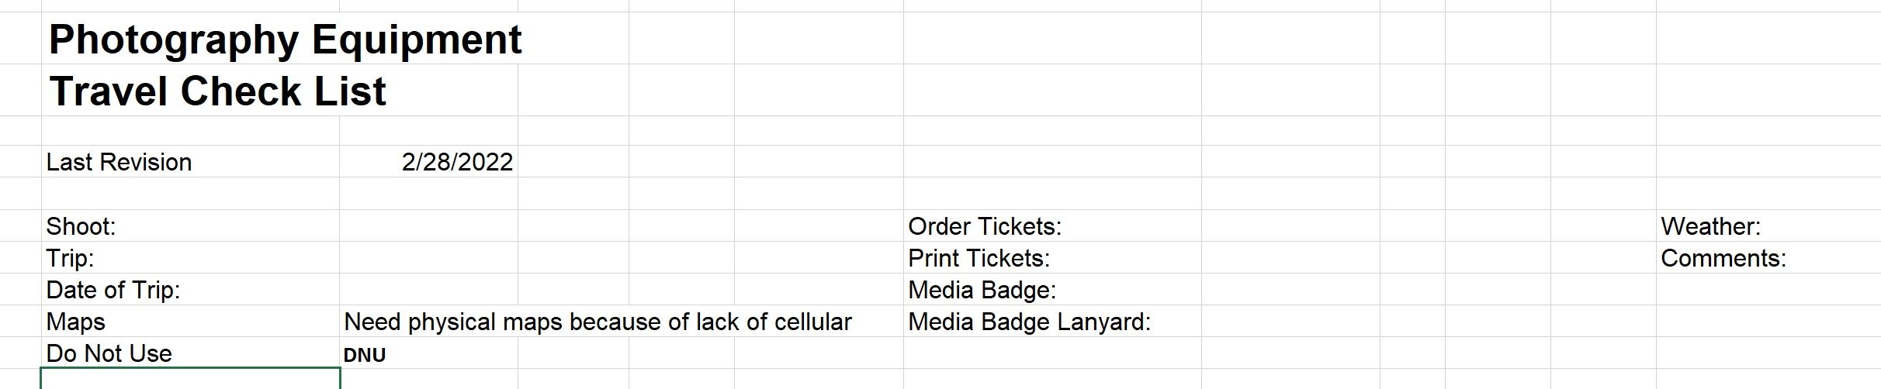
Starts
Here
Check List
Ends
Here
Workflow Process – Cliff McKenzie

Slide 10
Focus Terms
Folders
Collections
Catalog
Non-Destructive Editing
Workflow Process – Cliff McKenzie

Slide 11
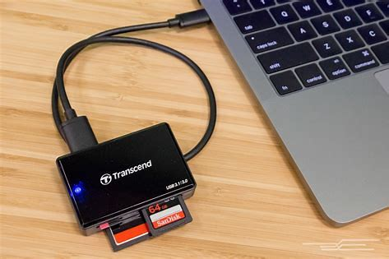
How You Get There Is Important
Upload to Computer Via Card Reader
This is a Temporary Upload
Never Modify Data on Card
Culling
Workflow Process – Cliff McKenzie

Slide 12




Culling Software
Culling
FastRawViewer
Photo Mechanic
Workflow Process – Cliff McKenzie

Slide 13
Photo Mechanic
Photo Mechanic is Fast
Uploads (ingest) Taken to New Upload Folder
Name Shoot, Folder & Images - Add Keywords
Simple Tag\UnTag (T)
Quick Zoom – Quick Crop (2nd Screen)
Culling
Workflow Process – Cliff McKenzie

Slide 14
Remote Drive F:\
F:\Picture Upload
F:\My Lightroom Images
Culling
Workflow Process – Cliff McKenzie

Slide 15

Processing Software
Capture One
Lightroom Classic
Workflow Process – Cliff McKenzie

Slide 16

Not Processing Software
Workflow Process – Cliff McKenzie

Slide 17

Not Processing Software
Workflow Process – Cliff McKenzie

Slide 18
Pixel Editing
VS
Parametric Editing
Workflow Process – Cliff McKenzie

Slide 19
Remote Drive F:\
F:\Picture Upload
F:\My Lightroom Images
Importing
Workflow Process – Cliff McKenzie

Slide 20
F:\My Lightroom Images
Family
Landscape-Nature
Miscellaneous
People
Street Photography
Travel-Events
Six Folders
All You Need
Importing
Workflow Process – Cliff McKenzie

Slide 21
F:\My Lightroom Images
Travel-Events
NTIF 20220306
Importing
Example
Workflow Process – Cliff McKenzie

Slide 22
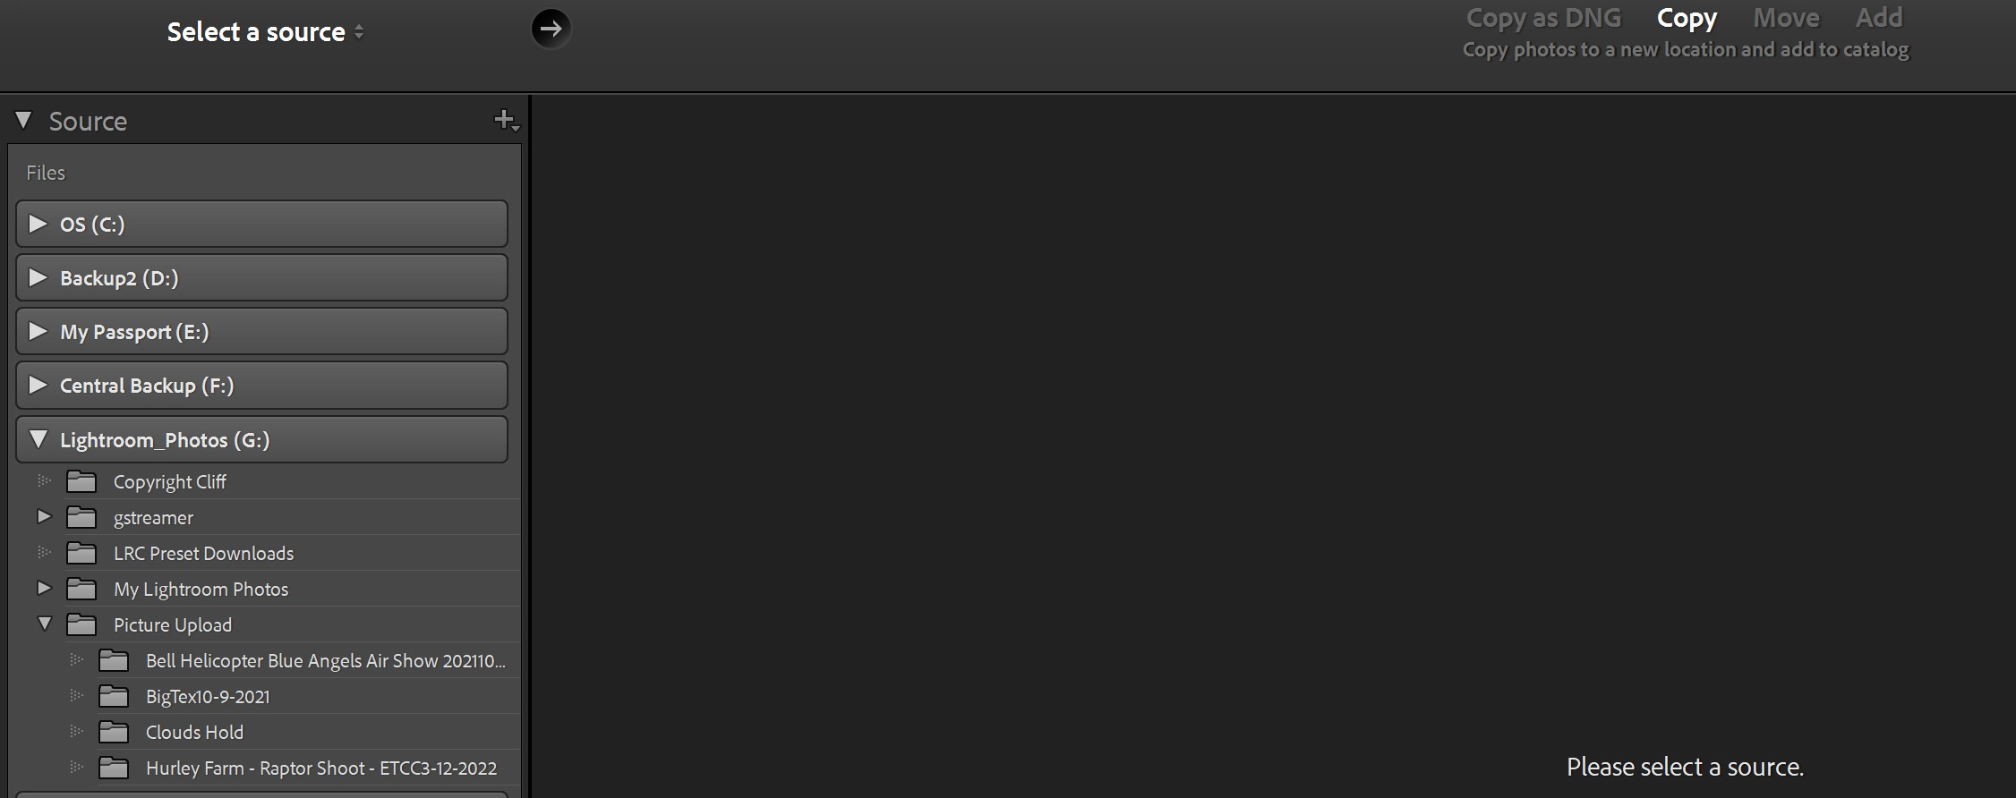
Library Module
Workflow Process – Cliff McKenzie

Slide 23
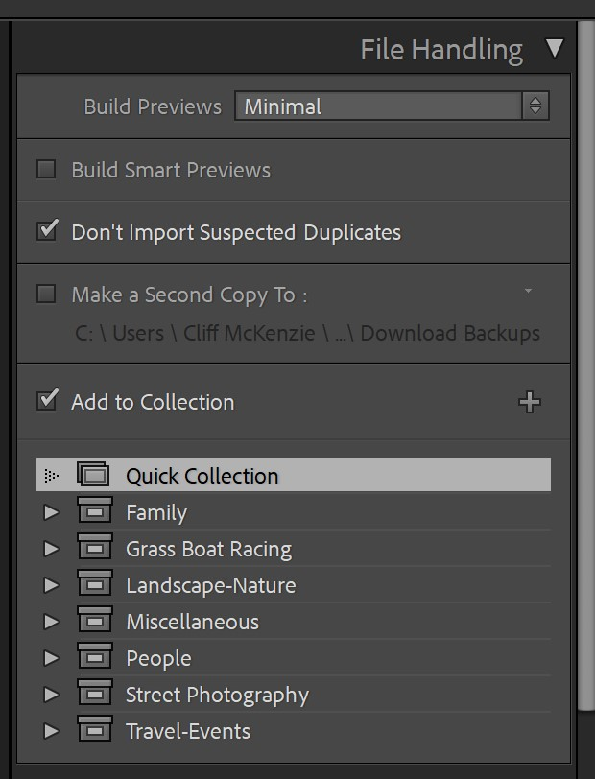
Library Module
Workflow Process – Cliff McKenzie

Slide 24
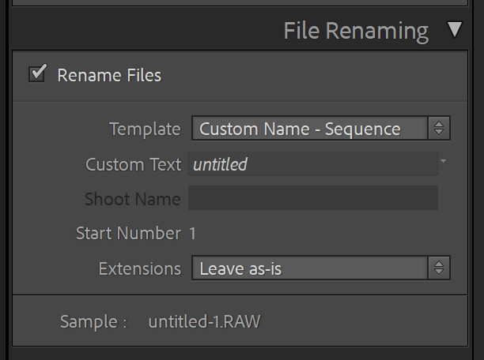
Library Module
Workflow Process – Cliff McKenzie

Slide 25
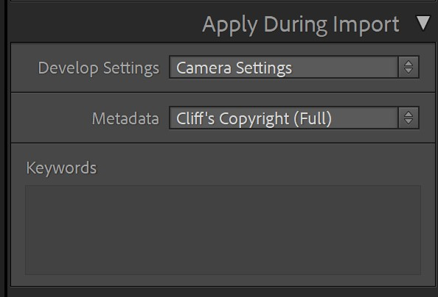
Library Module
Workflow Process – Cliff McKenzie

Slide 26
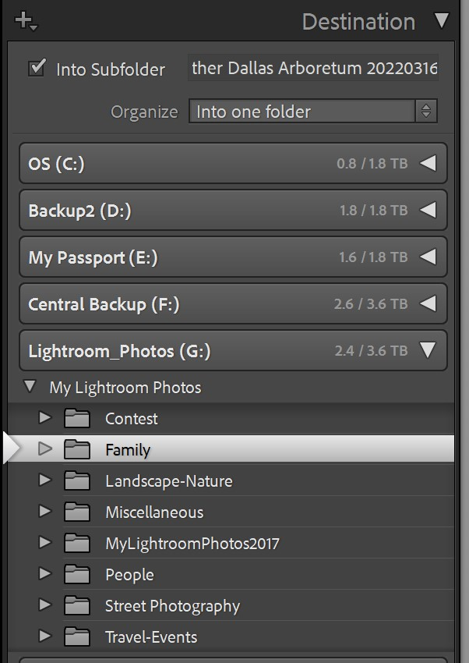
Library Module
Workflow Process – Cliff McKenzie

Slide 27
“Name” Full Shoot
Decision Time
Folder Parallelism
Collections – Parametric
Collections
Workflow Process – Cliff McKenzie

Slide 28
First…
IF Other Than Adobe Software is to be Used
Profile – Correct?
White Balance - Select
Detail – Sharpening Amount 0
Lens Correction - Enable
Develop
Then What?
Workflow Process – Cliff McKenzie

Slide 29
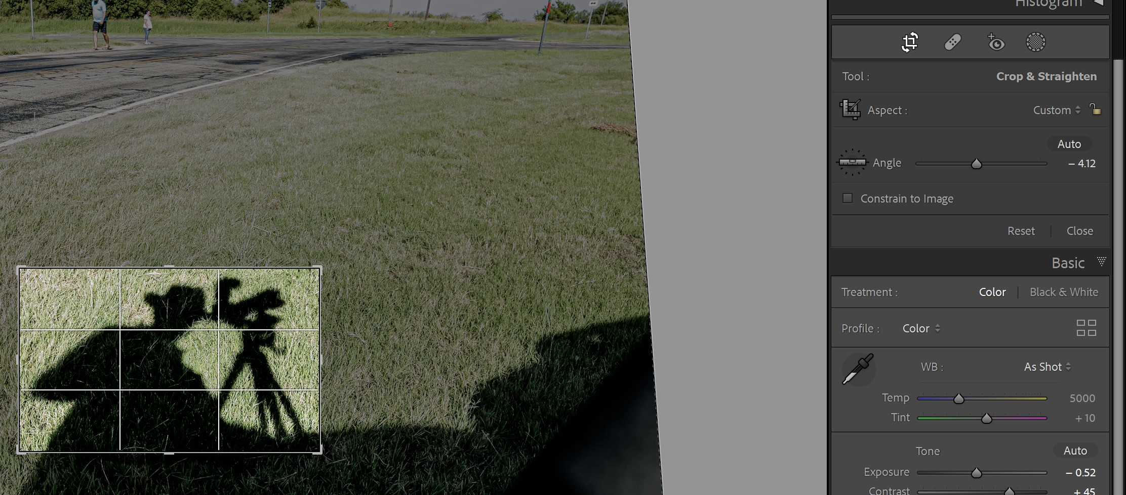
Develop Module
Crop
Develop
Level
Crop
Workflow Process – Cliff McKenzie

Slide 30
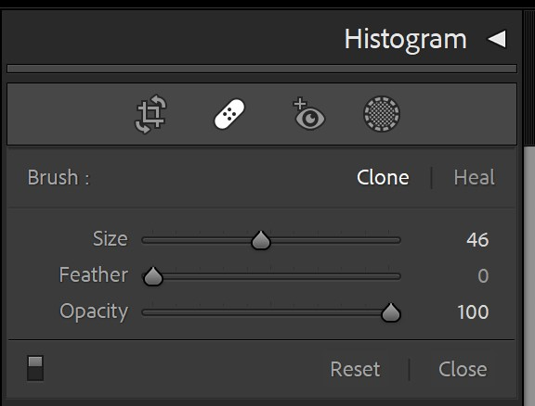
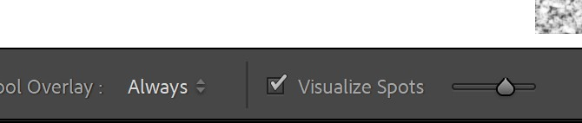
Develop Module
Develop
Workflow Process – Cliff McKenzie

Slide 31
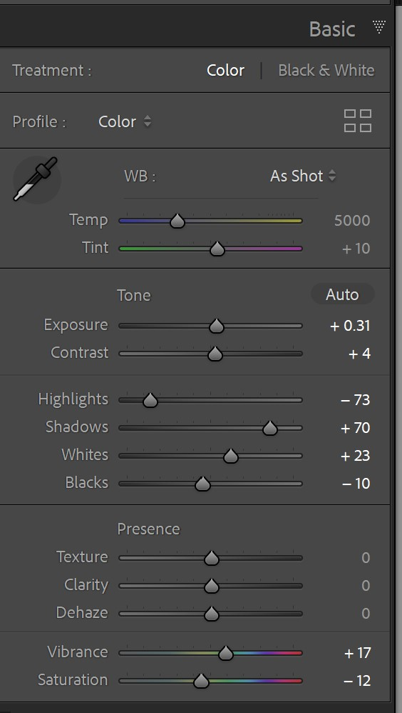
Develop Module
Basic
Develop
Tone
Presence
Workflow Process – Cliff McKenzie

Slide 32
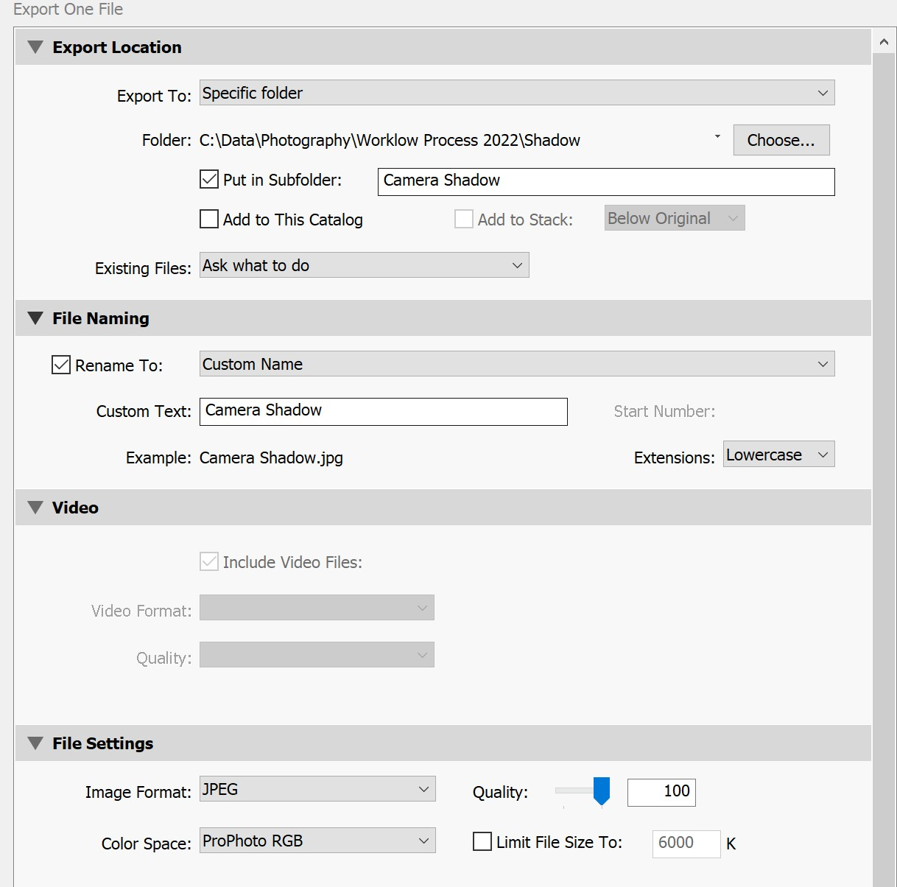
Export
Workflow Process – Cliff McKenzie

Slide 33

Backup to The Cloud (Recommended)
Backup to Other Drives (Recommended)
Images Always Exist 2 Places – At Least!
Backup
Workflow Process – Cliff McKenzie

Slide 34
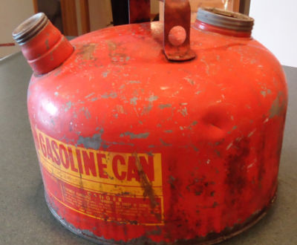


Cliff McKenzie LakeAthens@gmail.com
How to
Make
Your Own
Gasoline
at Home
March 31, 2022

